Slide 1
E-Bike & E-Scooter Micromobility Safety Workshop
September 10, 2025

Slide 2
Welcome & Housekeeping

Slide 3



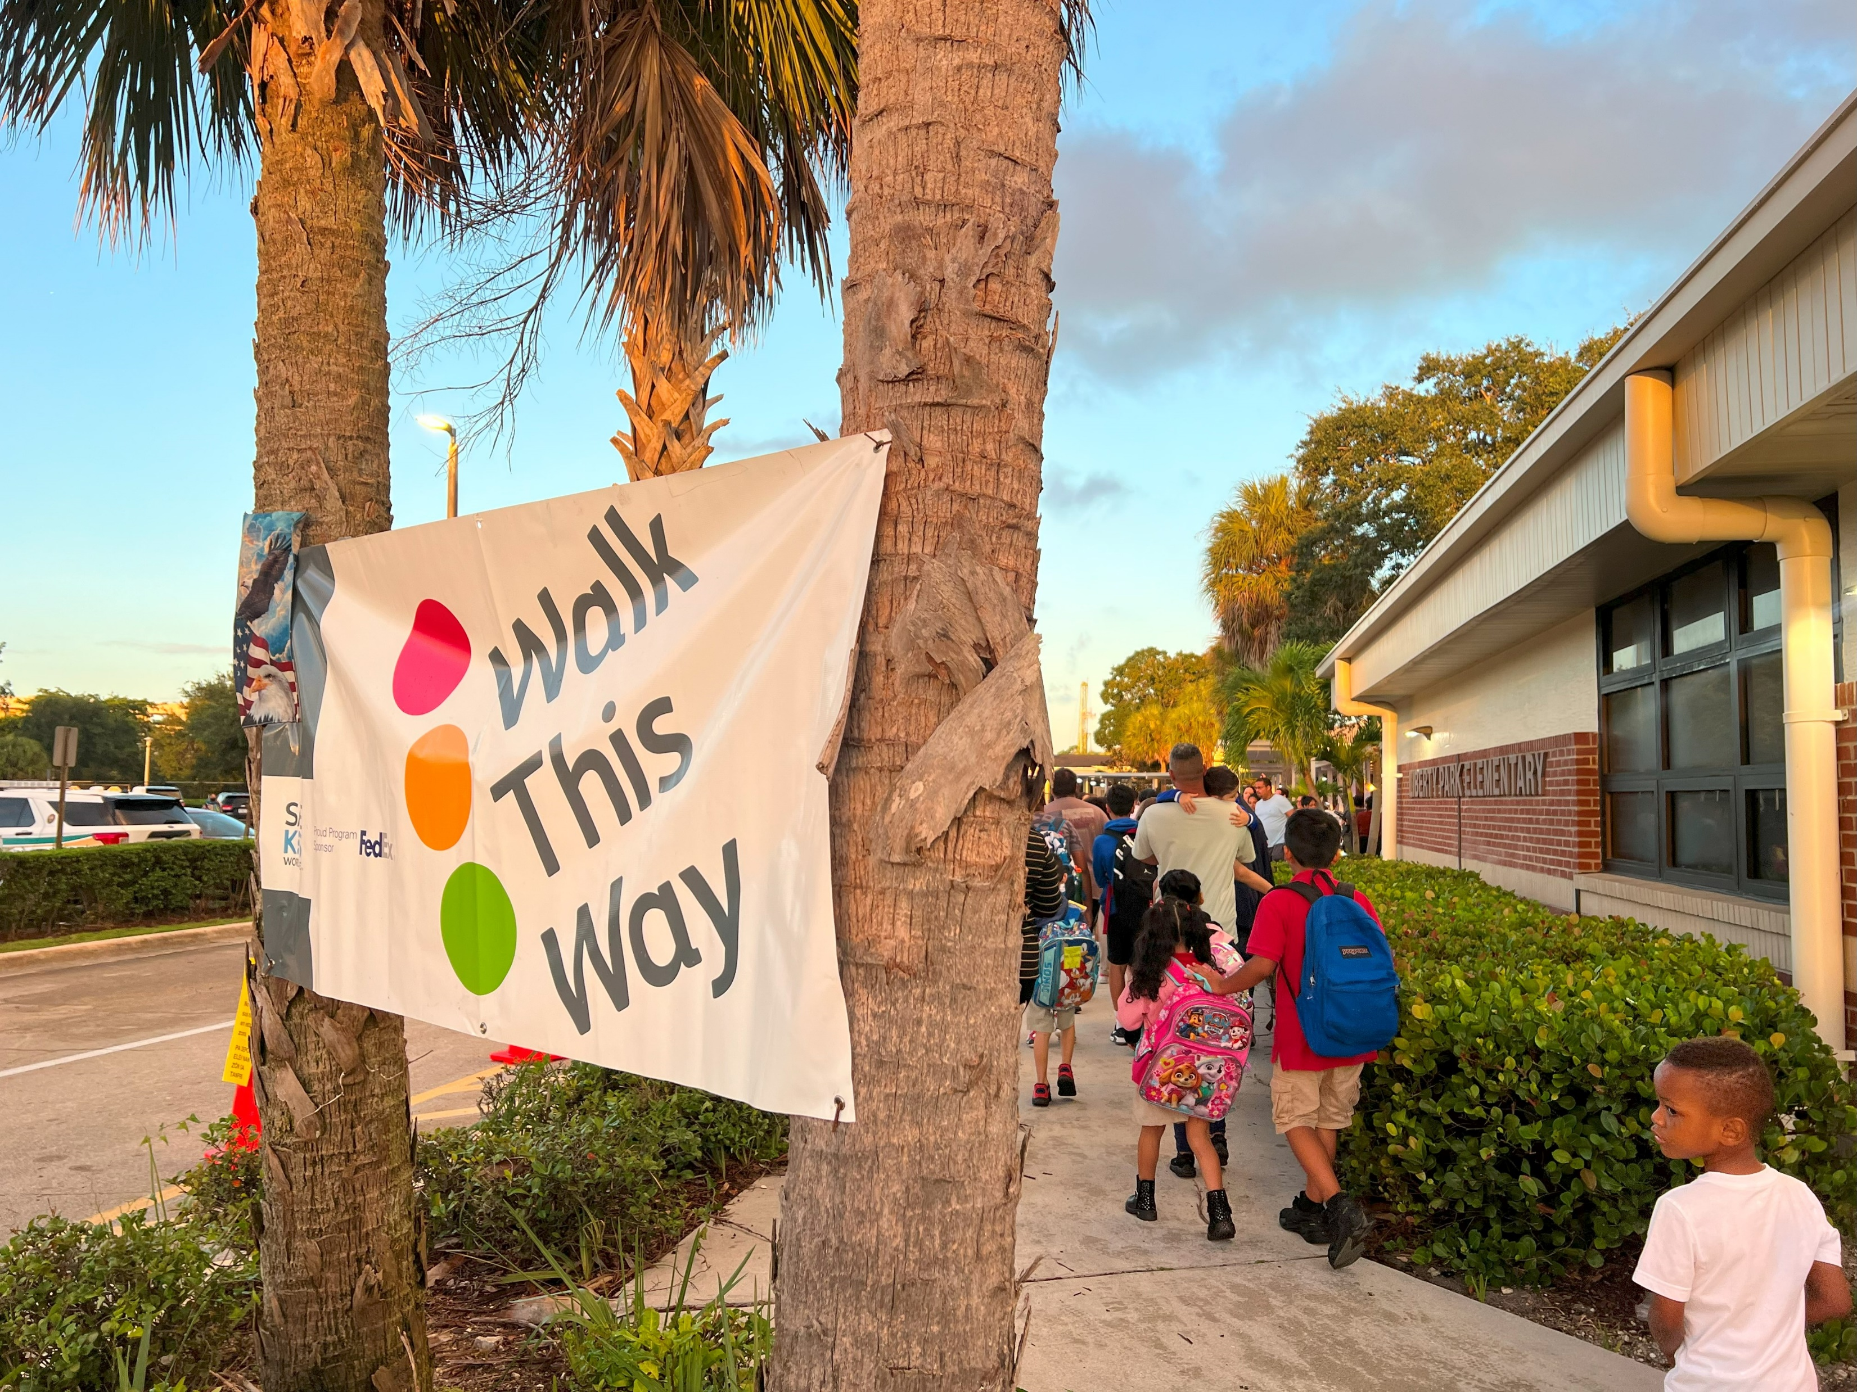
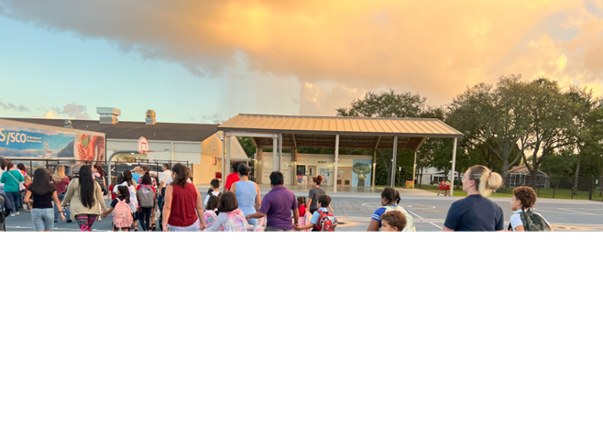
National Walk & Roll to School Day will be held on October 8, 2025. Save the date, find resources and see what schools are participating at WalkBiketoSchool.org.

Slide 4

National Walk & Roll to School Day will be held on October 8, 2025. Save the date, find resources and see what schools are participating at WalkBiketoSchool.org.

Slide 5
Presenter & Panel Introductions
E-Bike & E-Scooter Micromobility Safety

Slide 6
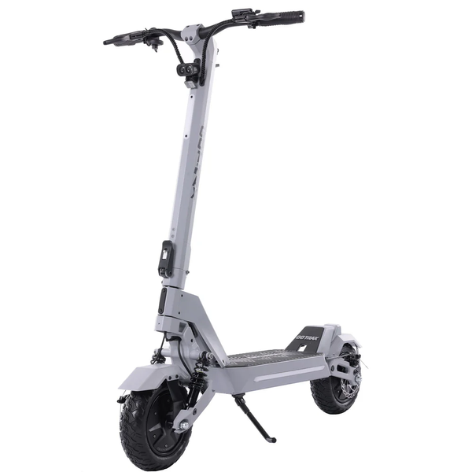
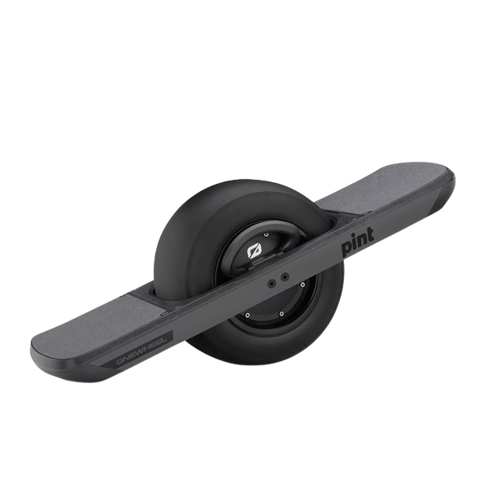
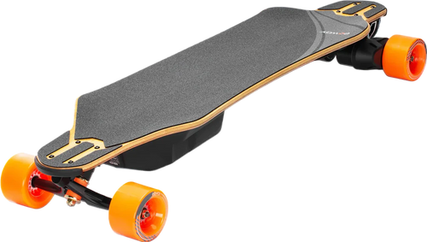
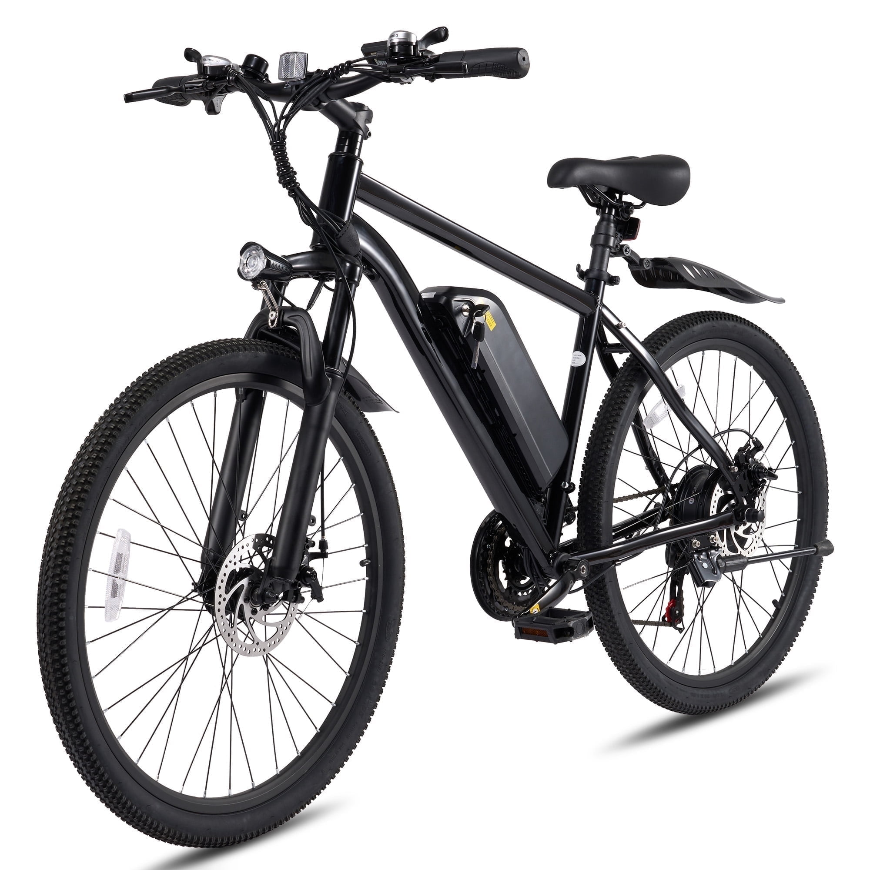
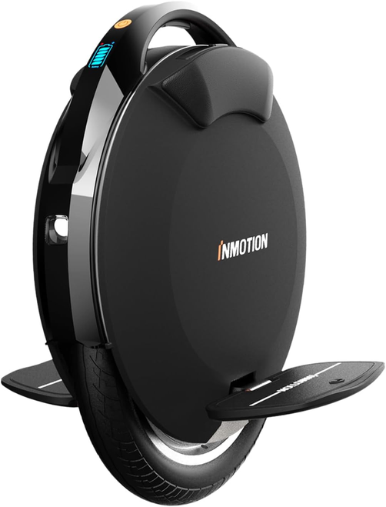
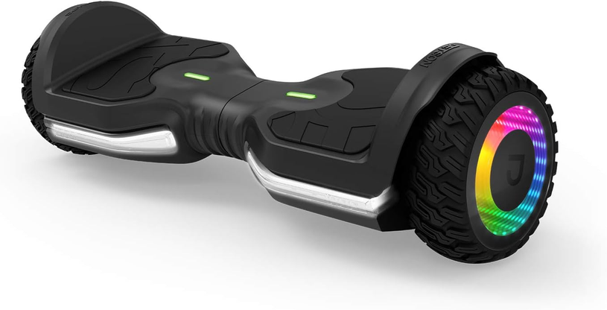
What are we talking about today?
E-SCOOTER
E-SKATEBOARD
ONE WHEEL
E-BIKE
E-UNICYCLE
HOVERBOARD

Slide 7
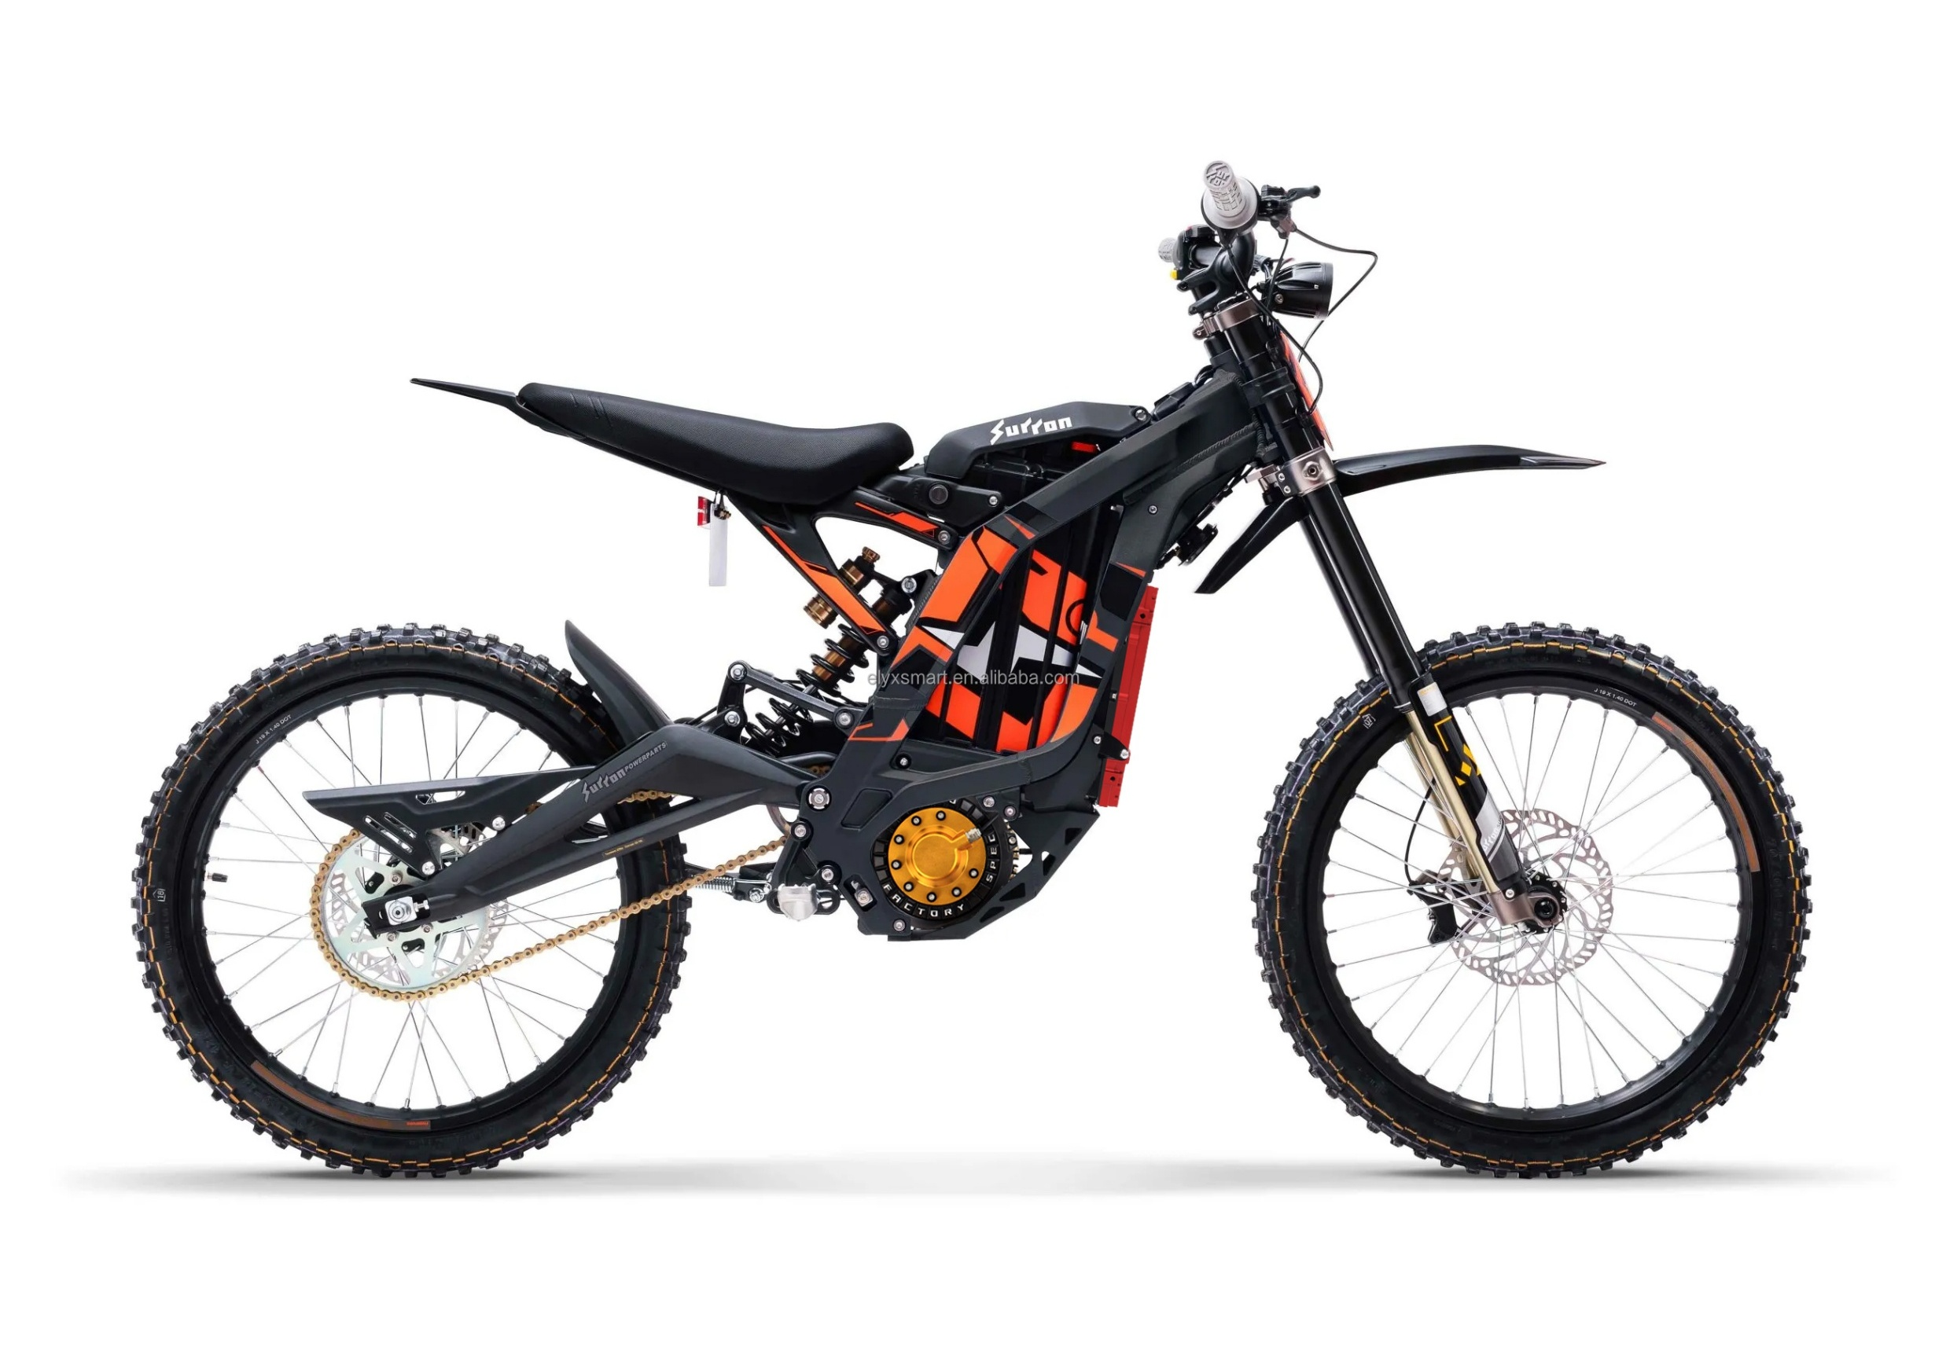
What about E-Motos (E-Dirtbikes)?
Capable of Speeds Exceeding 28 MPH
Scooters
Mopeds
E-Motos
Exceeding Class E-bike max speed assist
No Pedals
750+ Wattage
Safety Equipment
Not allowed on public ROWs

Slide 8
State Statutes
2025 Session Updates

Slide 9
E-Bicycles
Class 1: Pedal Assist – 20 MPH
Class 2: Throttle Assist – 20 MPH
Class 3: Pedal Assist – 28 MPH
Where May I Ride? Roadways, bike lanes, trails, multi-use paths, and sidewalks*
Should I Wear a Helmet? Yes! Legally required for riders under 16.
F.S. 316.003 (23) Definitions F.S. 316.20655 Electric Bicycle Regulations F.S. 316.2065 Bicycle Regulations
*Unless prohibited by local municipal code. Refer to local government regulations for more information and additional restrictions.

Slide 10
Micromobility Devices*
E-SKATEBOARD
Speeds: 15 MPH typical, 28 MPH max
Where Can I Ride?**Roadways, bike lanes, trails, multi-use paths, and sidewalks
Should I Wear a Helmet? YES! Legally required for riders under 16
Same Rights and Duties as a: Bicycle Rider (with exceptions).
F.S. 316.003 (41) Definitions F.S. 316.2128 Micromobility devices, motorized scooters, and miniature motorcycles; requirements
ONE WHEEL
HOVERBOARD
E-UNICYCLE
*Additional F.S. may apply to shared fleets; **Unless prohibited by local municipal code.
Notes:
(41) MICROMOBILITY DEVICE.—A motorized transportation device designed for individual use which is typically 20 to 36 inches in width and 50 pounds or less in weight and which operates at a speed of typically less than 15 miles per hour but no more than 28 miles per hour. This term includes both a human-powered and a nonhuman-powered device such as a bicycle, electric bicycle, motorized scooter, or any other device that is owned by an individual or part of a shared fleet.

Slide 11
2025 Legislative Session Updates SB 462 and Local Government Options
Age Requirement(s)
Government Photo ID
Training
Chapter 316.008 (Local Powers)
Tampering*
Manufacturing Requirements*
*E-Bicycle only
Notes:
F.S. 316.2128 (7), (8) and 316.20655 (8) (9)
A local government may adopt an ordinance providing one or more minimum age requirements to operate an electric bicycle and may adopt an ordinance requiring an operator of an electric bicycle to possess a government-issued photographic identification while operating the electric bicycle.
A local government may provide training on the safe operation of electric bicycles and compliance with the traffic laws of this state that apply to electric bicycles.

Slide 12
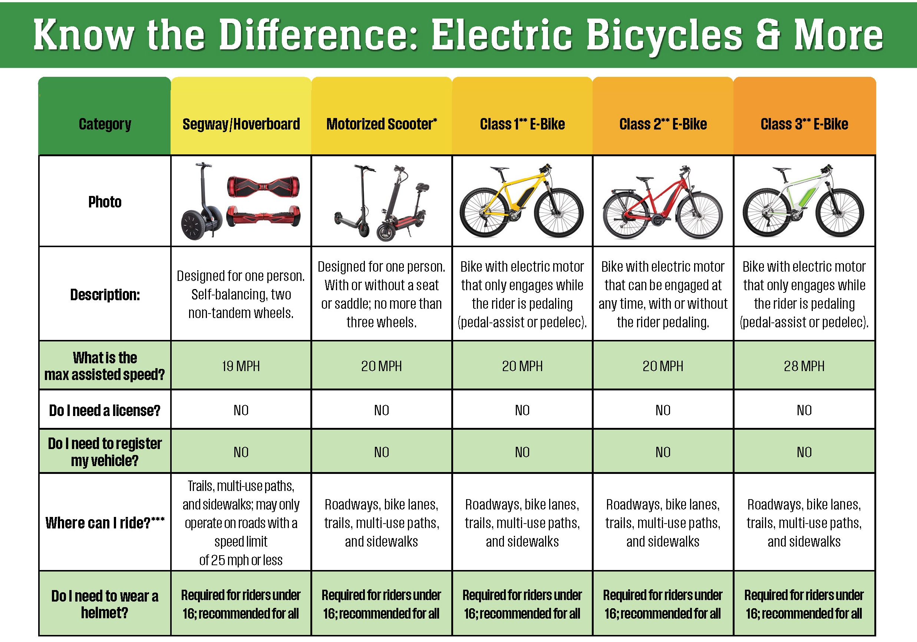
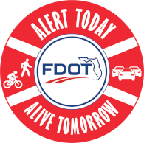
What are E-Bike and Micromobility Devices?
Key Characteristics:
Human-Powered with Electric-Assistance
Class 1 or 3 E-Bike
Electric Powered with Throttle or Human-Powered with Electric-Assistance
Class 2 E-Bike
Max Speed: 28 MPH
Source: Alert Today Florida

Slide 13
Local Policies
Micromobility Safety Subcommittee Safe Kids, Palm Beach County

Slide 14
Subcommittee Makeup
Healthcare Providers
Police Departments
School District
Municipal and County Staff
Transportation Providers
Non-Profits

Slide 15
Local Policy Research
Electric Bicycles
Motorized Scooters
Golf Carts
Low Speed Vehicles

Slide 16
Local E-Bicycle Regulations
Primarily Fleet Regulations (pre-2025)
Dockless Deployments
Prohibits sidewalk riding
Park Regulations
Only Ride on Paved Roads or Designated Paths
Prohibitions for some areas
Some are duplicative of state statute (visibility at night, yielding requirements)

Slide 17
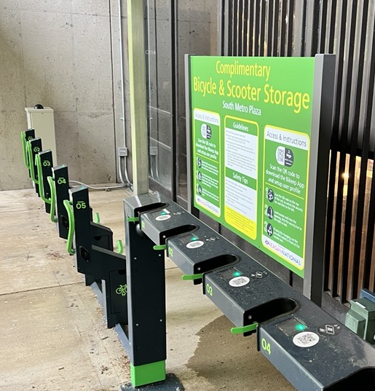
Motorized Scooters
Speed limits (15 MPH, where permissible)
District/Place-based limits
Prohibited Sidewalk Riding
One person per vehicle
Required a driver’s License
Daytime Use Only

Slide 18
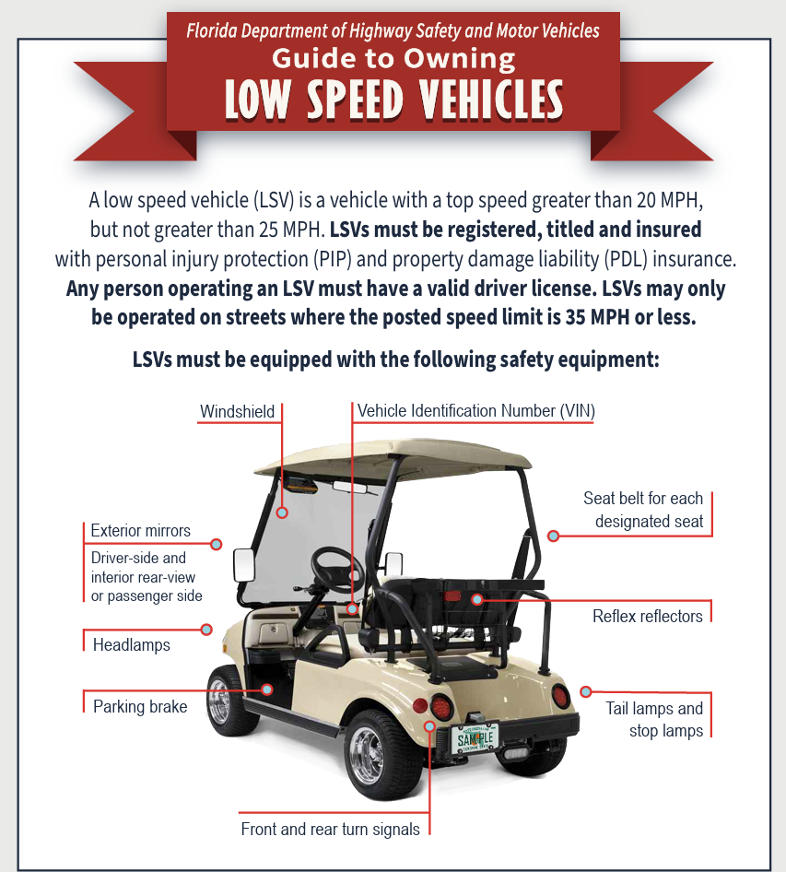
Golf Carts and Low Speed Vehicles
Location
Golf Carts (streets, sidewalks, paths)
LSVs (streets)

Slide 19

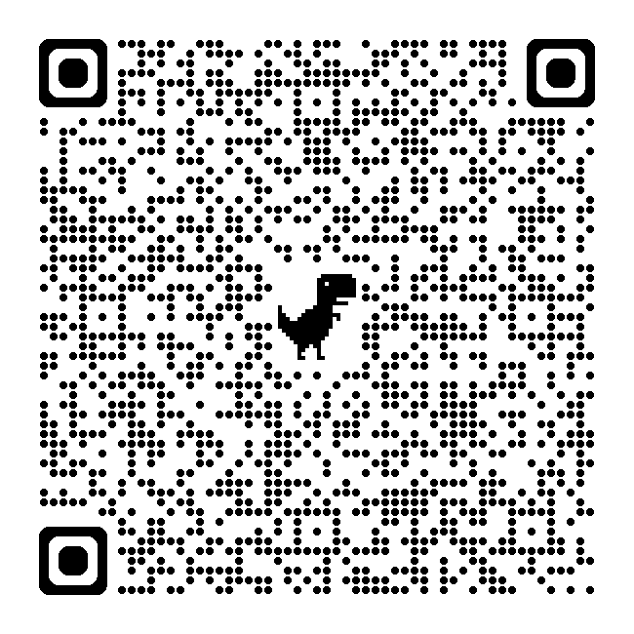

Driver Responsibilities

Slide 20
Key Takeaways
State statutes continue to evolve
Inconsistent and dated ordinances
Infrastructure cannot keep pace with emerging micromobility

Slide 21
Riding Safely with Micromobility
Notes:
Introduction: Brief overview of the Health Care District Trauma Agency.
Objective: Emphasize the importance of safe and predictable riding behaviors.

Slide 22
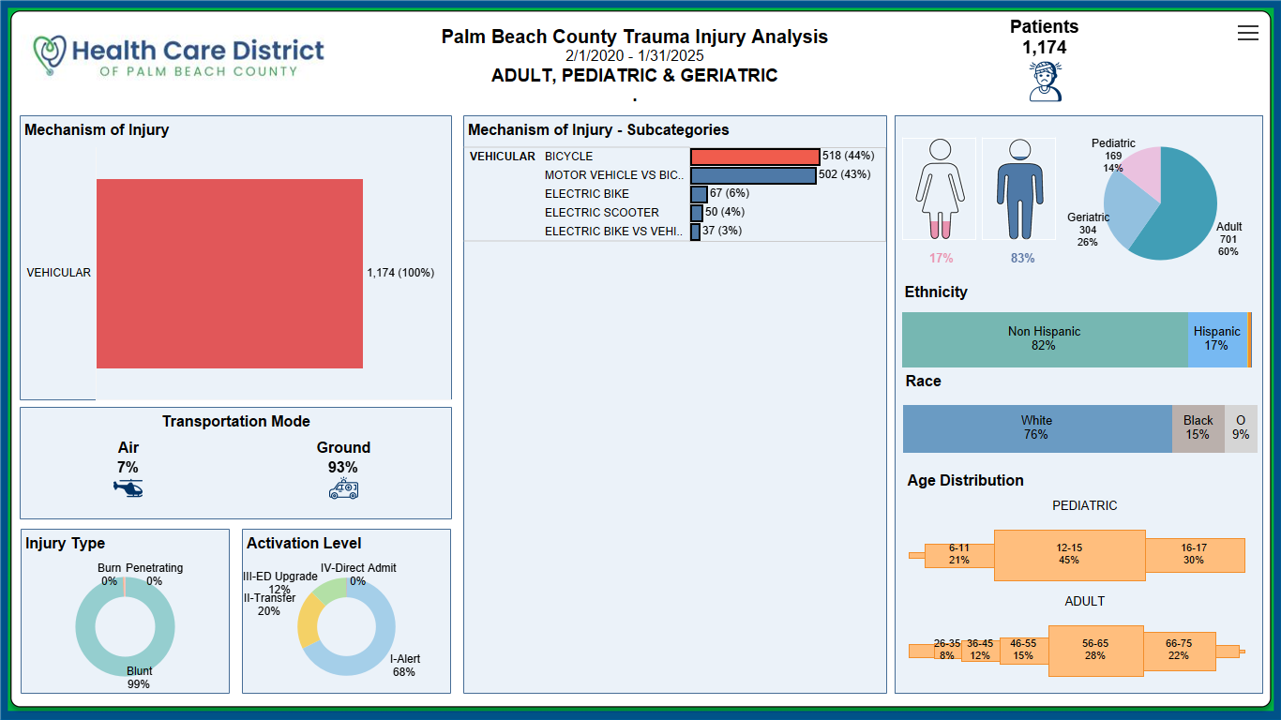
Micromobility Injury Data
In the U.S., the estimated ED visits associated with micromobility increased from 34,000 in 2017 to 87,800 in 2023 (U.S. Consumer Product Safety Commission, 2024).
There is an estimated 448,600 injuries relating to all micromobility products over the 7 years.
Notes:
Differences in # of ED visits compared to # of Trauma Center visits
Does not include mortality

Slide 23
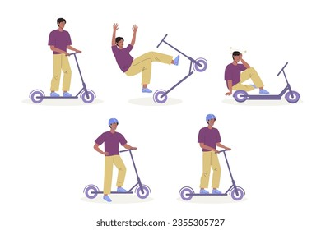
Common Injuries in Micromobility
Head Injuries: Concussions and traumatic brain injuries (TBI) are common without helmet use.
Fractures: Commonly in the arms, wrists, and collarbones.
Soft Tissue Injuries: Sprains, strains, and lacerations.
(Trivedi et al., 2019)
Notes:
The environment in which people ride scooters often contributes to the risk. Half of the participants in a 2018 CDC study on e-scooter-related injuries reported that a surface condition such as a pothole or a crack in the street contributed to their injury.
But our roadways need more than repair - Because most roadway systems were not designed with e-scooters in mind, many riders are traveling alongside 3,000 pounds of metal traveling at speeds anywhere from 15-30 miles per hour & often without a helmet.

Slide 24
The Importance of Predictable Riding
Safety in Predictability: Micromobility behavior is predictable and different across vehicle types.
Communication: Using hand signals and making eye contact with other road users.
Consistency: Following traffic rules and riding in designated areas.

Slide 25
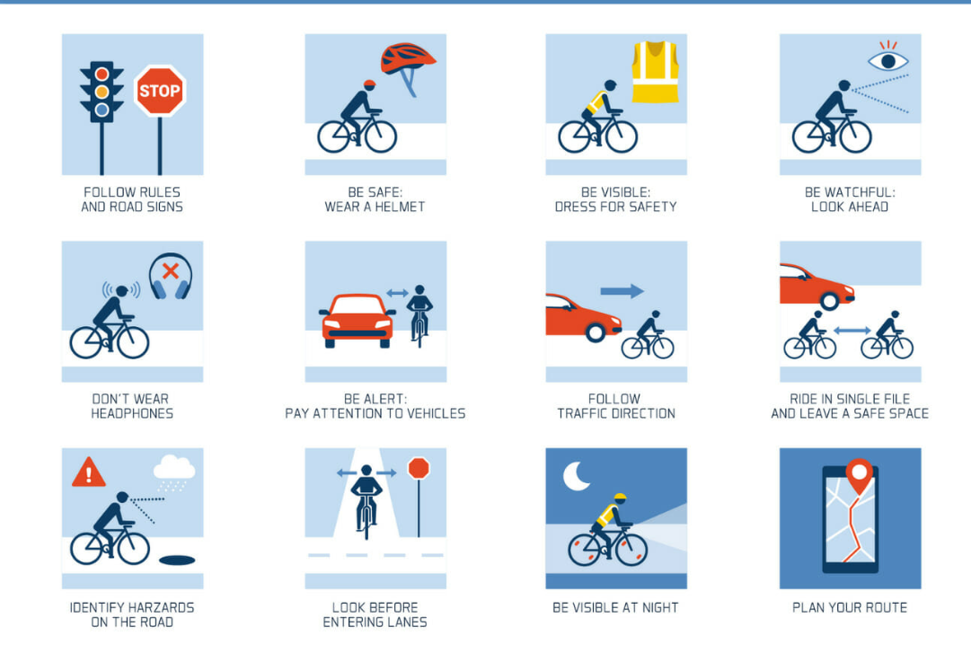
Key Safety Practices
Wear Protective Gear: Helmets, knee pads, and elbow pads
Regular Maintenance: Ensuring your micromobility device is in good working condition
Awareness: Staying alert and avoiding distractions like smartphones

Slide 26

Conclusion and Call to Action
Summary: Riding predictably can save your life and prevent a visit to a trauma center!
Riding safely today ensures we can ride tomorrow.

Slide 28
Community Engagement and Safety Tips
Kathy Wall
Safe Kids Palm Beach County

Slide 29





Slide 30

mission
Keep all kids safe from preventable injuries

Slide 31

Our programs

Slide 32
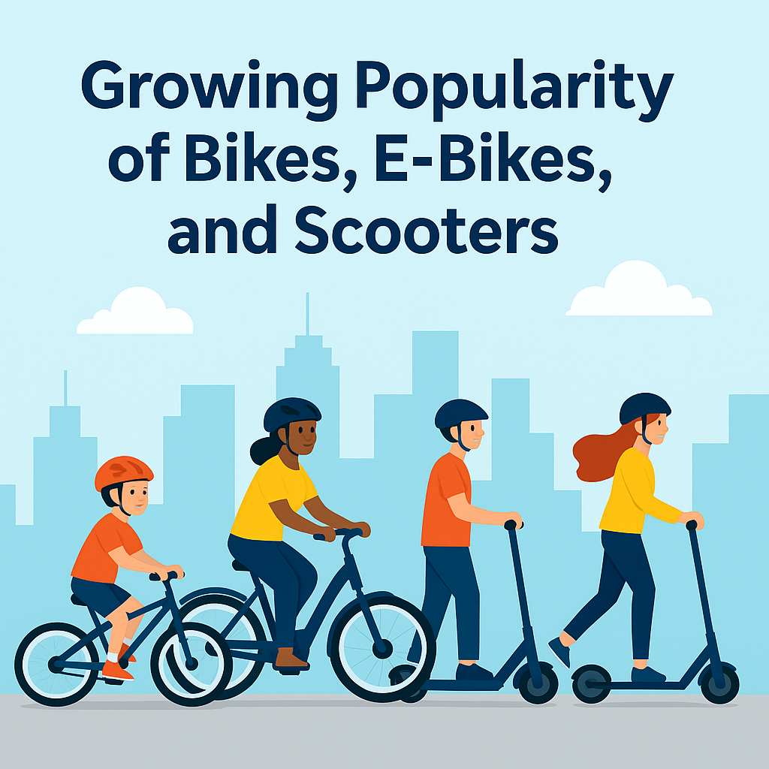
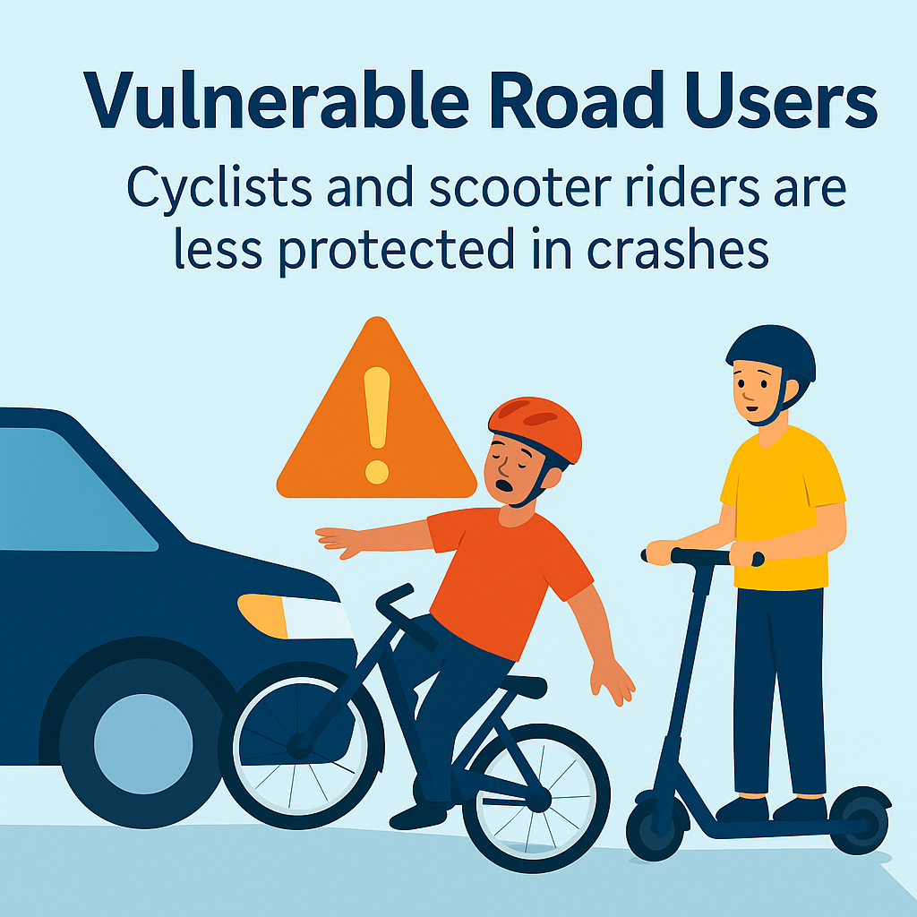
Why bike safety matters

Slide 33
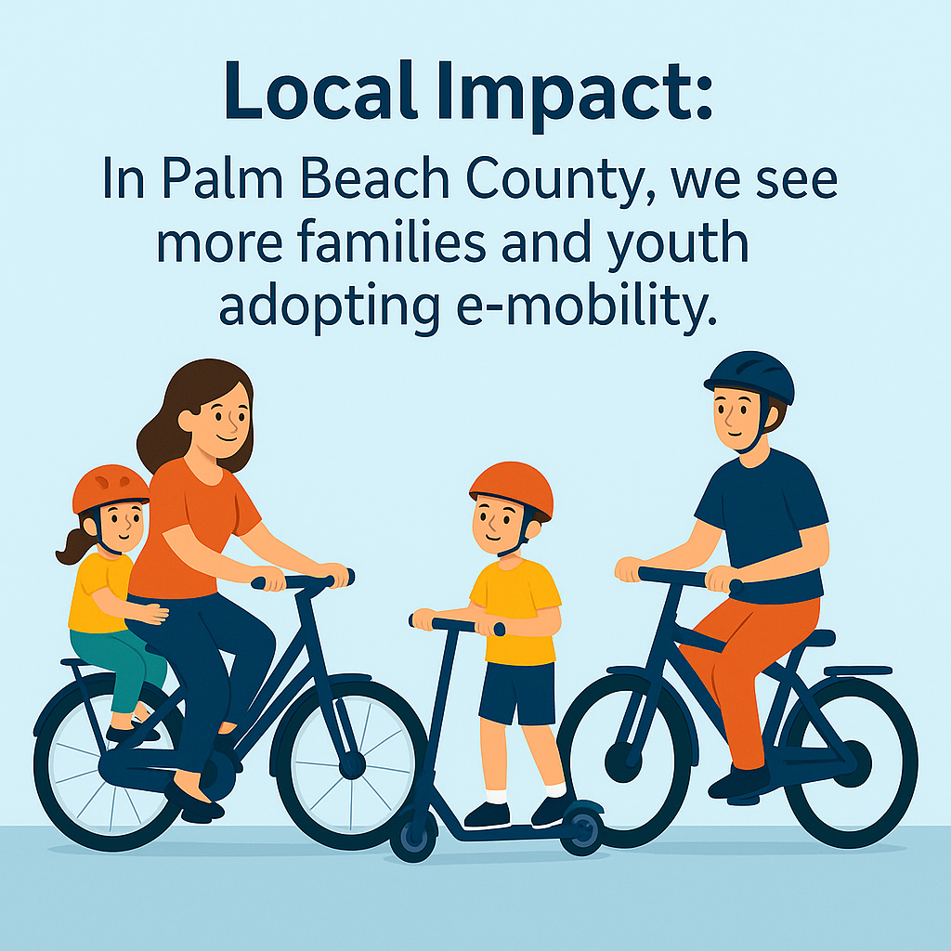
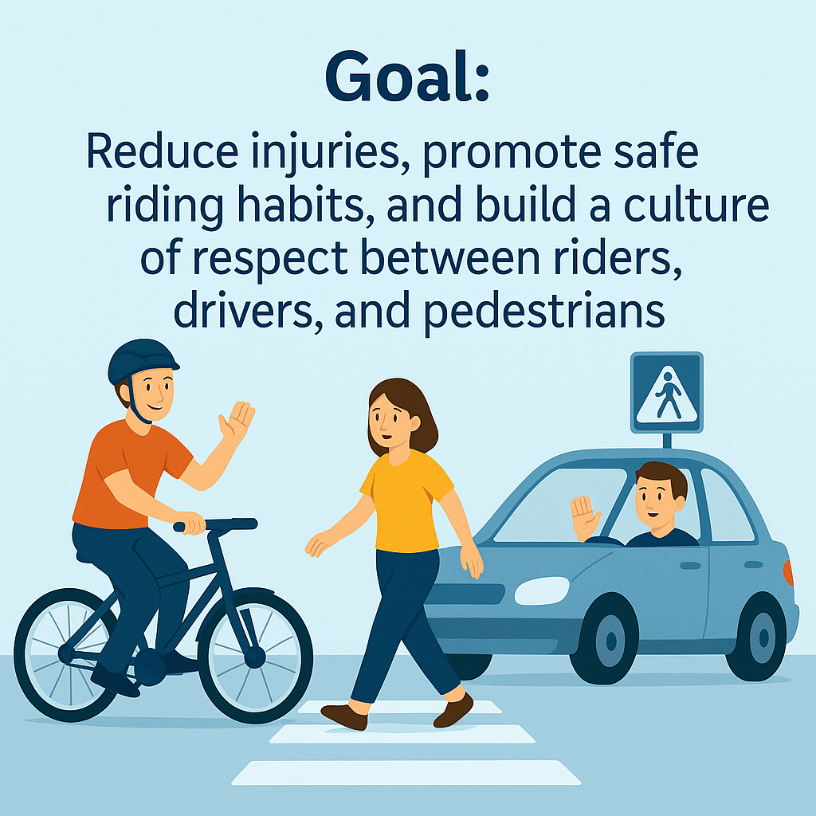

Slide 34






Why are Children Vulnerable?
{{
Believe that adults
will look out for them
{{
Inexperience judging speed
and distance of oncoming cars
{{
Less supervision after school
and during the summer
{{
Undeveloped peripheral vision
{{
{{
{{
Auditory inexperience,
where is the sound coming from?
Feel powerful & invincible,
like a superhero
Focus on their interests
(friends, hobby, etc.)
Notes:
Review each of these statements and discuss.
Ask someone to read the vulnerabilities out loud.

Slide 35
Engagement strategies
School Programs:
Walk & Bike to School events.
Helmet giveaways, pedestrian/bike safety workshops.
Partnerships:
Work with local law enforcement, schools, and neighborhood groups.
Collaborations with scooter/bike share companies and non profits.
Advocacy & Infrastructure:
Support safe bike lanes, crosswalks, and signage.
Community input on new e-mobility regulations.
Public Campaigns:
Social media messages (“Stop, Look, Listen”) (No Helmet No Ride), safety videos, safety fairs.
Involve youth ambassadors to spread peer-to-peer safety messages.

Slide 36
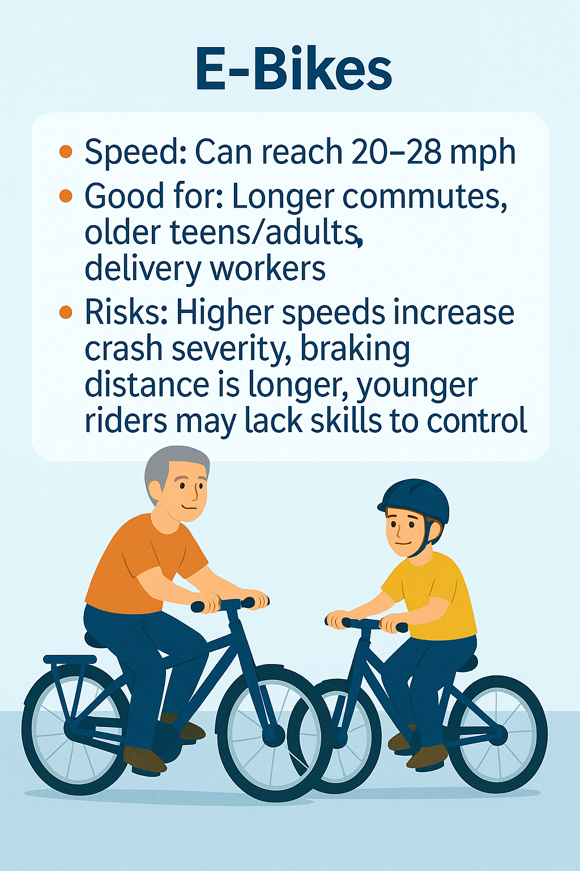
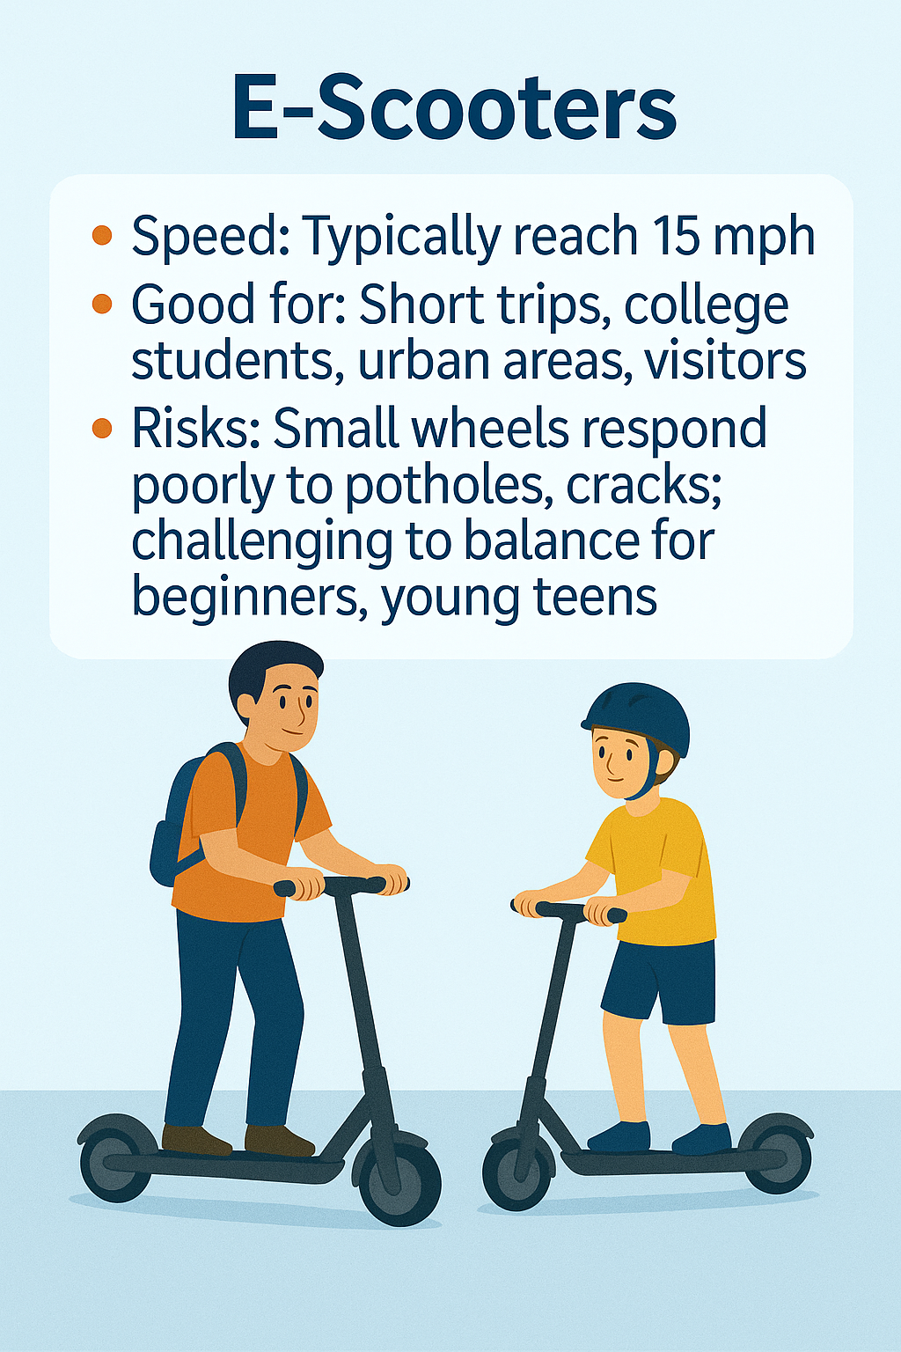
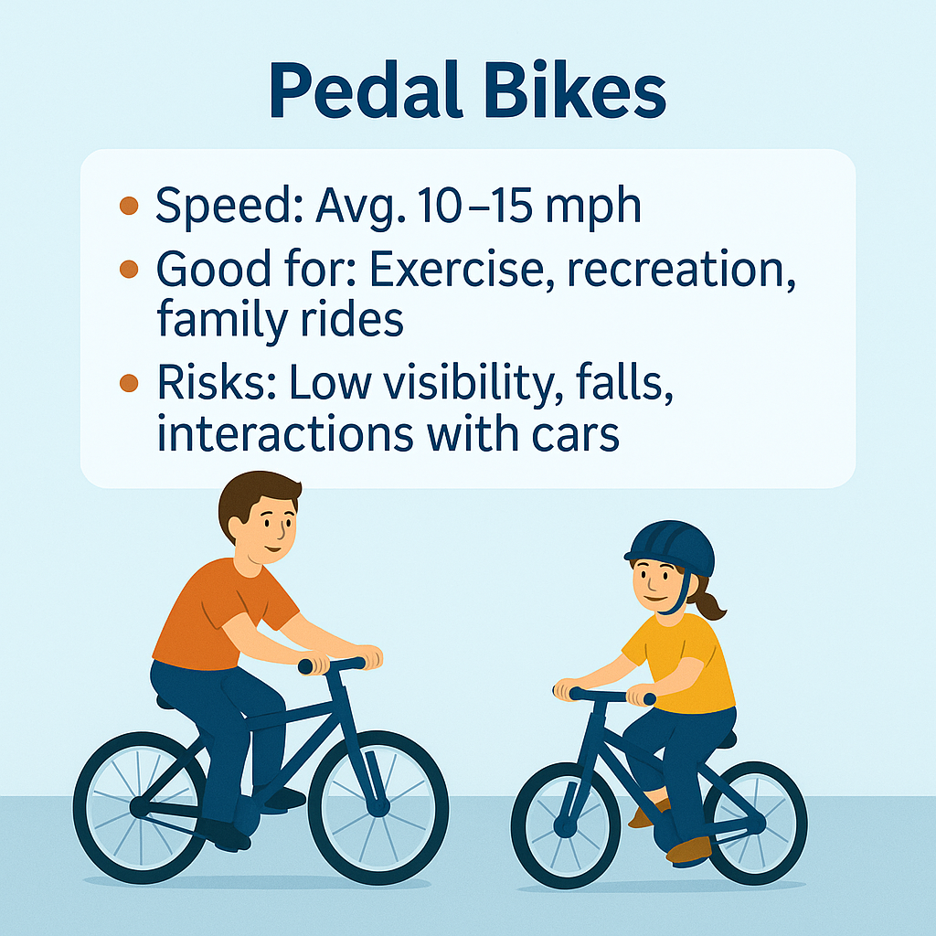
Pedal Bikes vs. E-Bikes vs. Scooters

Slide 37
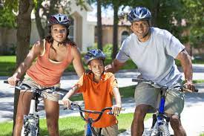
Safety tips for riders
Helmets reduce head injuries by 48%,
serious head injury by 60%,
and TBIs by 53%.
National Highway Traffic Safety Administration (n.d.). Understanding the Problem. NHTSA.org. https://www.nhtsa.gov/book/countermeasures-that-work/bicycle-safety/understanding-problem

Slide 38
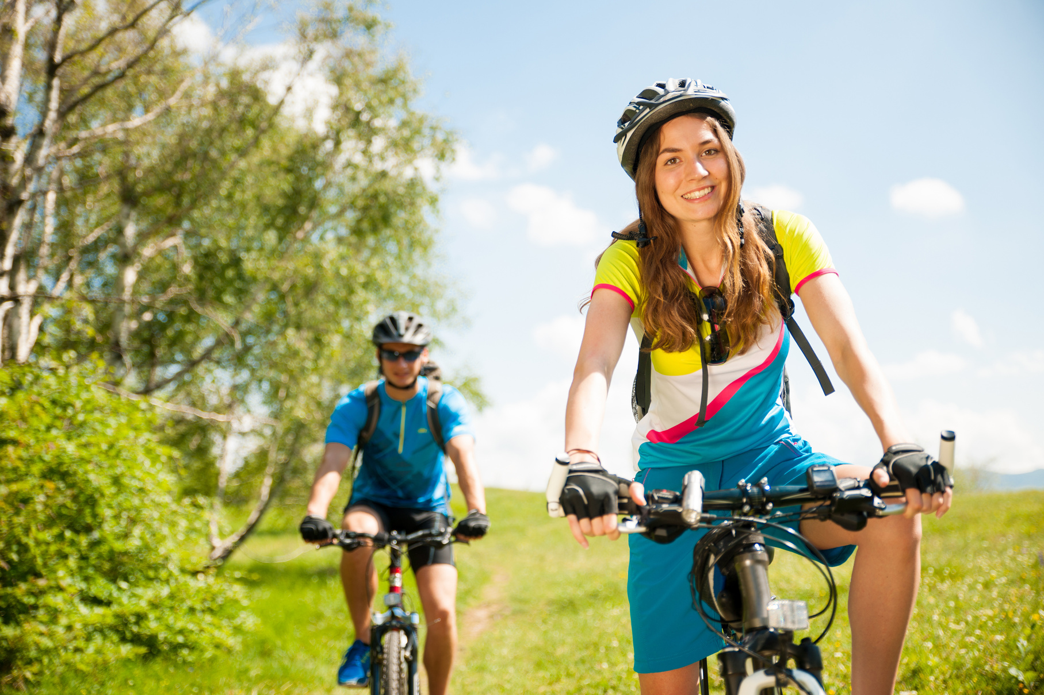
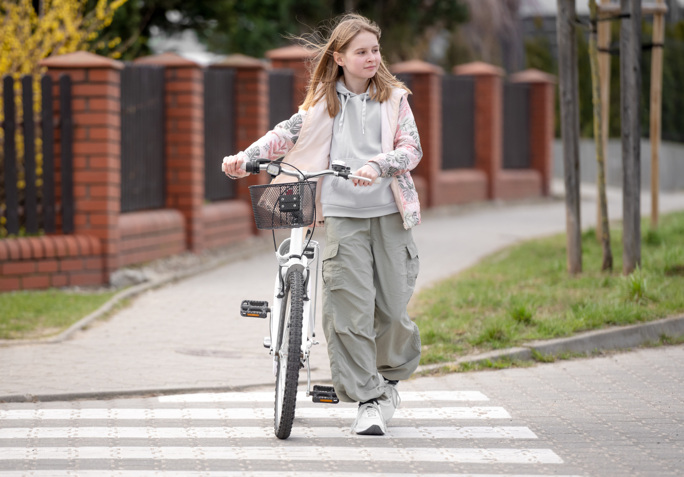
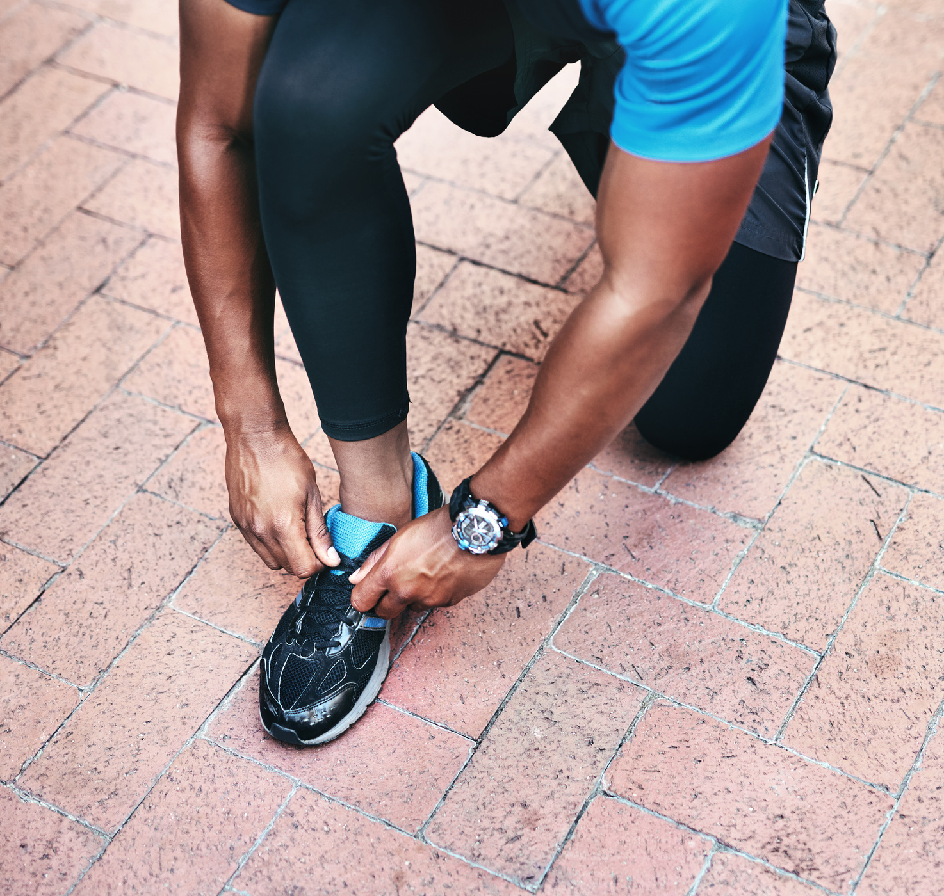
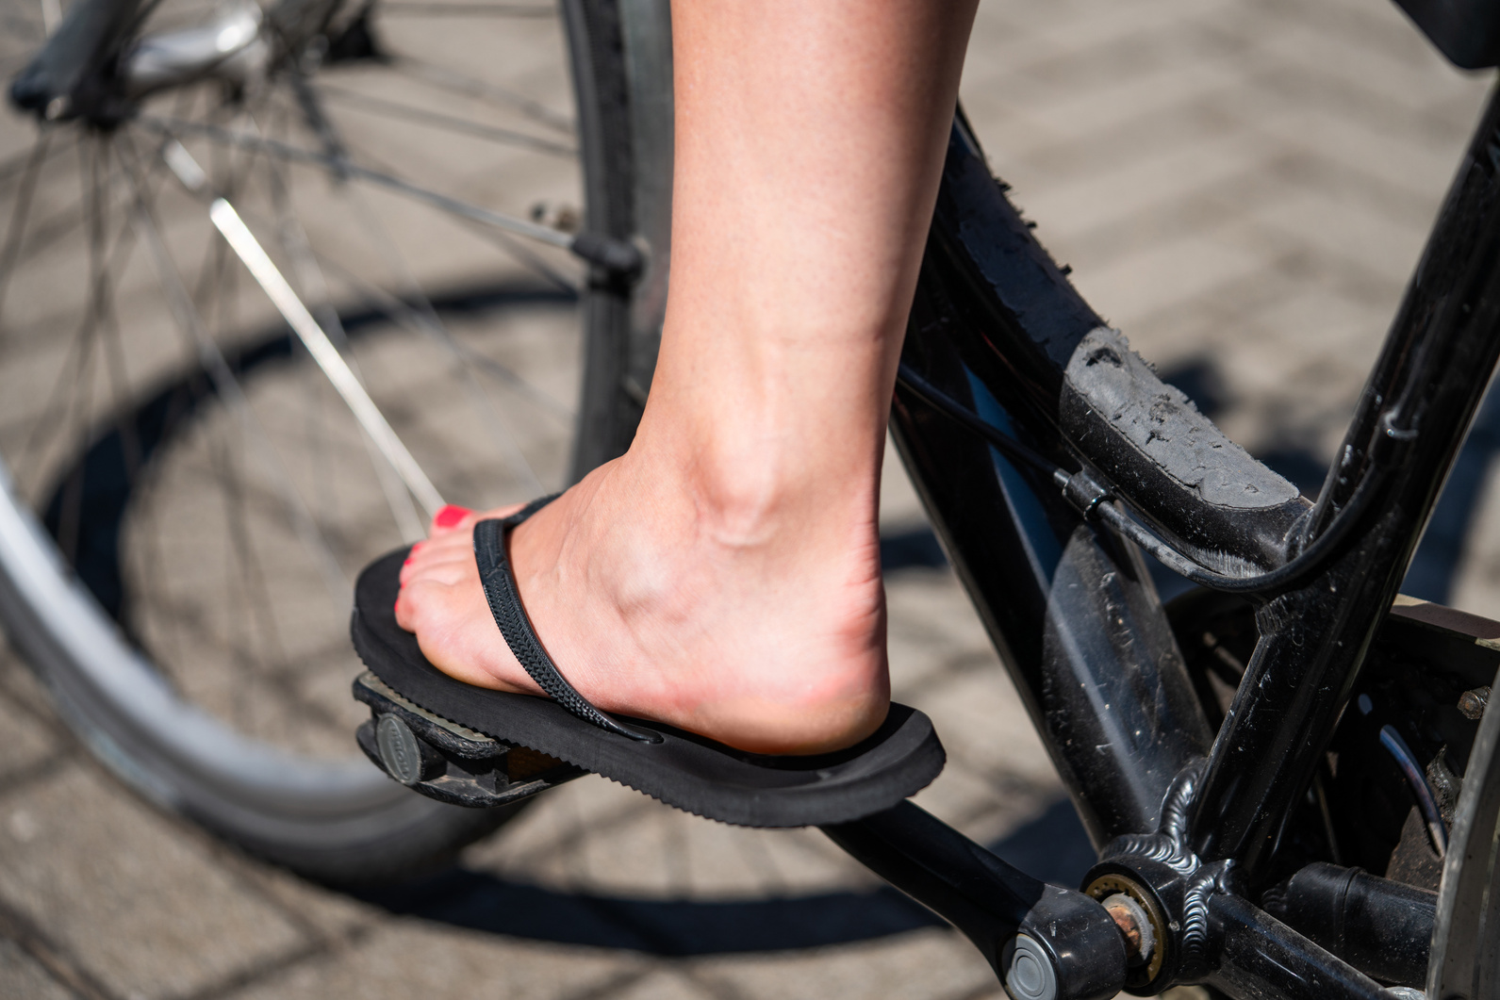
Clothing for Safety
Tuck away shoelaces, strings, or cords so they don’t dangle.
Avoid sandals, flip flops, or bare feet.
Wear light, bright, or reflective clothing.
Avoid loose or
baggy clothing.
Notes:
Read and review

Slide 39
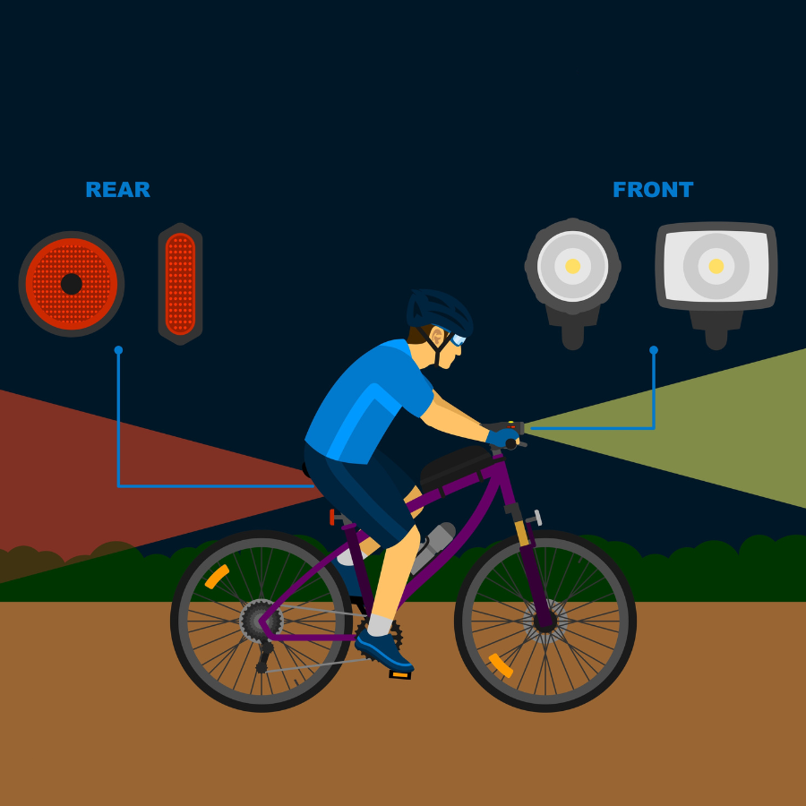
Bicycles in use between sunset and sunrise shall be equipped with white lamp on front and a red lamp and reflector on rear.
Notes:
Discuss the light law.
White light visible from 500 ft.
Red light visible from 600 ft.

Slide 40
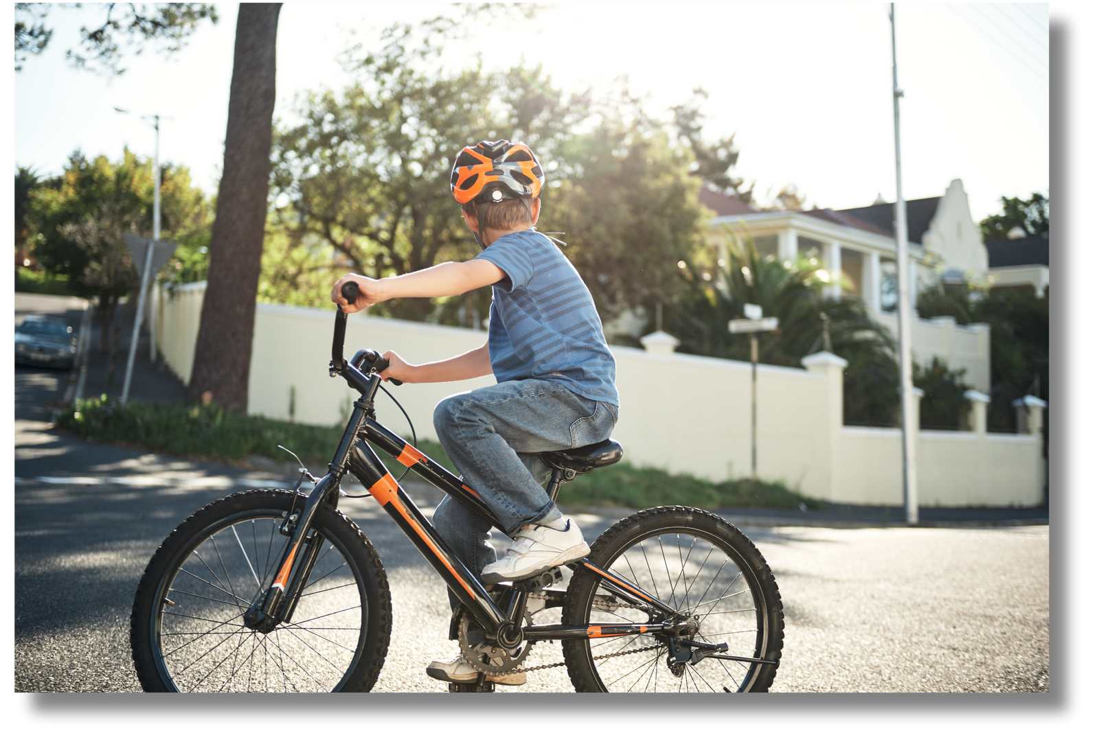
Road Safety Basics
Look left, right, left again before pulling out in traffic or making a turn.
Ride with traffic, not against traffic.
Obey all traffic laws.
Always wear a helmet!
Notes:
Very basic skills and rules
When did you learn to look left, right, left?
Some people want to fight over which side of the road to ride their bikes on. Which side of the road do you walk on? Ride on?
For the folks that want to disagree with the law: a bike is a vehicle, for consistency vehicles go in the same direction; The law says so. Our elected officials got together and in an effort to make road use more safe for bicyclists, use of the road by bikes was codified/standardized/uniform.

Slide 41
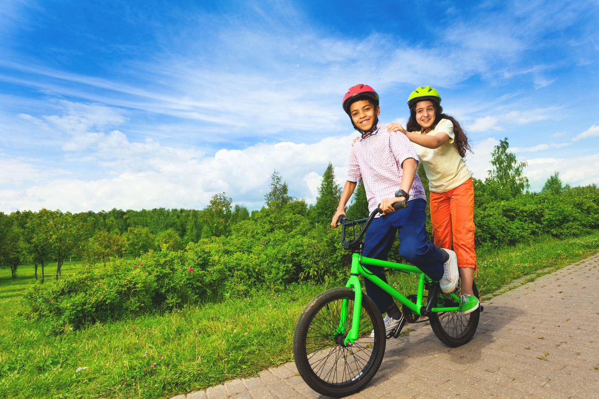
May not carry more persons than the number it was designed to carry.
Notes:
Briefly discuss what is wrong with the picture.
Remember a bike is only designed to carry as many people as there are seats for.

Slide 42
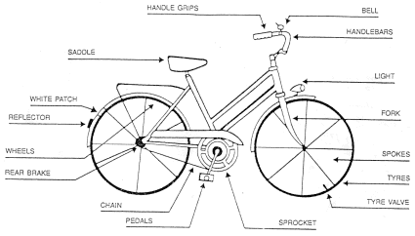
ABC Quick Safety Check
AIR
BRAKES
CHAIN
Notes:
A is for air: Check the air pressure, spin the wheels and make sure the tires are not worn out.
B is for brakes: Check to make sure coaster brakes will stop the bike by spinning the back wheel and applying the brake.
C is for Cranks, Chain, and Cogs: Grab the crank arms and try to wiggle side to side. There should be no movement.
Quick refers to the Quick Release: Some bikes have quick releases on the wheels or the seat post.

Slide 43
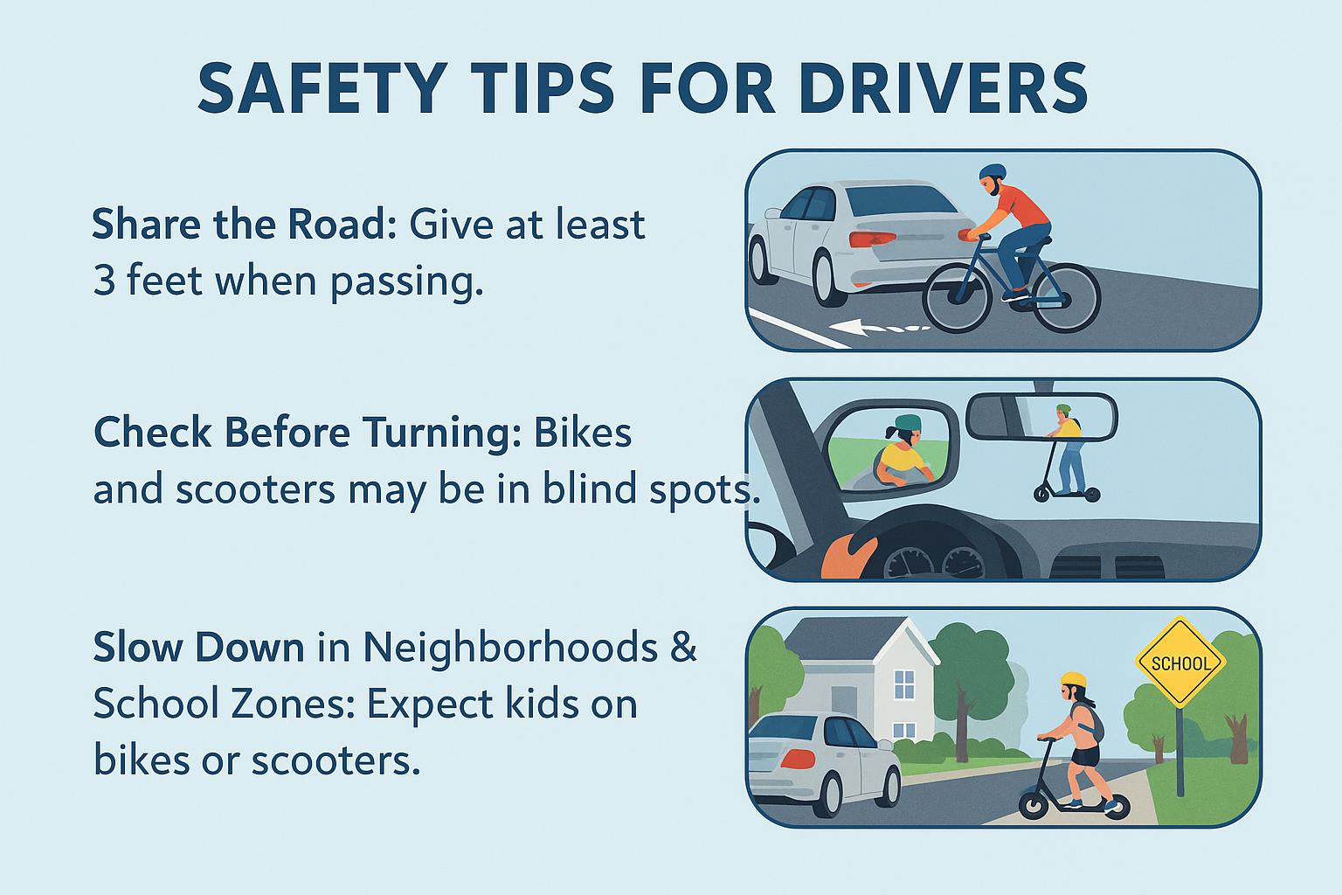

Slide 44
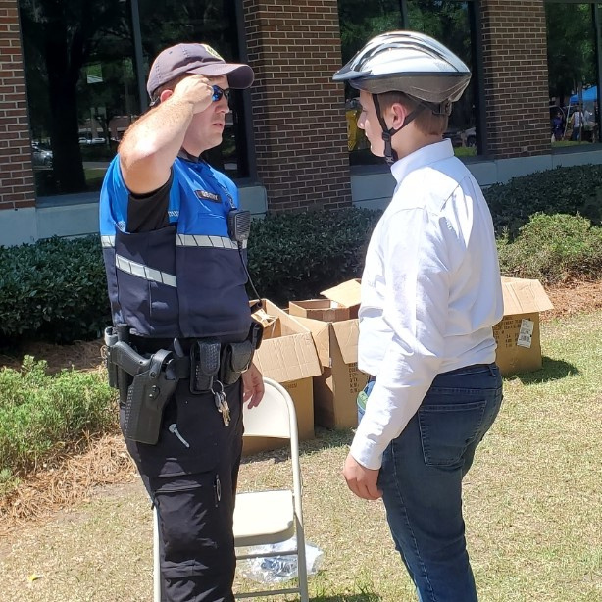
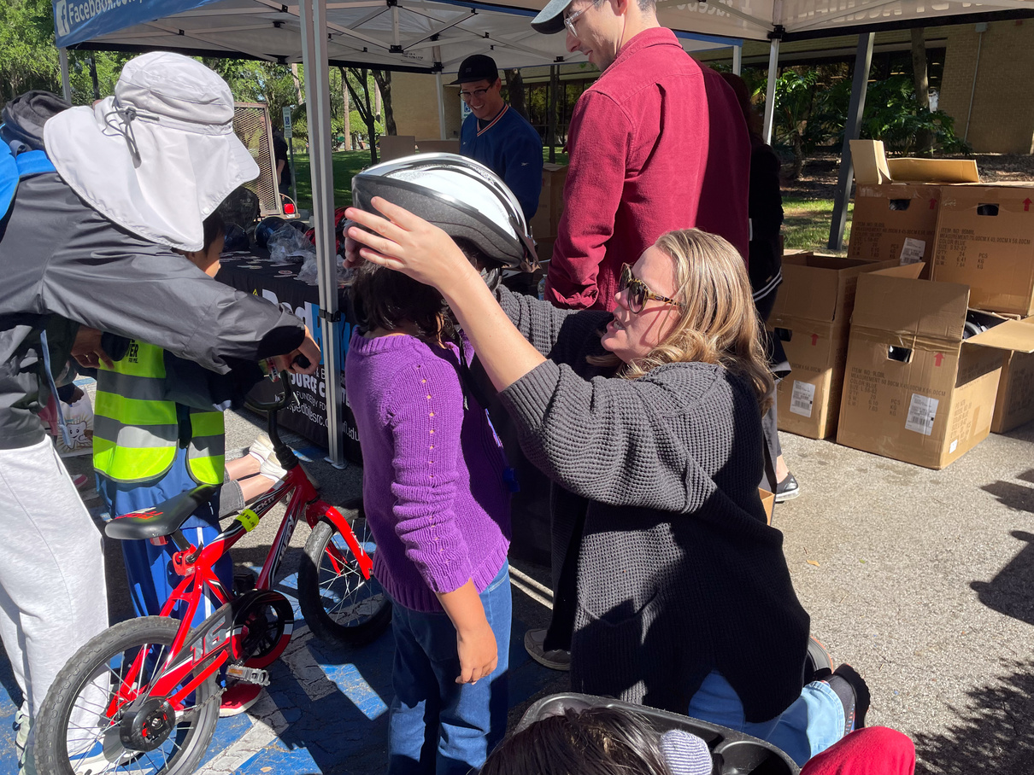
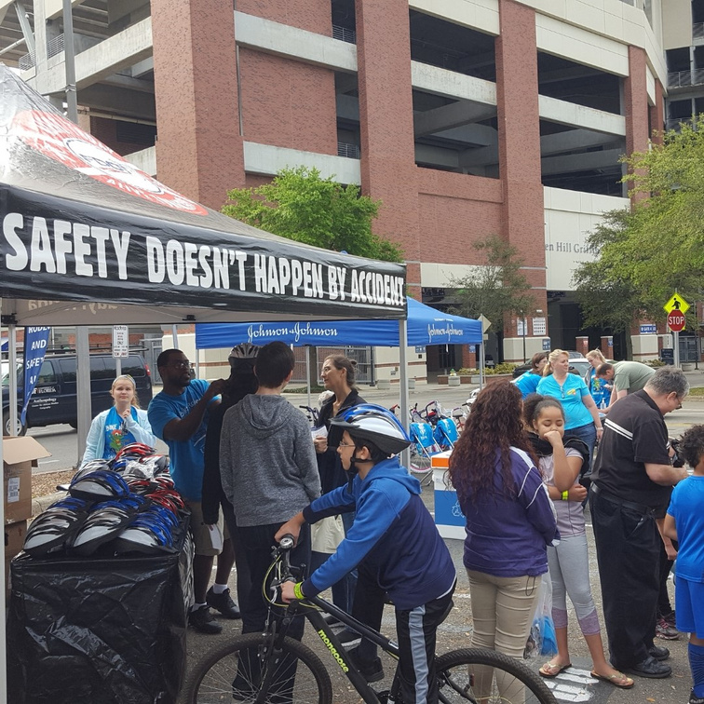
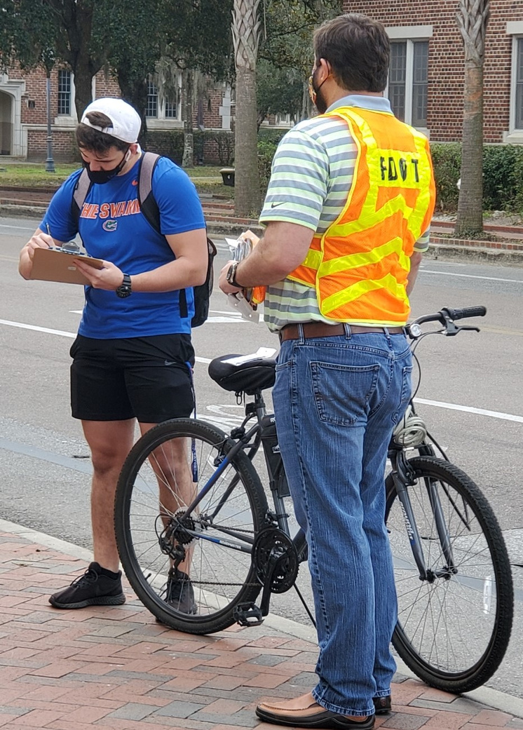
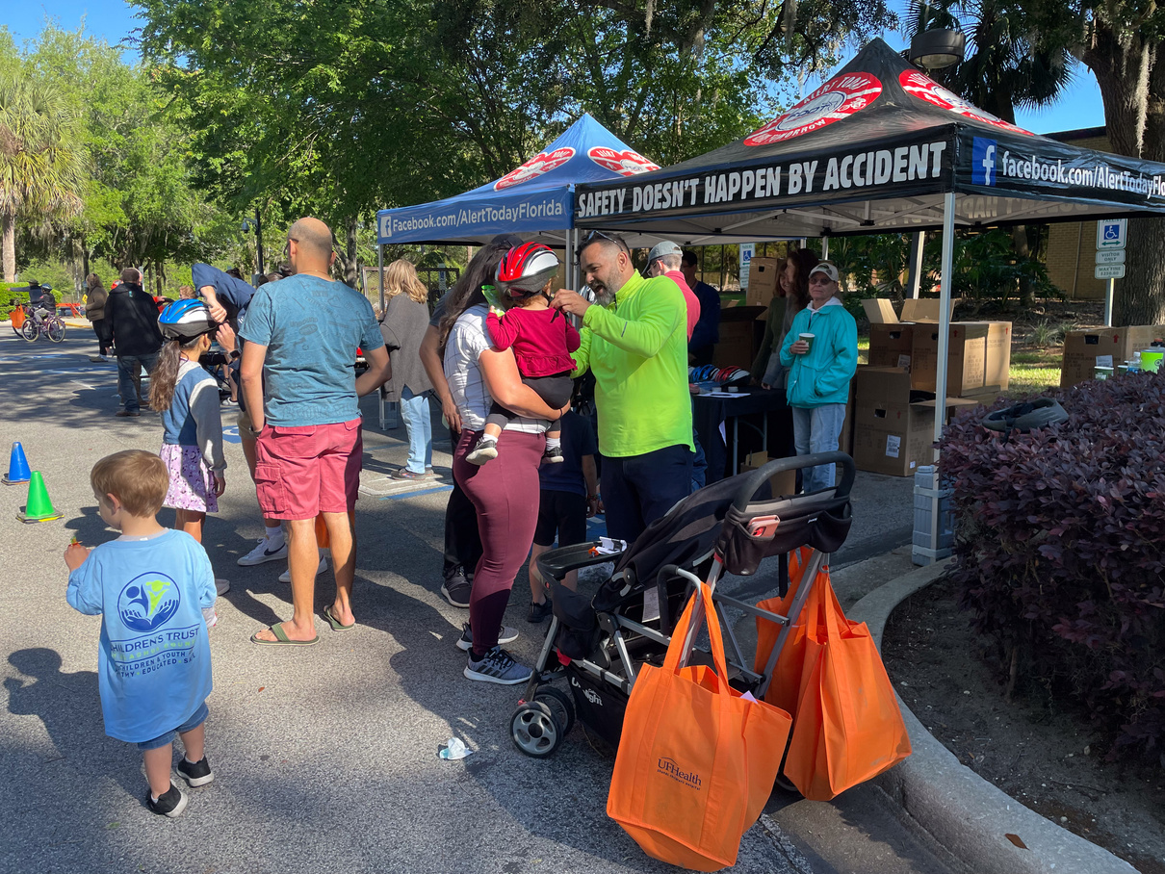
Outreach Events
Outreach events vary in size, from 1-on-1 helmet fittings
to booths at festivals with thousands of attendees.
Notes:
What do events look like?

Slide 45
Where will the event be held?
Common venues include parking lots, fields, libraries, schools, festivals, etc.
Who will be helping?
Volunteers can be parents, teachers, safety pros, neighbors, coworkers, etc.
How many helmets?
~15, you can fit 10-20 helmets/hr.
# of fitters X hours of event X 15 (avg) = # helmets you can fit.
Notes:
Common things to note about events you do not plan but will attend.
The formula! How many helmets can I order? (is the wrong question) How many helmets can you fit at your event with the help you have lined up? (is the right question)

Slide 46

What Should I Bring?
Table & Tablecloth
Helmet Signature Forms
Chairs
Handouts
Posters or Signs
Weather-Related Items (sunscreen, hat, raincoat, etc.)
Clipboard & Pens
Helmets
Notes:
Make your own checklist. We have one on the site you can download.

Slide 47
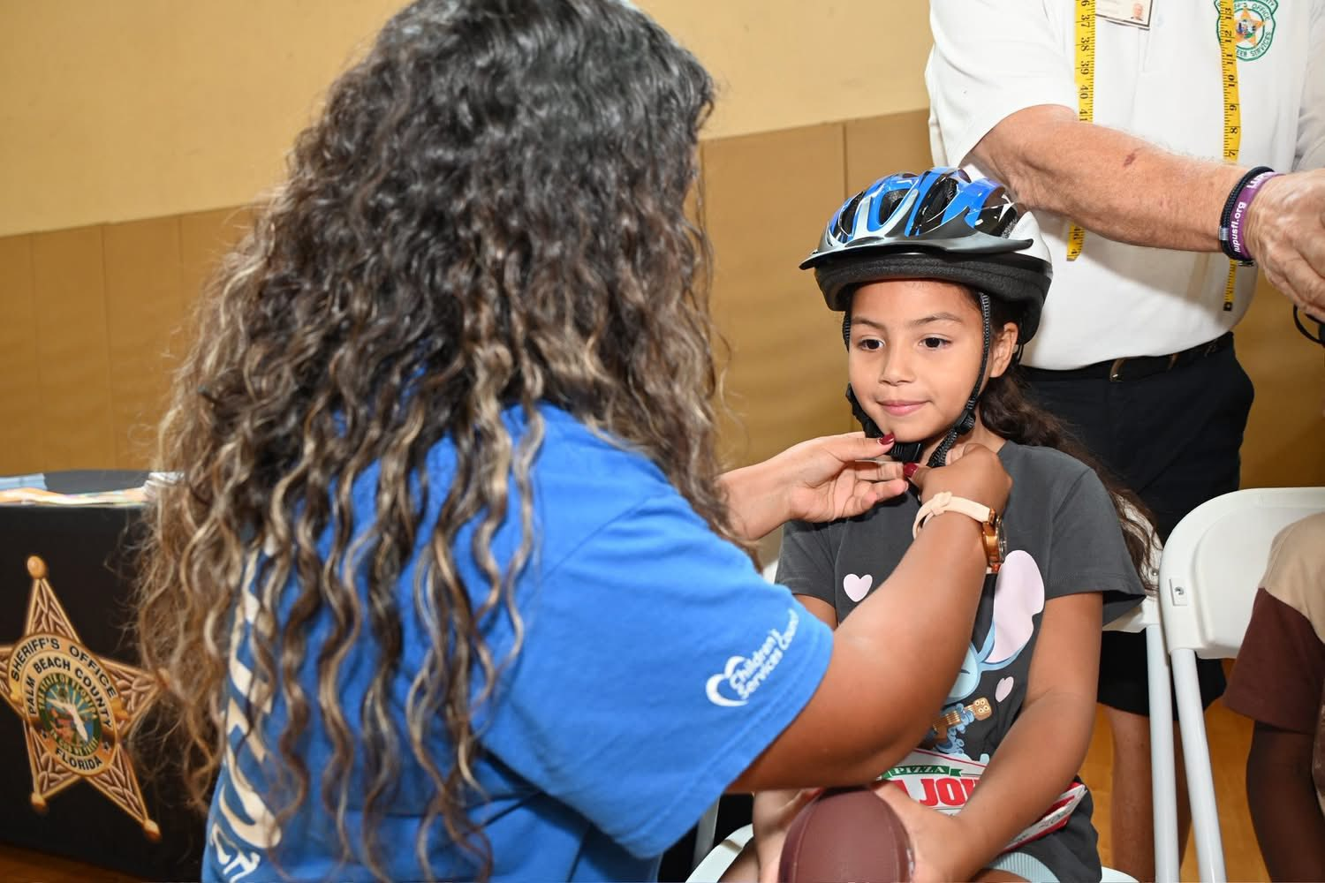
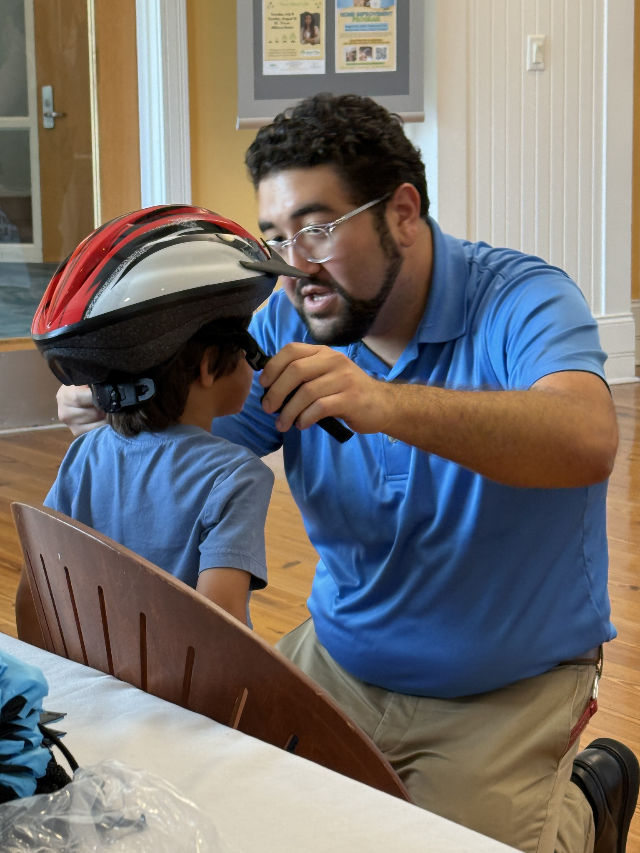
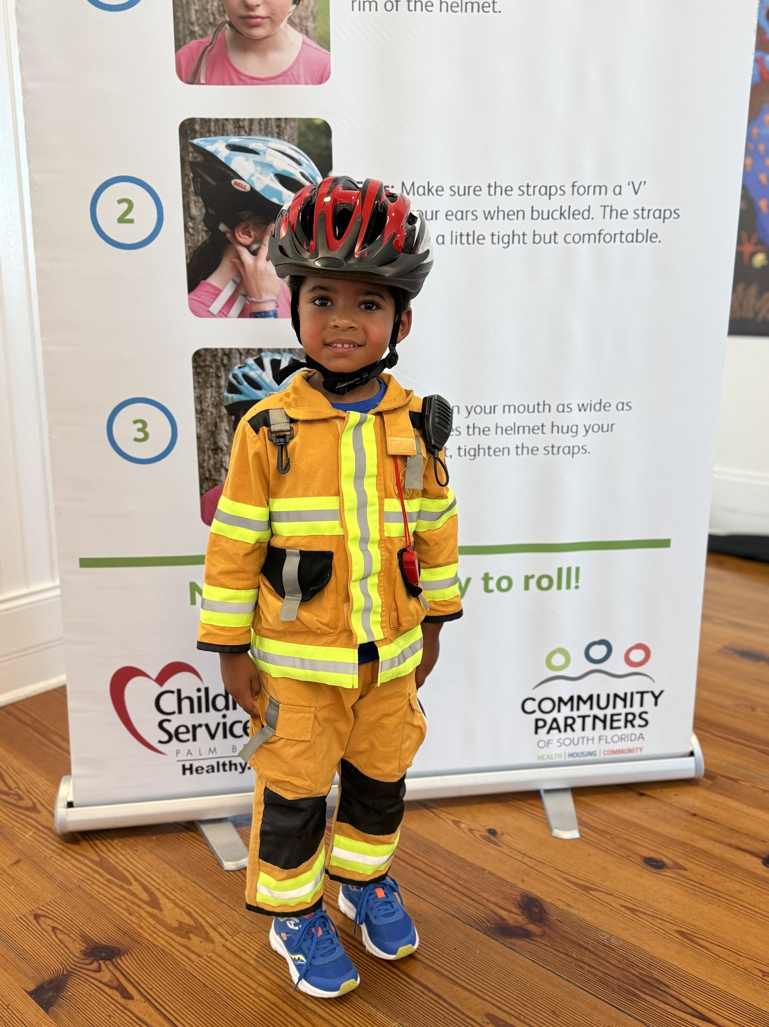
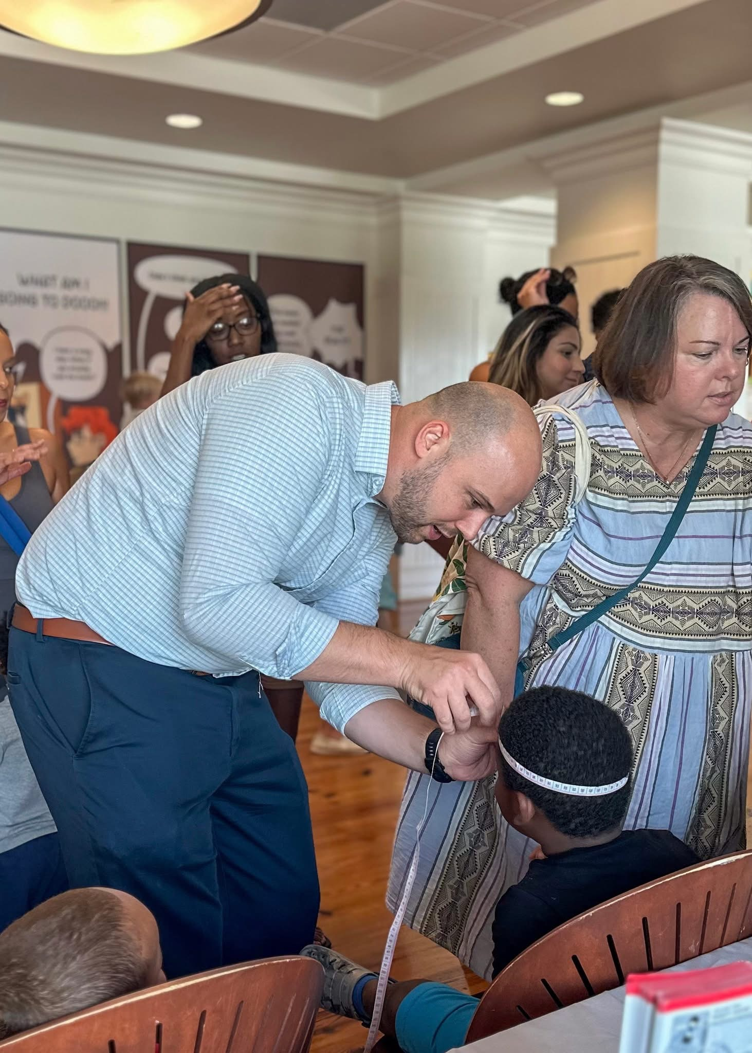
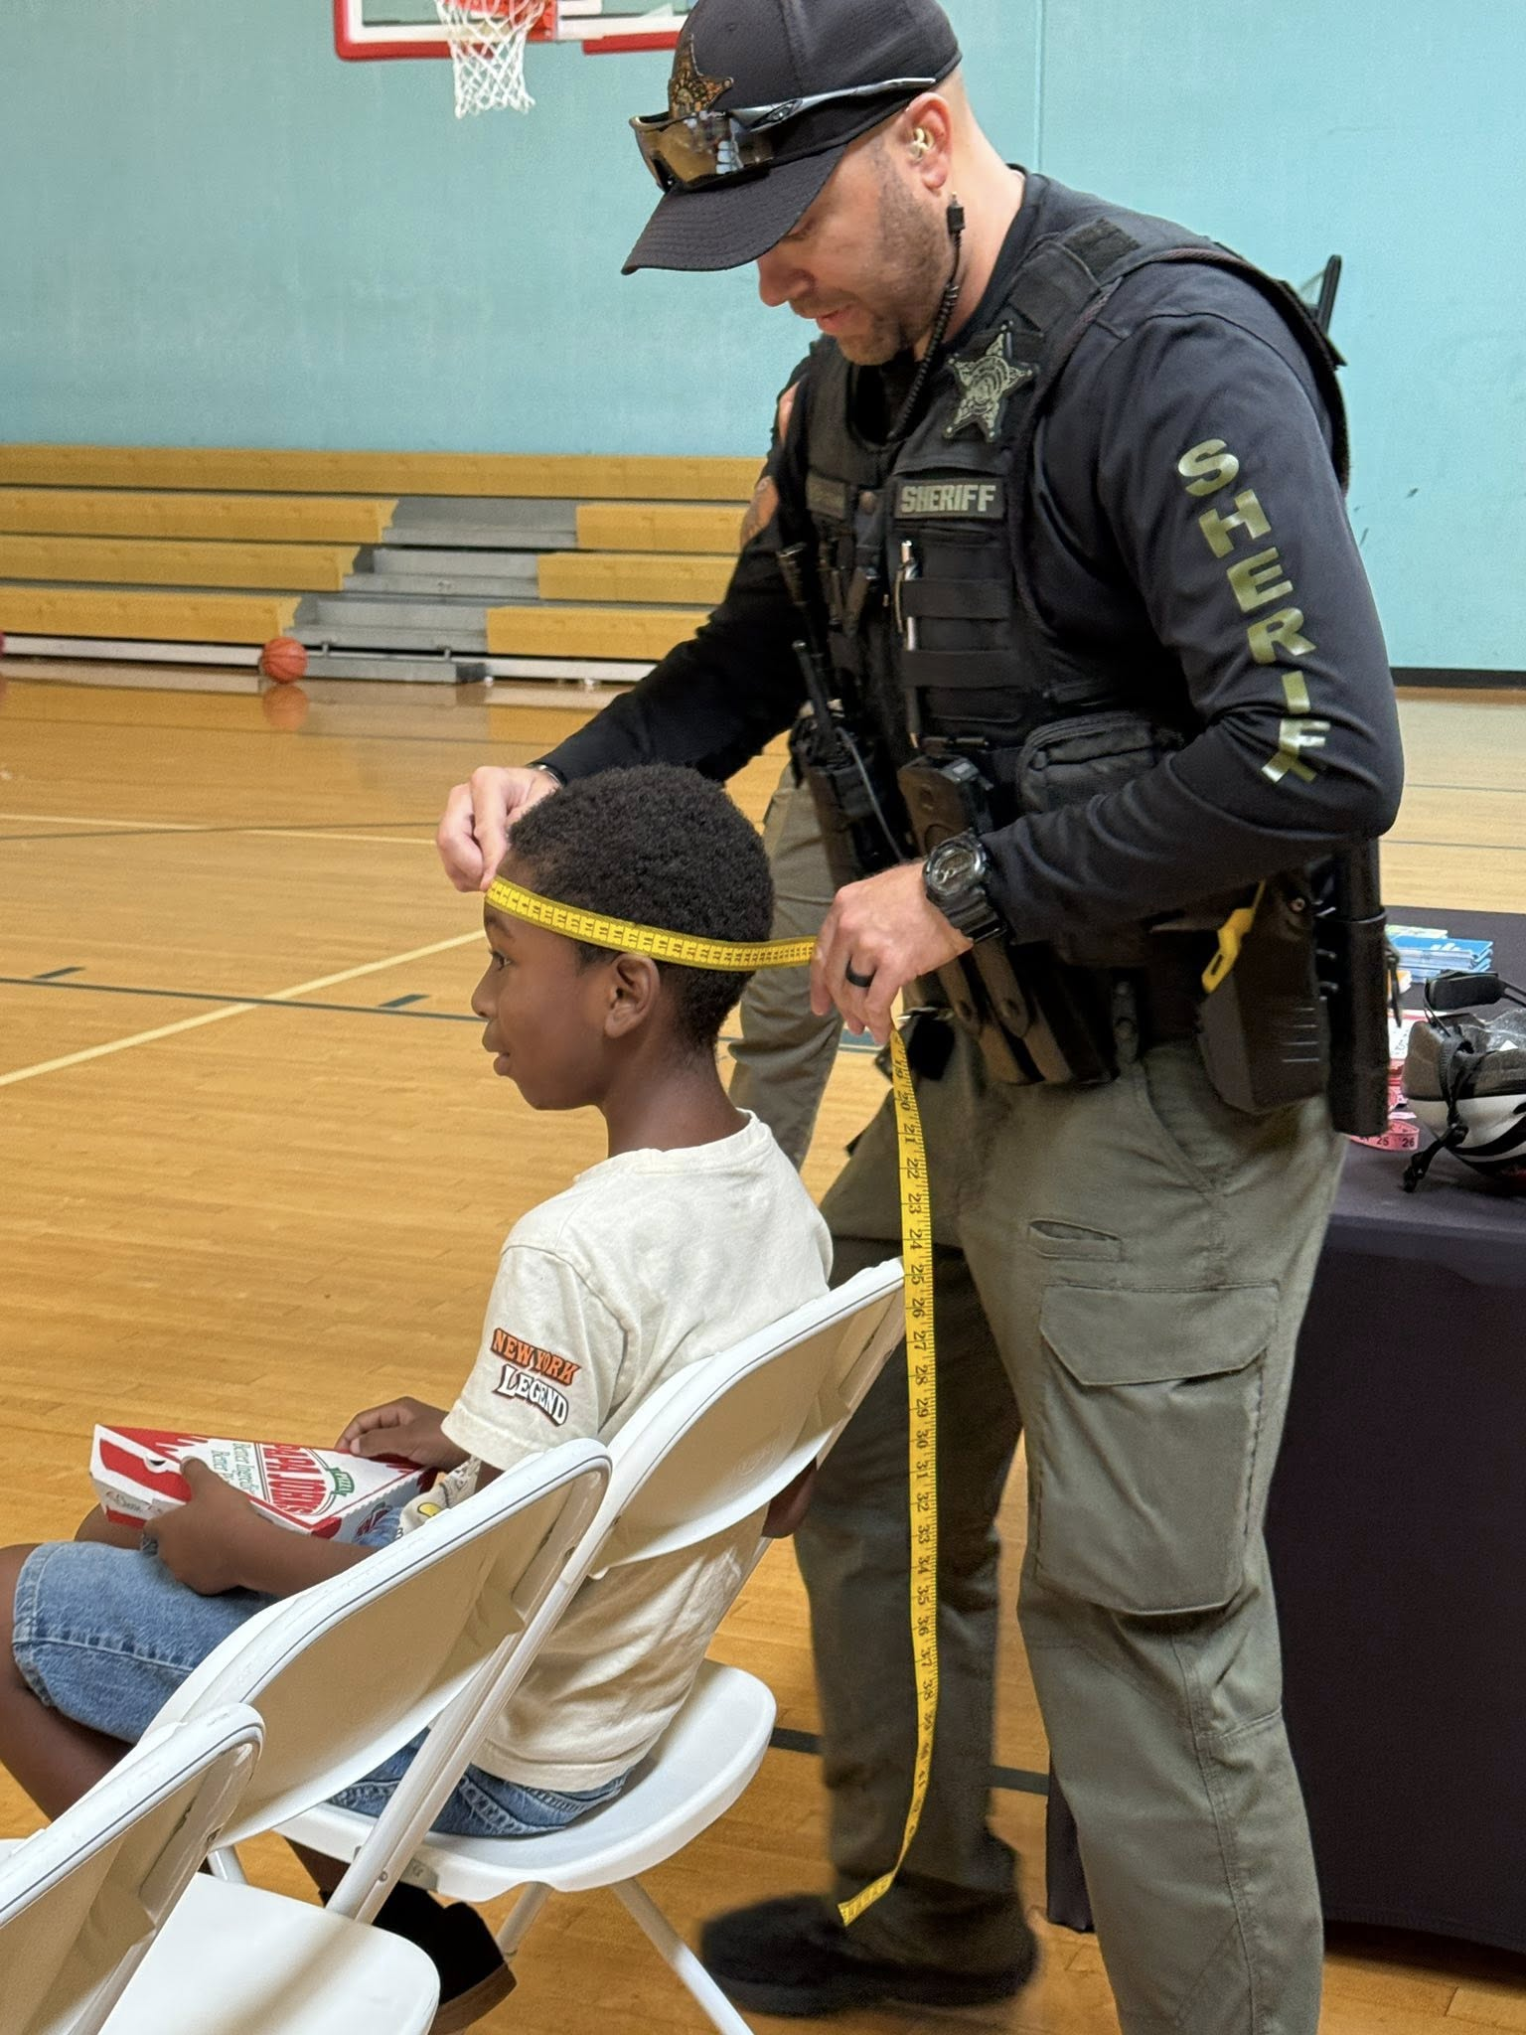
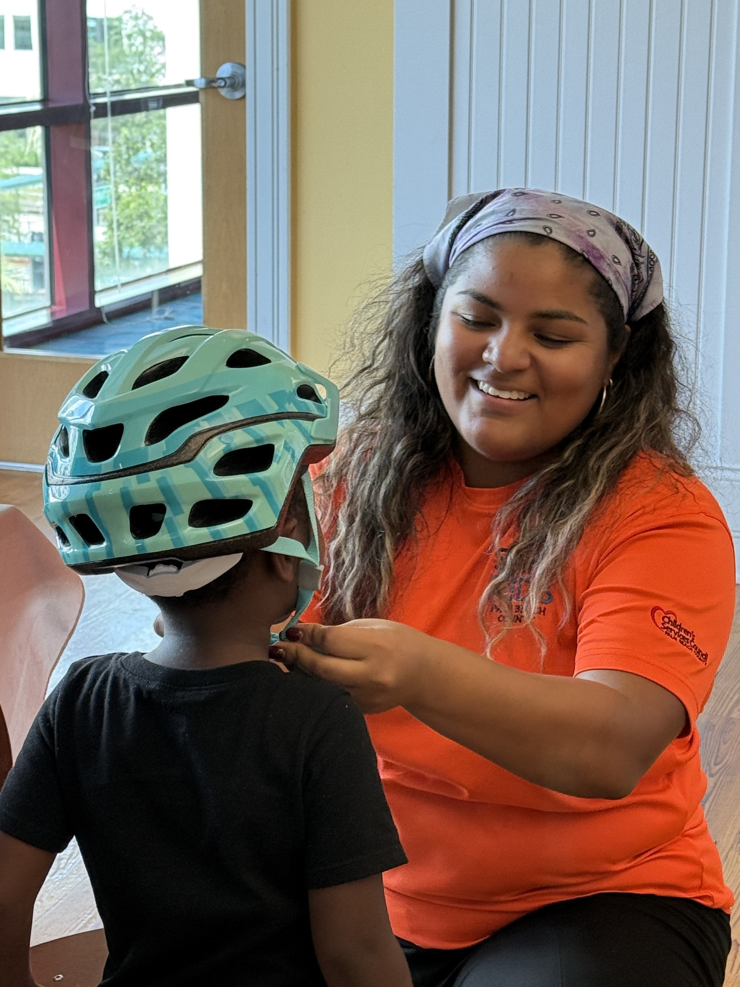

Slide 48
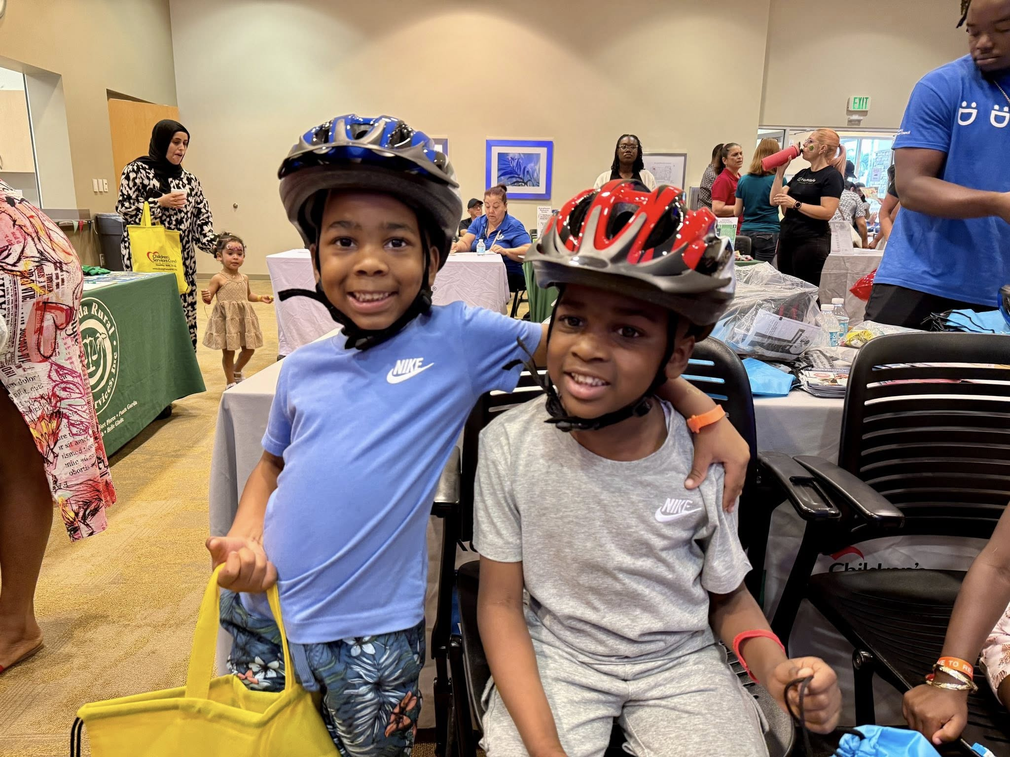
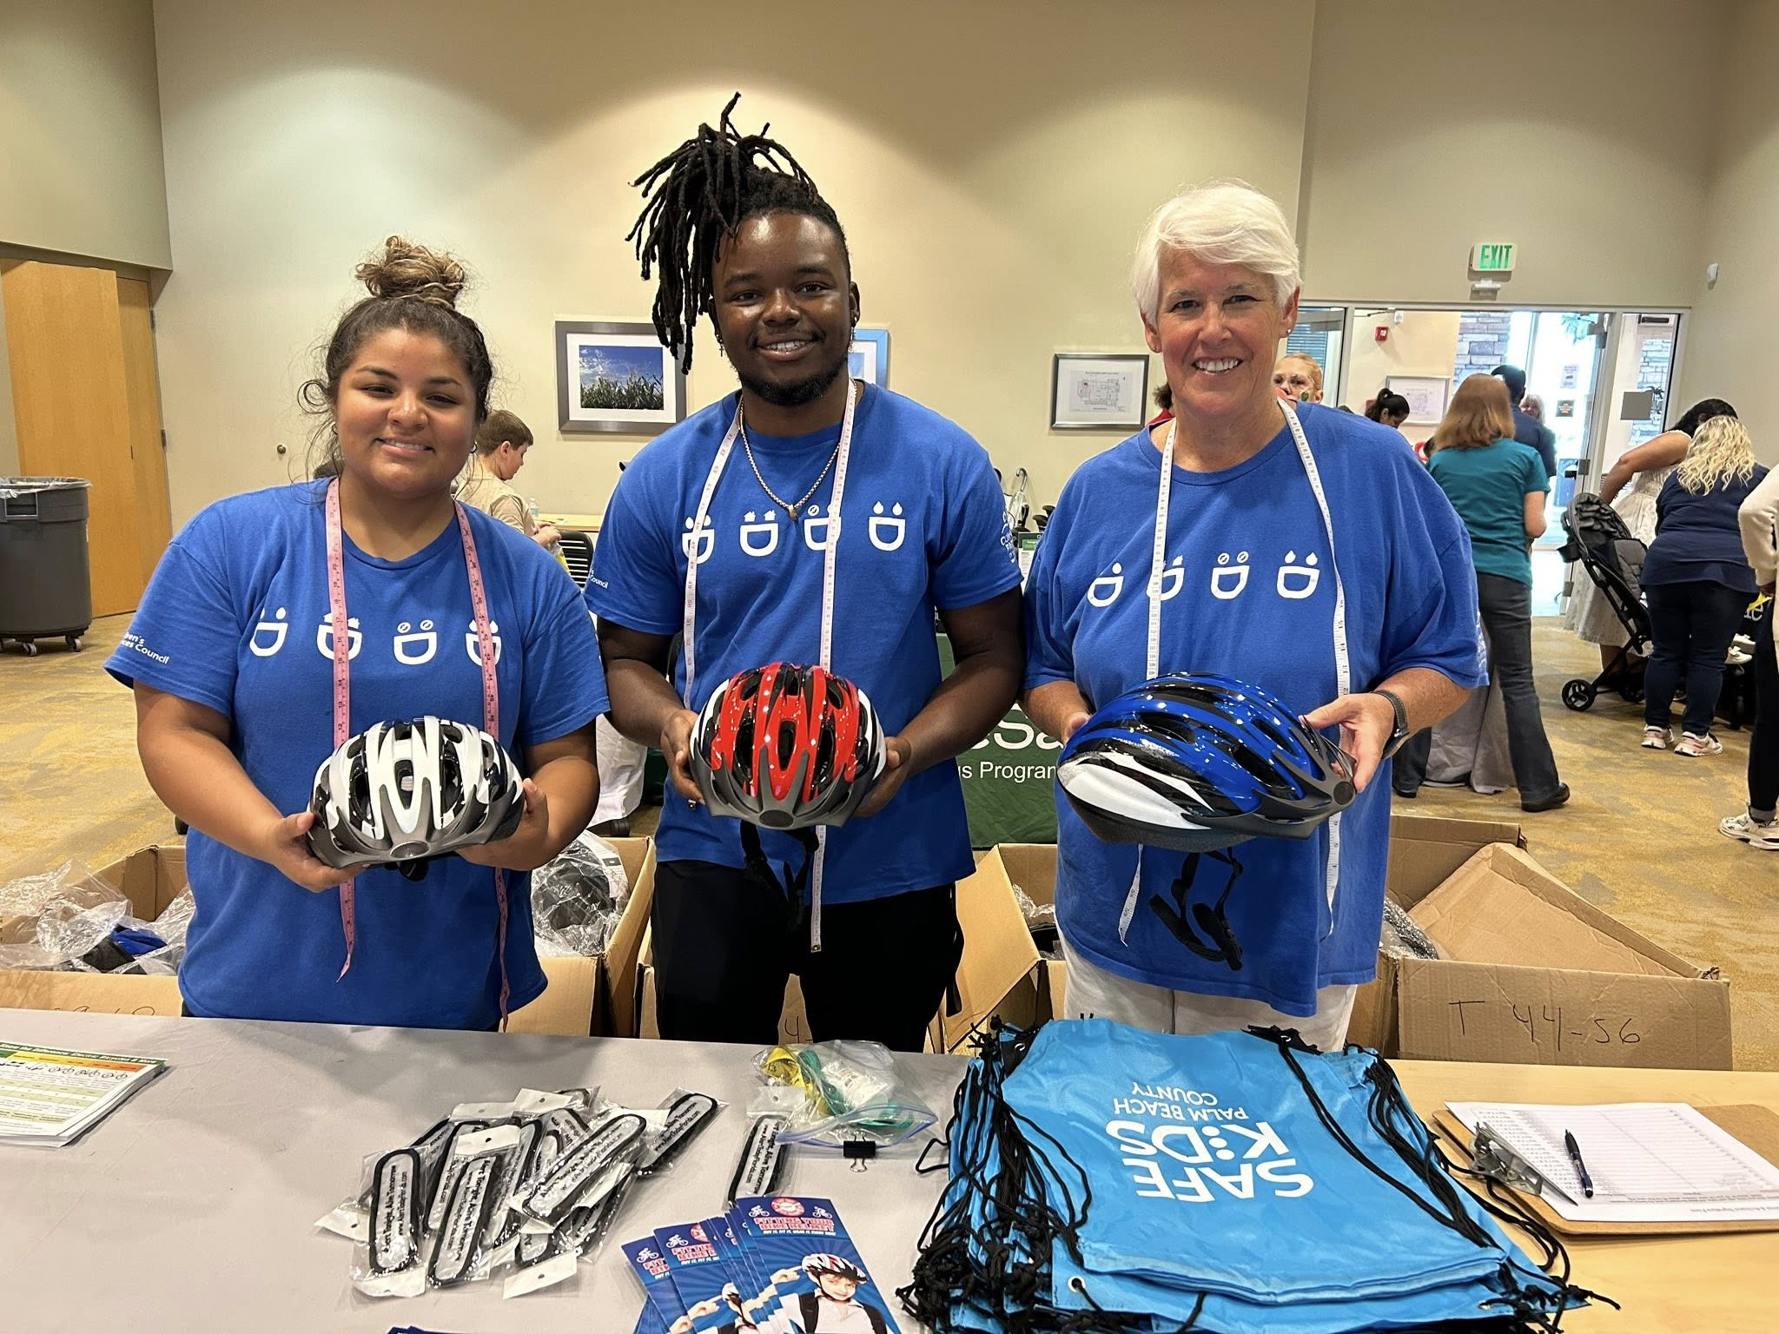
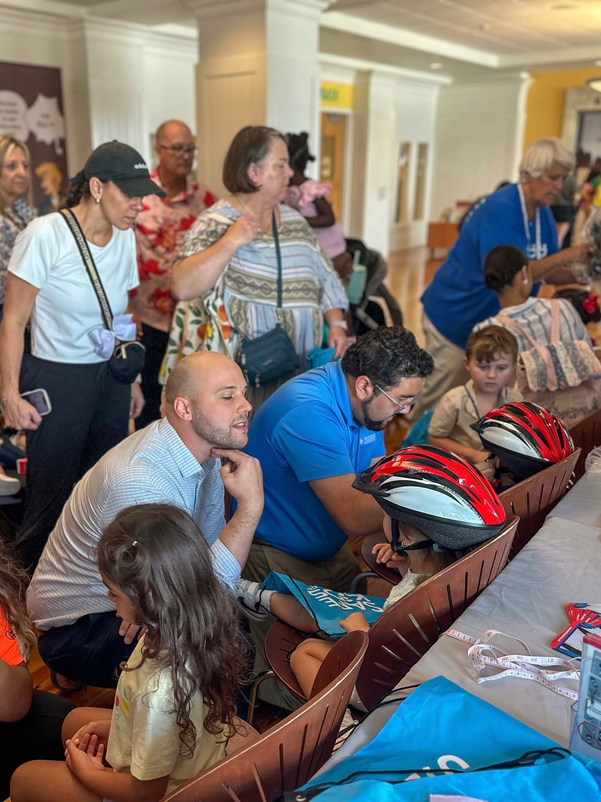
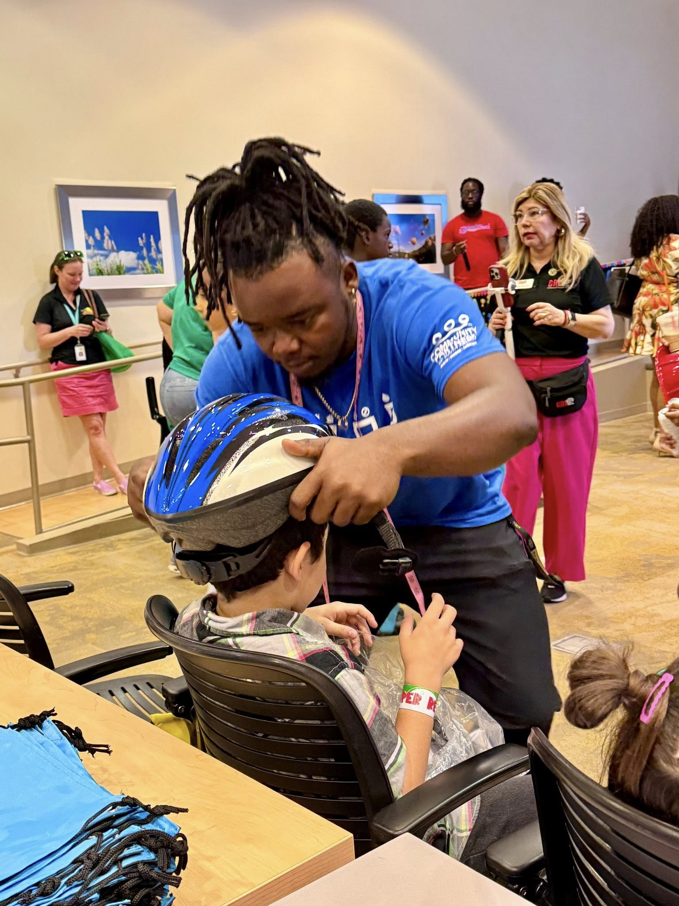
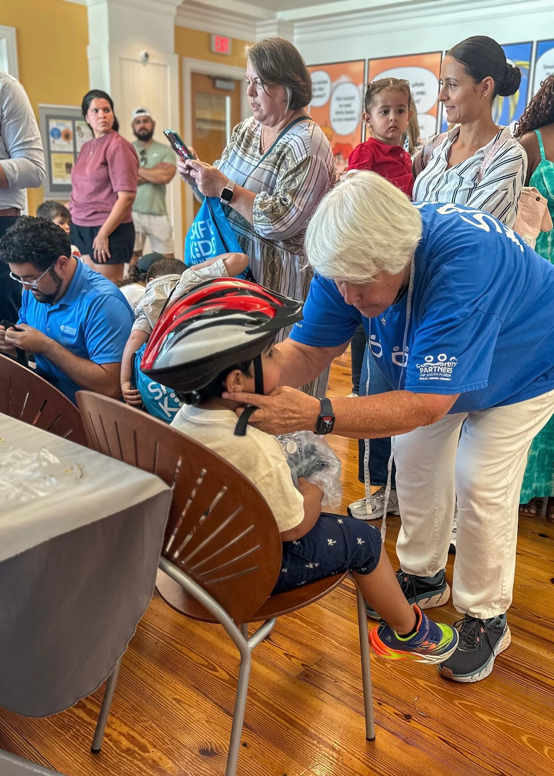

Slide 49


Slide 50
Audience Questions?

Slide 51
Micromobility Panel Discussion

Slide 52
15 Minute Break
The workshop will resume at 11 a.m.

Slide 53
Designing for Micromobility

Slide 54
Brave New World?
Or Back to the Future? E-bikes are upon us!
DeWayne Carver, CNU-A

Slide 55

DeWayne Carver
Associate Planner, Kittelson & Associates
Bicycle and pedestrian planning and design
Context based design
Speed management
Florida Department of Transportation
State Bicycle/Pedestrian Coordinator
State Criteria Publications Manager
Former LCI, CSI
Bicycle tourist, commuter, instructor

Slide 56

What shall we do with these e-Bikes?
Beginning to know them better now
Latest information from AASHTO
Evolving regulation and practice
Are they really that different?
Some thoughts and observations

Slide 57


E-bike characteristics
Faster acceleration
Easier to achieve and maintain higher speeds (20-30mph)
Easier to start
They have lights!
They are heavier
Less maneuverable?

Slide 58

2024 AASHTO Guide to Bicycle Facilities
Treats them essentially as regular bikes
2024 GBF also includes a number of other bike types:
Cargo bikes
Trikes
Tandems
Recumbents
eBikes are not the weirdest thing in this box of cereal
They have some special design considerations, just like other types of bikes

Slide 59

AASHTO recognizes eBikes…
Accelerate faster
Achieve higher velocities more easily
Are heavier than conventional bikes

Slide 60

Some aspects of eBikes seem universally helpful…
Faster acceleration
More motion with less energy
They have lights!
Greater carrying capacity

Slide 61
So what’s the problem? Speed
Cruise at 15-20 mph
Way too fast for sidewalks (even conventional bikes are too fast for sidewalks)
Also outside the parameters for most urban bike facilities
Exacerbates issues even on shared use paths

Slide 62

Other problems…
Riding the throttle – using as a moped, esp. in suburban environments
All the regular bike conflicts, but faster!
Bicyclist or scooters running into vehicles (more)
Pedestrians (or other micromobility) being struck

Slide 63

A Bicycle-Friendly City
Engineering
Education
Enforcement
Encouragement
All of these groups
have an interest

Slide 64

Engineering
Separated facilities
Bike Boulevards
Make them faster
Make them slower
Mix them up
Separate them

Slide 65

Engineering

Slide 66
Education
Don’t ride on the sidewalk! But this is how to ride on the sidewalk
Riding as a vehicle – is this an option now?
Safety equipment
Train the cyclist
Train the motorist
Train the planners and engineers
Train law enforcement

Slide 67

Enforcement
Where is it legal to ride?
Where is it not?
Three feet passing distance
Partnerships are better

Slide 68

Encouragement
“Safety in Numbers”
Signs and markings – when they matter, when they don’t
The others “E”s are also encouraging!
What would encourage you?

Slide 69

dcarver@kittelson.com

Slide 70
Audience Questions?

Slide 71
Thank you!

Slide 72

Question:
Is There A Helmet Standard for Micromobility Riders?
NTA 8776
Dutch helmet safety standard
Developed in 2016
Specific Standard for high-speed (28 MPH) electric micromobility

Slide 73




Question:
What Standards and Guidance Should Designers Reference?
On System:
Florida Design Manual (FDM)
Off System:
Florida Green Book
NACTO
Urban Bikeway Design Guide, 3rd Edition
AASHTO
Guide for the Development of Bicycle Facilities, 5th Edition

Slide 74




Question:
What Role Does The Vehicle Play In Design?
Utility
Performance

Slide 75

Question:
How Should Micromobility Influence Design Of Innovative Facilities?
Source: MassDOT Separated Bike Lane Planning and Design Guide

Slide 76




Question:
How Should Micromobility Passengers Influence Design?

Slide 77


Question:
How Dan We Ensure The Benefits Of Micromobility Extend To Seniors?

