Slide 1
Speed Management Study
September 2024

Slide 2
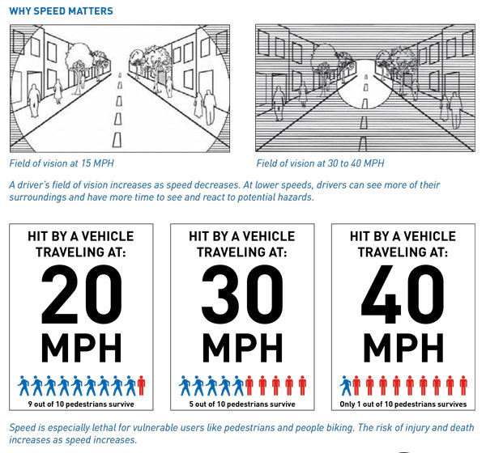
Why Conduct a Speed Management Study?
Advance VZAP Policy Action 1.3
Improve human behavior and manage speeding
Accountability - Speeding & aggressive driving accounted for 17% of traffic-related deaths from 2017 to 2023

Slide 3
Study Scope and Timeline
Study Kickoff
FDOT Coordination
Draft Target Speed Methodology
Operating Speed Data
Final Target Speed Methodology
Estimated Completion
April 2024
May 2024
June 2024
July 2024
August 2024
September 2024
April
May
June
July
August
September
Study Kickoff
FDOT Coordination
Operating Speed Data
Estimated Completion
Draft Target Speed Methodology
Final Target Speed Methodology
2024
Identify appropriate Target Speeds and countermeasures
Uses national best practices and guidance for speed setting
Applies a Safe System approach to prioritize vulnerable road users

Slide 4
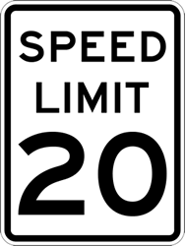
Speed Definitions
Target Speed
Design Speed
Posted Speed
Operating Speed
Notes:
Target Speed is the highest speed vehicles should operate on a roadway, given the context of the roadway and consideration for multimodal users
Design Speed is the speed that regulates the roadway design including characteristics such as lane widths, clear zone, speeds, etc.
Posted Speed established by methods described in the Speed Zoning for Highways, Roads, and Streets in Florida Manual. This manual is adopted by Rule 14- 15.012, F.A.C. Generally set based upon doing a speed study and looking at the 85th percentile speed
Operating Speed - the speed at which drivers are observed traveling during free flow conditions. Generally considered the 85th percentile speed

Slide 5
Target Speed Methodology
Data driven, point-based approach
Applied on…
All Federal-Aid Roads not a State Road
State, County, and Municipal roads on the TPA High Injury Network
Emphasizes most vulnerable roadway users
Roadway Characteristics
Safety Data
Multimodal Data
Geometric Data
Notes:
Assigned Target Speed Range
Roadway Centerlines
Functional Classification
Roadway Ownership
FDOT D4 Context Classification
Safety Data
Palm Beach TPA HIN
FDOT VRU
Transit Data
Palm Tran Stop Level Transit Ridership
Geometric Data
Number of Lanes
Pedestrian and Bicycle Data
Palm Beach TPA LTS
Replica Origin Destination Data
The data was developed into a points-based methodology

Slide 6
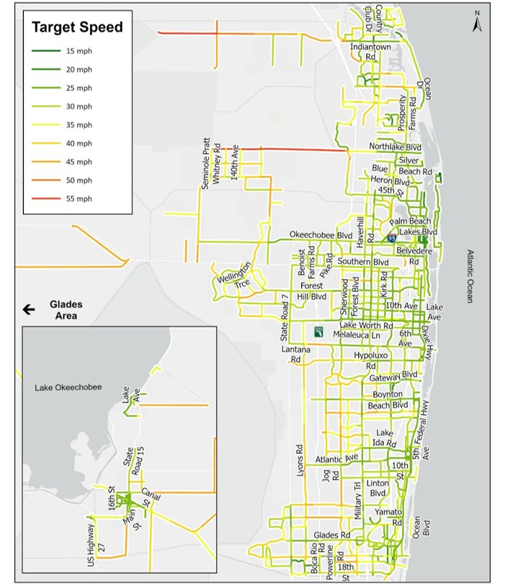
Draft Target Speed Results
DRAFT
Notes:
More than a third (~192 miles) of non- SHS collectors were assigned a 30 MPH target speed.
About a third (~92 miles) of non-SHS arterial roadways also have a 30 MPH target speed,
Local roads (~29 miles) and SHS roads (~144 miles), with SHS roads receiving the lowest target speeds (25 or 30 MPH)

Slide 7
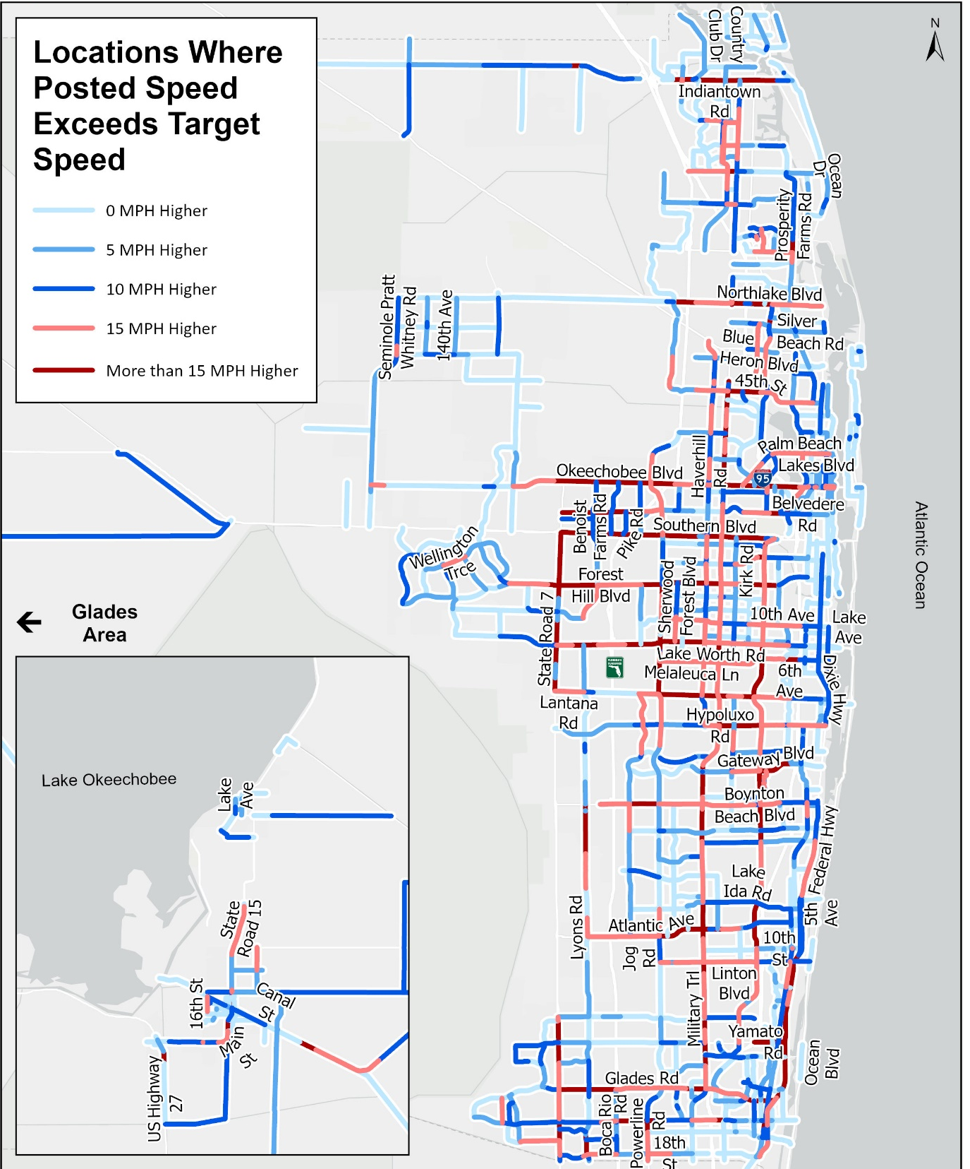
Draft Speed Comparative Analysis
Operating Speed Data
85th Speed
Median Speed
Average Speed
Study Network Analysis
High Injury Network Analysis
vs.
Target Speed
Posted Speed
vs.
Operating Speed
Posted Speed
Notes:
Operating Speed Data
RITIS
TMC codes from RITIS were added to the HIN network.
The network was divided into positive (northbound/eastbound) and negative (southbound/westbound) TMC codes based on road direction.
Some TMC codes required segmentation to align the linework with RITIS data, ensuring correct TMC representation.
TMC code data was downloaded from RITIS for speed analysis at the 85th, 50th, and Mean Speed intervals during the following periods:
Weekday
Weekend
Overnight
TMC data was joined to the TMC code on the HIN network to conduct a Speed Comparative Analysis.
Conducted multiple different types of analyses with the operating speed data and on the study network.
We compared the Target Speed to the posted speed to identify locations with large differences to potentially prioritize.
For the HIN, conducted an operating speed analyses to identify location with potentially existing speeding concerns.

Slide 8
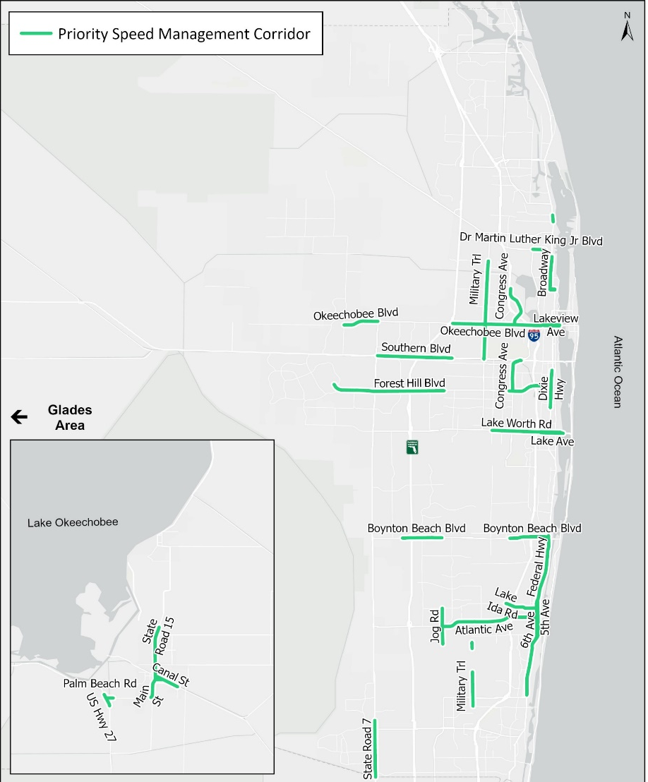
Draft Priority Speed Management Corridors
Identification
Speeding
Traditionally Underserved Index
Posted Speed vs. Target Speed
Target Speed points
>
Operating Speed
Posted Speed
vs.
Posted Speed
Target Speed
Notes:
To identify the high priority corridors, the following variables were considered. Corridors with existing speeding, traditionally underserved index (low income, racial %, English, disability, youth, elderly, 0 car HH).
Looking at locations with posted speed vs. target speed.
Overall Target Speed Points.

Slide 9
Next Steps
Example Target Speed Countermeasures from NACTO
Finalize priority speed management corridors
Identify countermeasures and strategies to achieve Target Speed
Complete Final Report
Median
Pinchpoint
Chicane
Lane Shift
Speed Hump
Roundabout
On Street Parking

Slide 10
Questions?

Slide 11
Additional Information: Draft Operating Speed
Operating Speed Data
85th Speed
Median Speed
Average Speed
Time Periods
Weekday
Weekend
Overnight
Notes:
Operating Speed Data
RITIS
TMC codes from RITIS were added to the HIN network.
The network was divided into positive (northbound/eastbound) and negative (southbound/westbound) TMC codes based on road direction.
Some TMC codes required segmentation to align the linework with RITIS data, ensuring correct TMC representation.
TMC code data was downloaded from RITIS for speed analysis at the 85th, 50th, and Mean Speed intervals during the following periods:
Weekday
Weekend
Overnight
TMC data was joined to the TMC code on the HIN network to conduct a Speed Comparative Analysis.
Conducted multiple different types of analyses

Slide 12
Additional Information: Draft Comparative Speed Analysis
Identification
Speeding
>
Operating Speed
Posted Speed

