Slide 1
Urban Area Boundary & Functional Classification Update Process
Matthew Masa – Planner I

Slide 2
Overview
Apportionment Plan & Metropolitan Planning Area Boundary
Adjusted Urban Area Boundary
Functional Classification

Slide 3
Determines Federal Aid Eligibility Funding
Roadways
Bridges
Transit

Slide 4
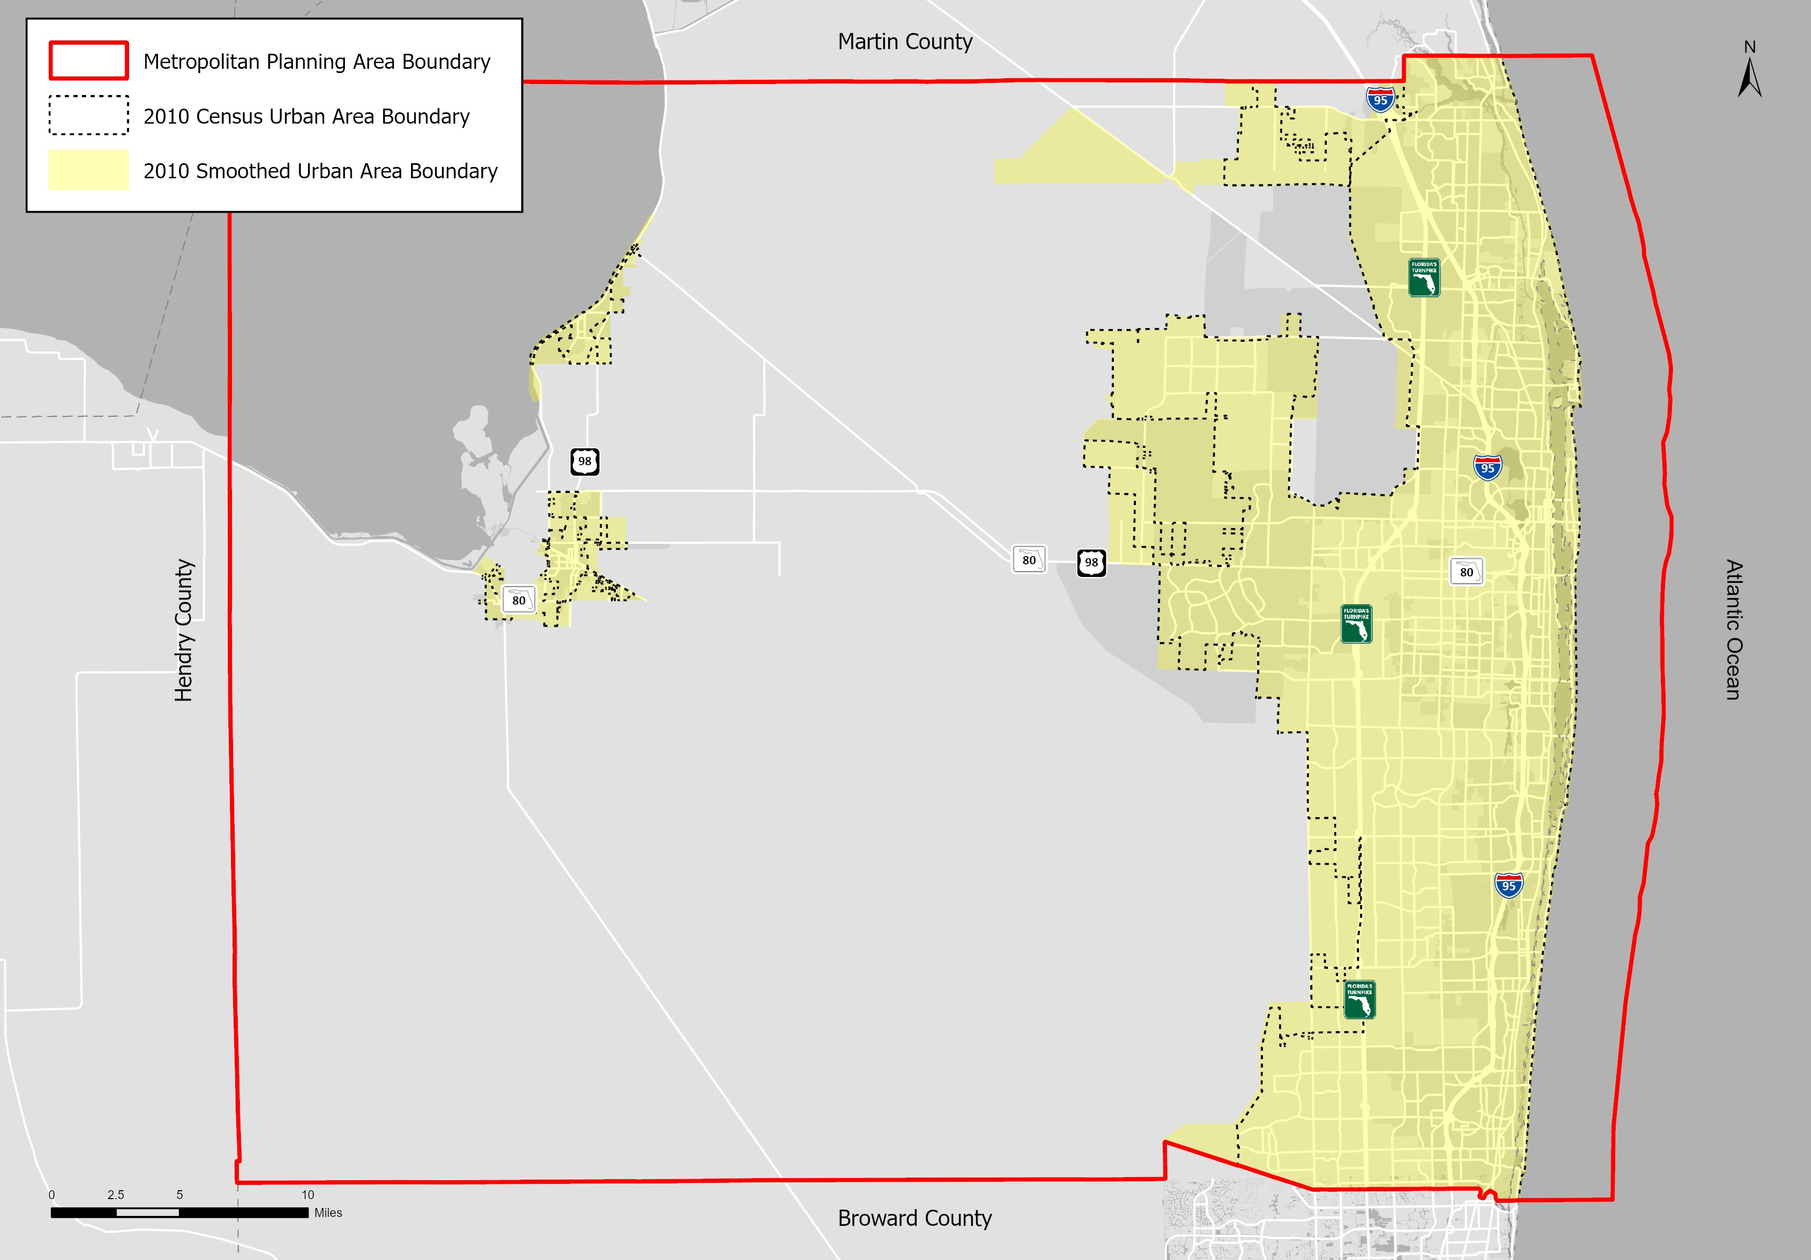
Notes:
Revised Urban Areas every 10 years based on the Decennial Census population counts?
To meet dynamic transportation needs.

Slide 5
Functional Classification
All Roads
Rural
Urban
Arterials
Arterials
Collectors
Local
Collectors
Local
Principal
Minor
Major
Minor
Principal
Minor
Major
Minor
Interstate
Expressway
Other
Interstate
Expressway
Other
Federal-Aid Eligible Roadways

Slide 6
Process – Roles
Lead Agency
Develops guidance
Coordinate review and approval
Update Enterprise Systems
Finalize & Submit documentation to FHWA
Coordinates adjustments to…
Metropolitan Planning Area (MPA) Boundary
Apportionment Plan
Urban Area
Functional Classification
Notes:
Not much changes

Slide 7
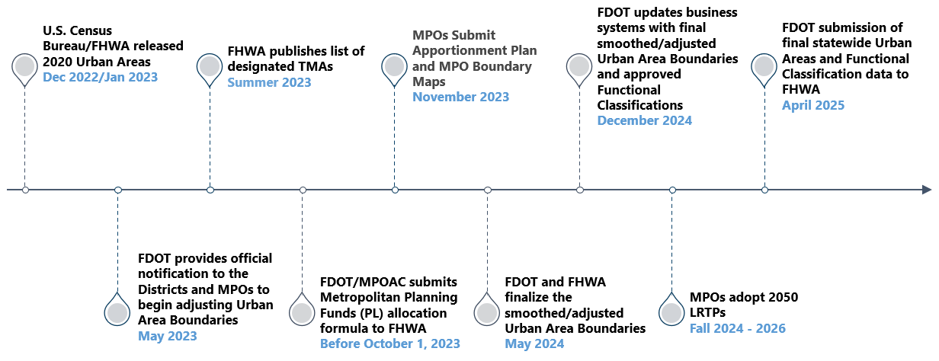
Timeline

