Slide 1
Pedestrian & Bicycle Quarterly Crash Analysis
October 1 – December 31, 2022

Slide 2
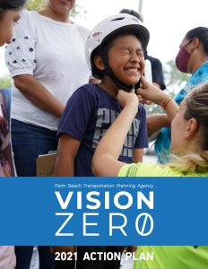
Why Quarterly Reviews of Ped/Bike Crashes?
Implements TPA Vision Zero Action Plan
Quarterly review promotes discussion and urgency
Accumulated data reveals trends and countermeasures

Slide 3
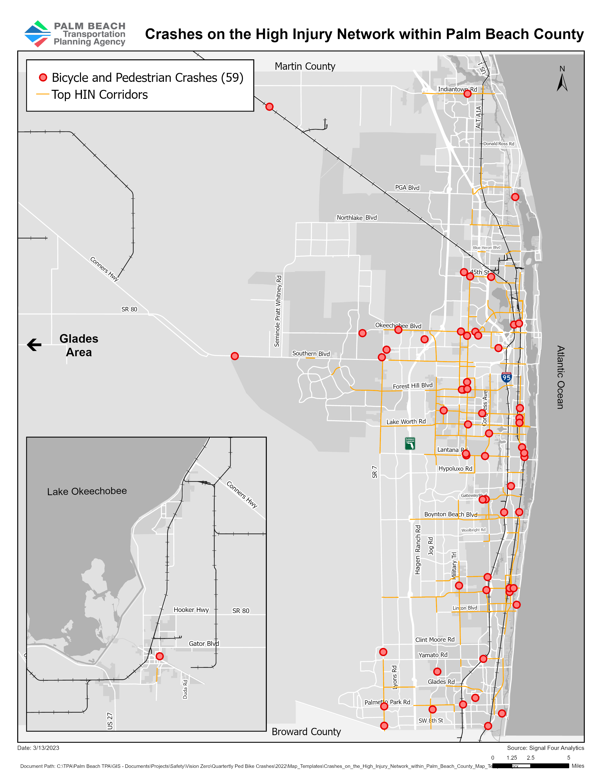
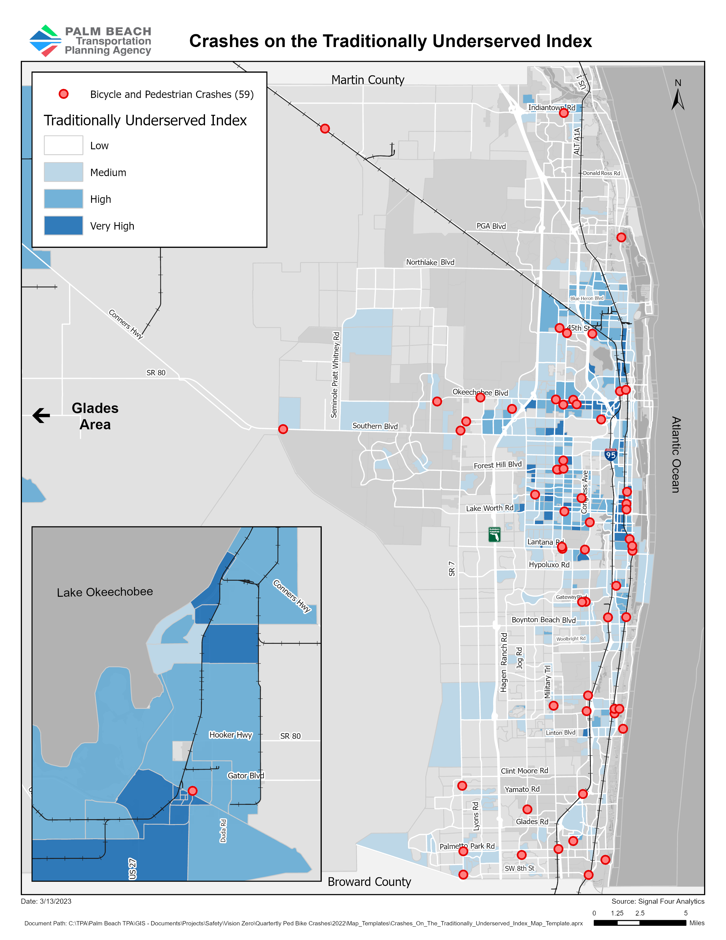
Mapping Crashes
Notes:
While performing the analysis for Q4, we found that
Q4 had a total of 59 fatal and serious injury crashes, which is an increase of 11 crashes from Q3.
53% of the mapped crashes were on the Palm Beach TPAs High Injury Network. If you are not familiar with the TPA’s High Injury Network, it is a selection of corridors with the highest fatal and serious injuries.
There was also a strong concentration of crashes in the medium to very high area of Central Palm Beach County on the Traditionally Underserved Index

Slide 4
Crashes by Emphasis Area
Roadway Conditions
Human Behavior
78%
Of pedestrian
crashes occurred
midblock.
Distracted driving
continues as the leading
human behavior with
most crashes.
Socioeconomic Conditions
Roads with a posted
speed limit of 45mph
or above had the
highest crash rates.
Aging drivers continues as
the leading age
characteristic with
most crashes.
Notes:
As a reminder, we have 3 emphasis areas: Roadway conditions, Human Behavior, and Socioeconomic conditions.
For roadway conditions, we found that 78% of pedestrian crashes occurred midblock.

Slide 5
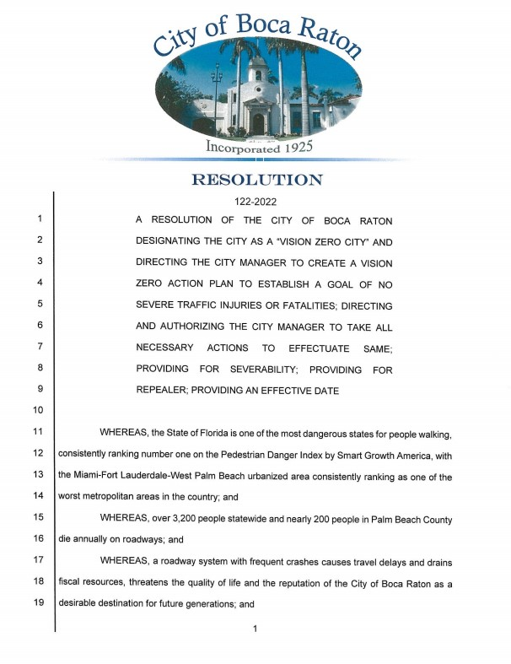
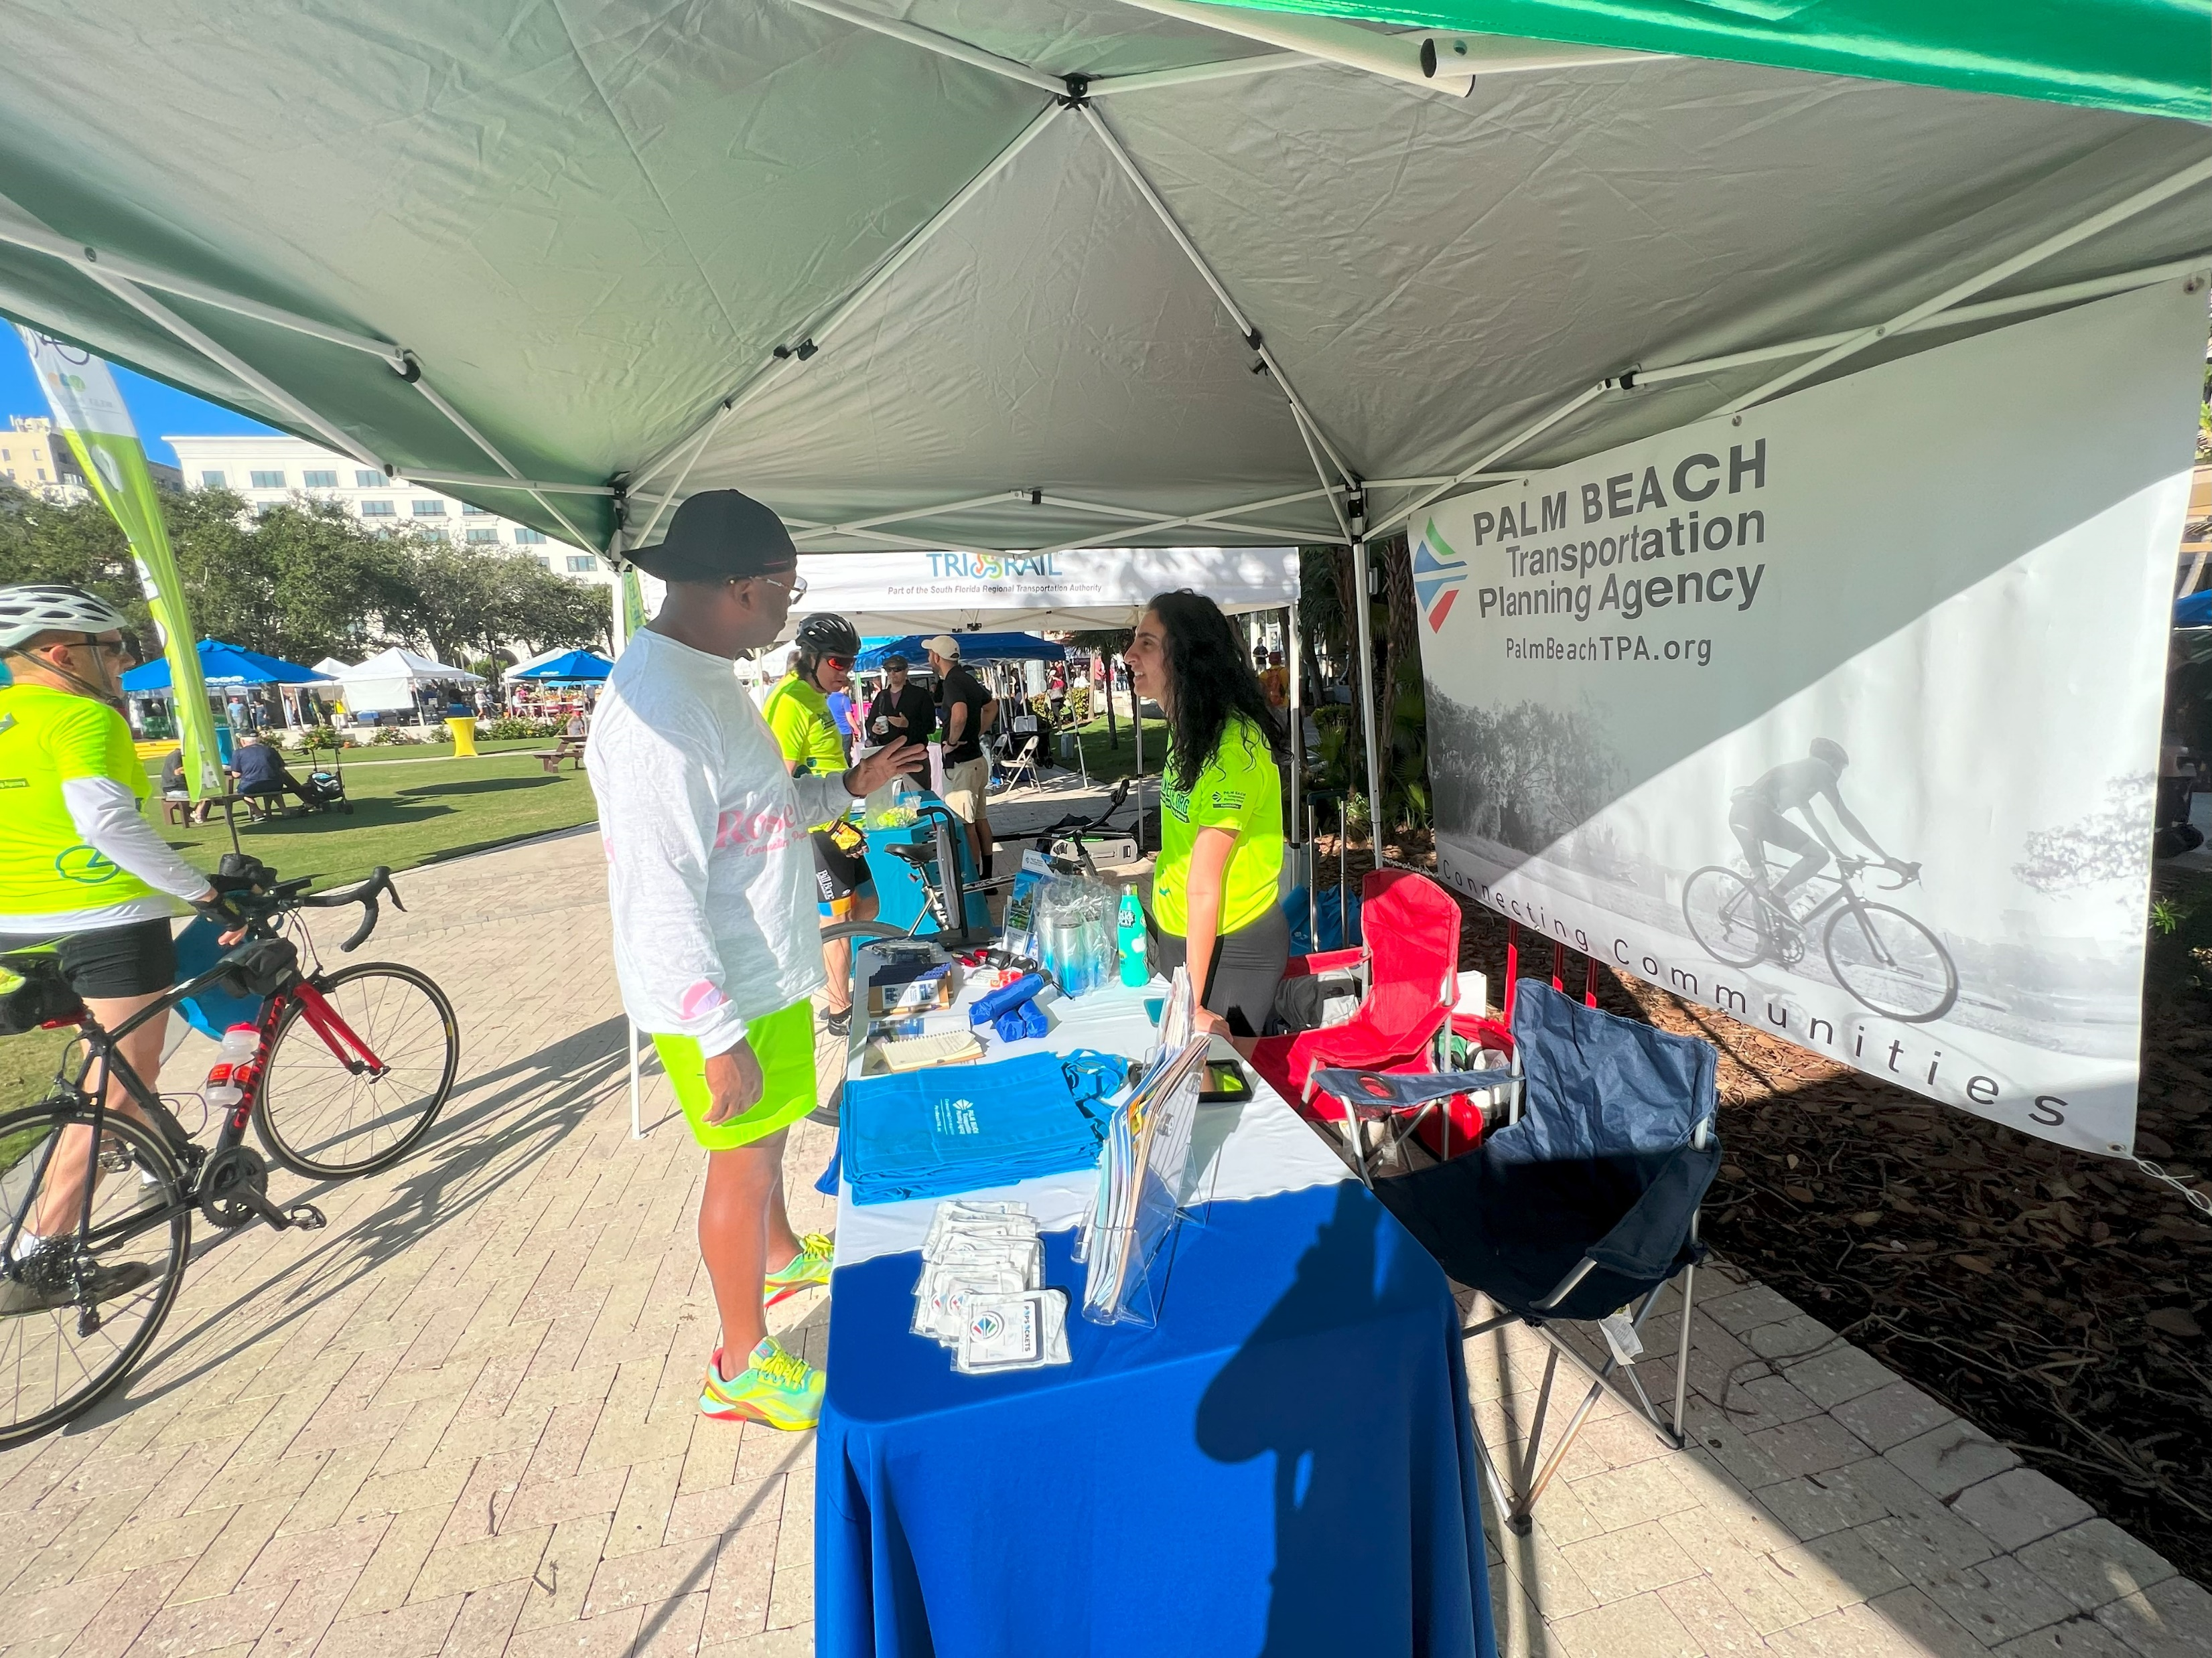
TPA Q4 2022 Reporting
Notes:
To track the progress made since updating the TPA’s 2021 Vision Zero Action Plan, the following actions/activities were applied during the fourth quarter to help reach our Vision Zero goal:
The TPA supported the adoption of a Vision Zero resolution for the City of Boca Raton

Slide 6
2022 Pedestrian and Bicycle Crash Analysis Summary

Slide 7
2022 Pedestrian and Bicycle Summary Crashes
Notes:
Q1 had the highest number of crashes on arterial roads with 37 crashes for both pedestrians and bicyclists.
51% of the crashes were in the Palm Beach TPA’s High Injury Network
The corridors on the HIN were selected based on the roads with the most fatal and serious injuries. The TPA’s HIN has 20 identified intersections and approximately 50 corridors
Also say what is an arterial road and an example

Slide 8
5-Year Summary Crashes
Traffic Fatalities in PBC are increasing…..
2018
2019
2020
2021
2022
55
43
46
48
42
14
6
13
8
5
159
135
130
150
127
Notes:
2022 had the highest number of combined pedestrian and bicycle fatalities over the course of 5 years
28% increase over 5 years for ped fatalities
Distracted driving had the highest number of crashes in 2022
There was a 46% increase in pedestrian and bicycle deaths since 2018

Slide 9
Questions?
Valentina Facuse, TPA Ped-Bike Coordinator
Vfacuse@PalmBeachTPA.org
Notes:
Notes:
Signal Four Analytics is an interactive web-based platform from the FDOT, which is maintained by the University of Florida GeoPlan Center in partnership with the Traffic Records Coordinating Committee (TRCC). The TRCC manages federal funds and aims to improve traffic information systems in the state. Access to the Signal Four Dashboard is open to the public, and its downloading capabilities to government agencies.
FDOT has a program to review all fatalities that occur on the State Highway System anywhere in the 5-county District, called the Highway Safety Improvement Program (HSIP).

