Slide 1
Pedestrian & Bicycle Quarterly Crash Analysis
April 1 – June 30, 2023

Slide 2
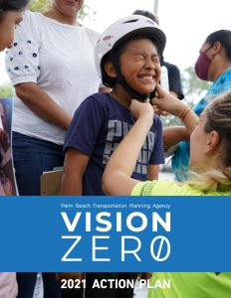
Why Quarterly Reviews of Ped/Bike Crashes?
Implements TPA Vision Zero Action Plan
Quarterly review promotes discussion and urgency
Accumulated data reveals trends and countermeasures
Notes:
to serve as a refresher to everyone, we provide these quarterly reviews to implement our Vision Zero Action Plan to reach our main goal of zero fatalities and serious injuries.

Slide 3
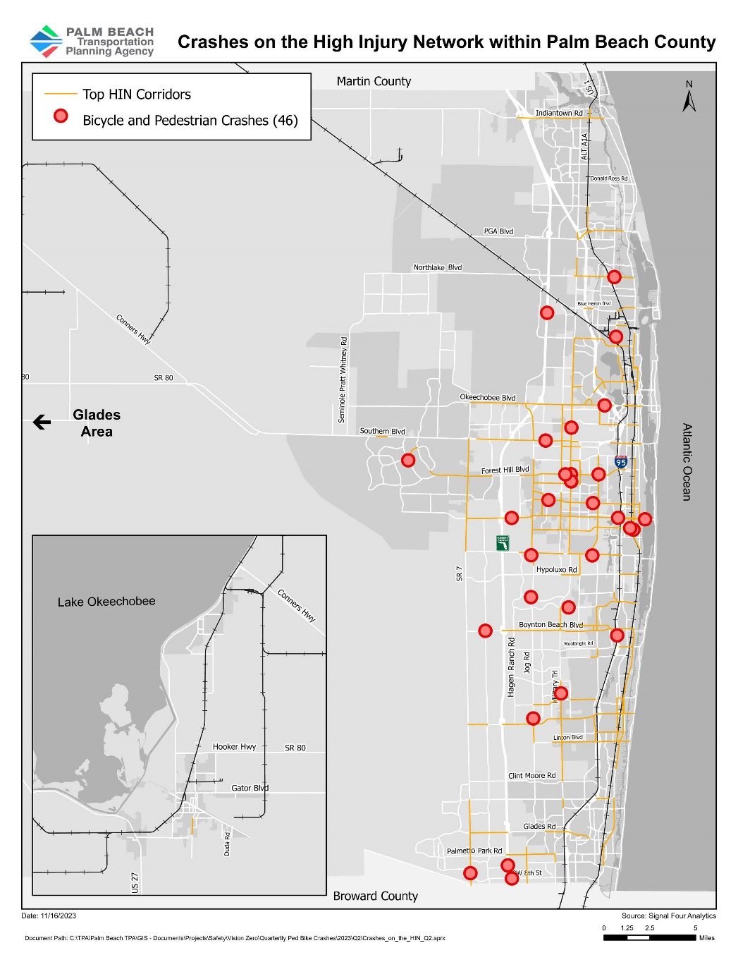
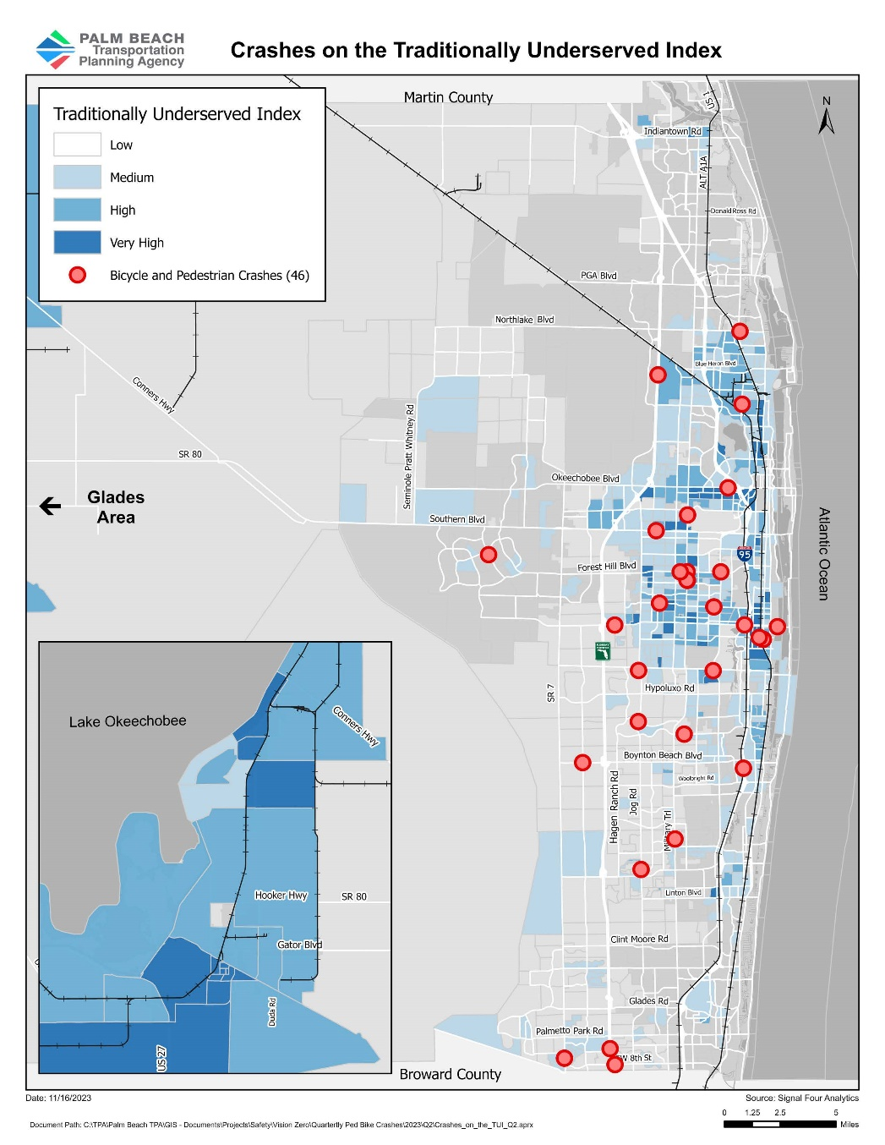
Mapping Crashes
Notes:
While performing the analysis for Q2, we found that
Q2 had a decrease of 23 crashes from Q1 due to the typical seasonal population decline that occurs in South Florida from residents returning to other regions. Nevertheless, 7 more crashes occurred in Q2 in 2023 than in 2022.
46% of the mapped crashes were on the Palm Beach TPAs High Injury Network. If you are not familiar with the TPA’s High Injury Network, it is a selection of corridors with the highest fatal and serious injuries.
28% of crashes occurred within the medium to very high areas of the Traditionally Underserved Index.

Slide 4
Crashes by Emphasis Area
Roadway Conditions
Human Behavior
70%
Of pedestrian
crashes occurred
midblock.
Distracted, Impaired, Speeding & Aggressive Driving
Contributed to 3 pedestrian
crashes this quarter.
Socioeconomic Conditions
63%
Of the crashes were on
roads with posted speed
limits of 35 mph or above.
Aging drivers continues as
the leading age
characteristic with the
most crashes (24%).
Notes:
We have 3 emphasis areas: Roadway conditions, Human Behavior, and Socioeconomic conditions.
For roadway conditions, we found that in Q2 70% of pedestrian crashes occurred midblock.

Slide 5
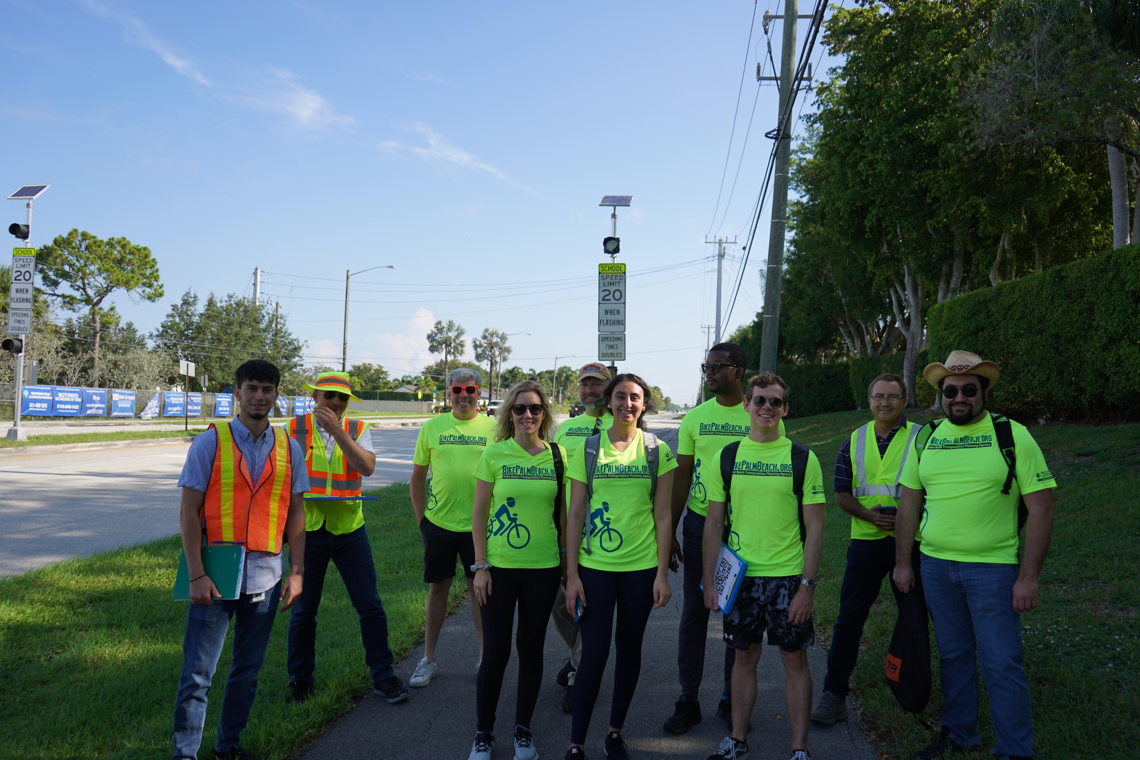
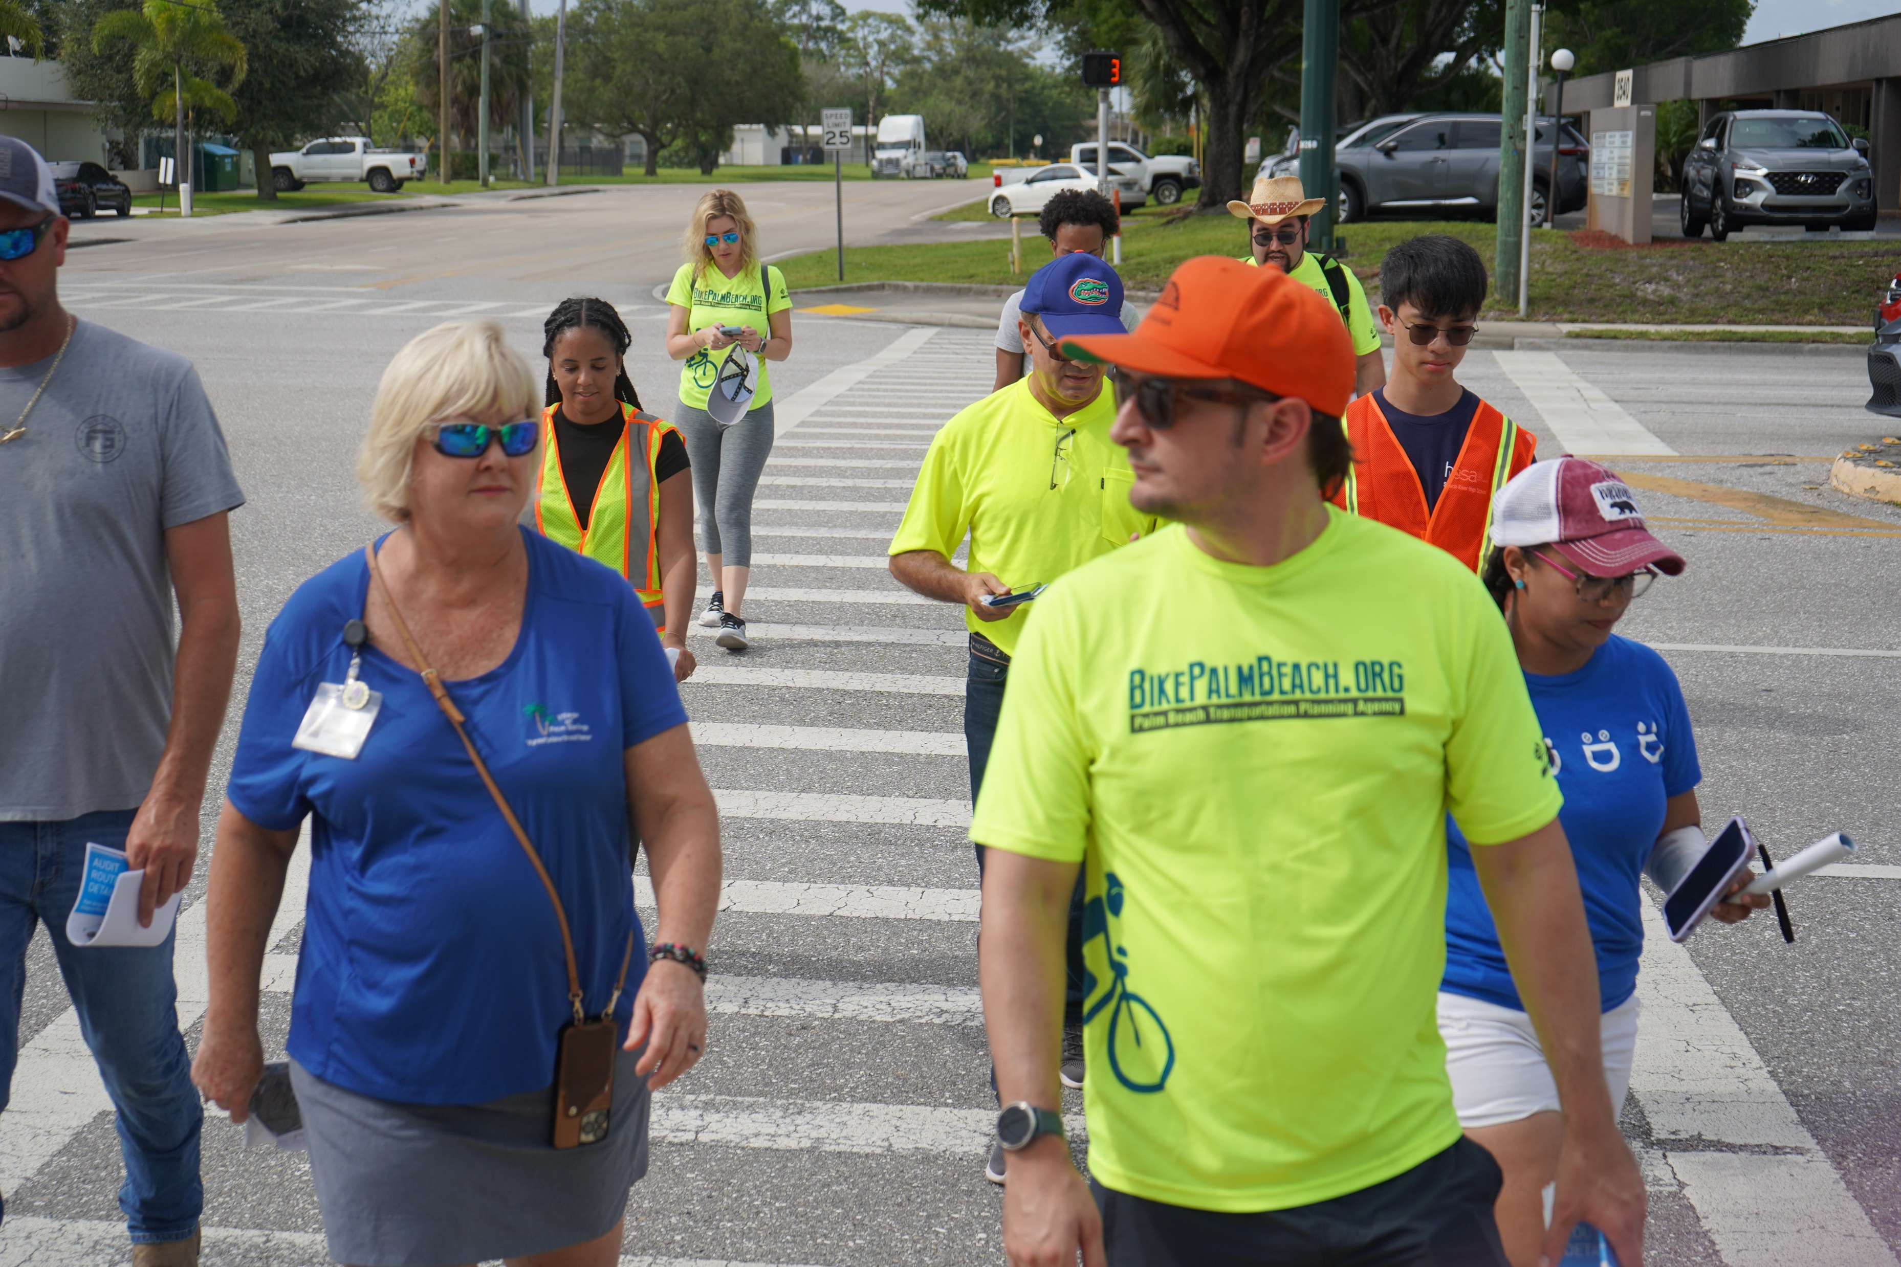
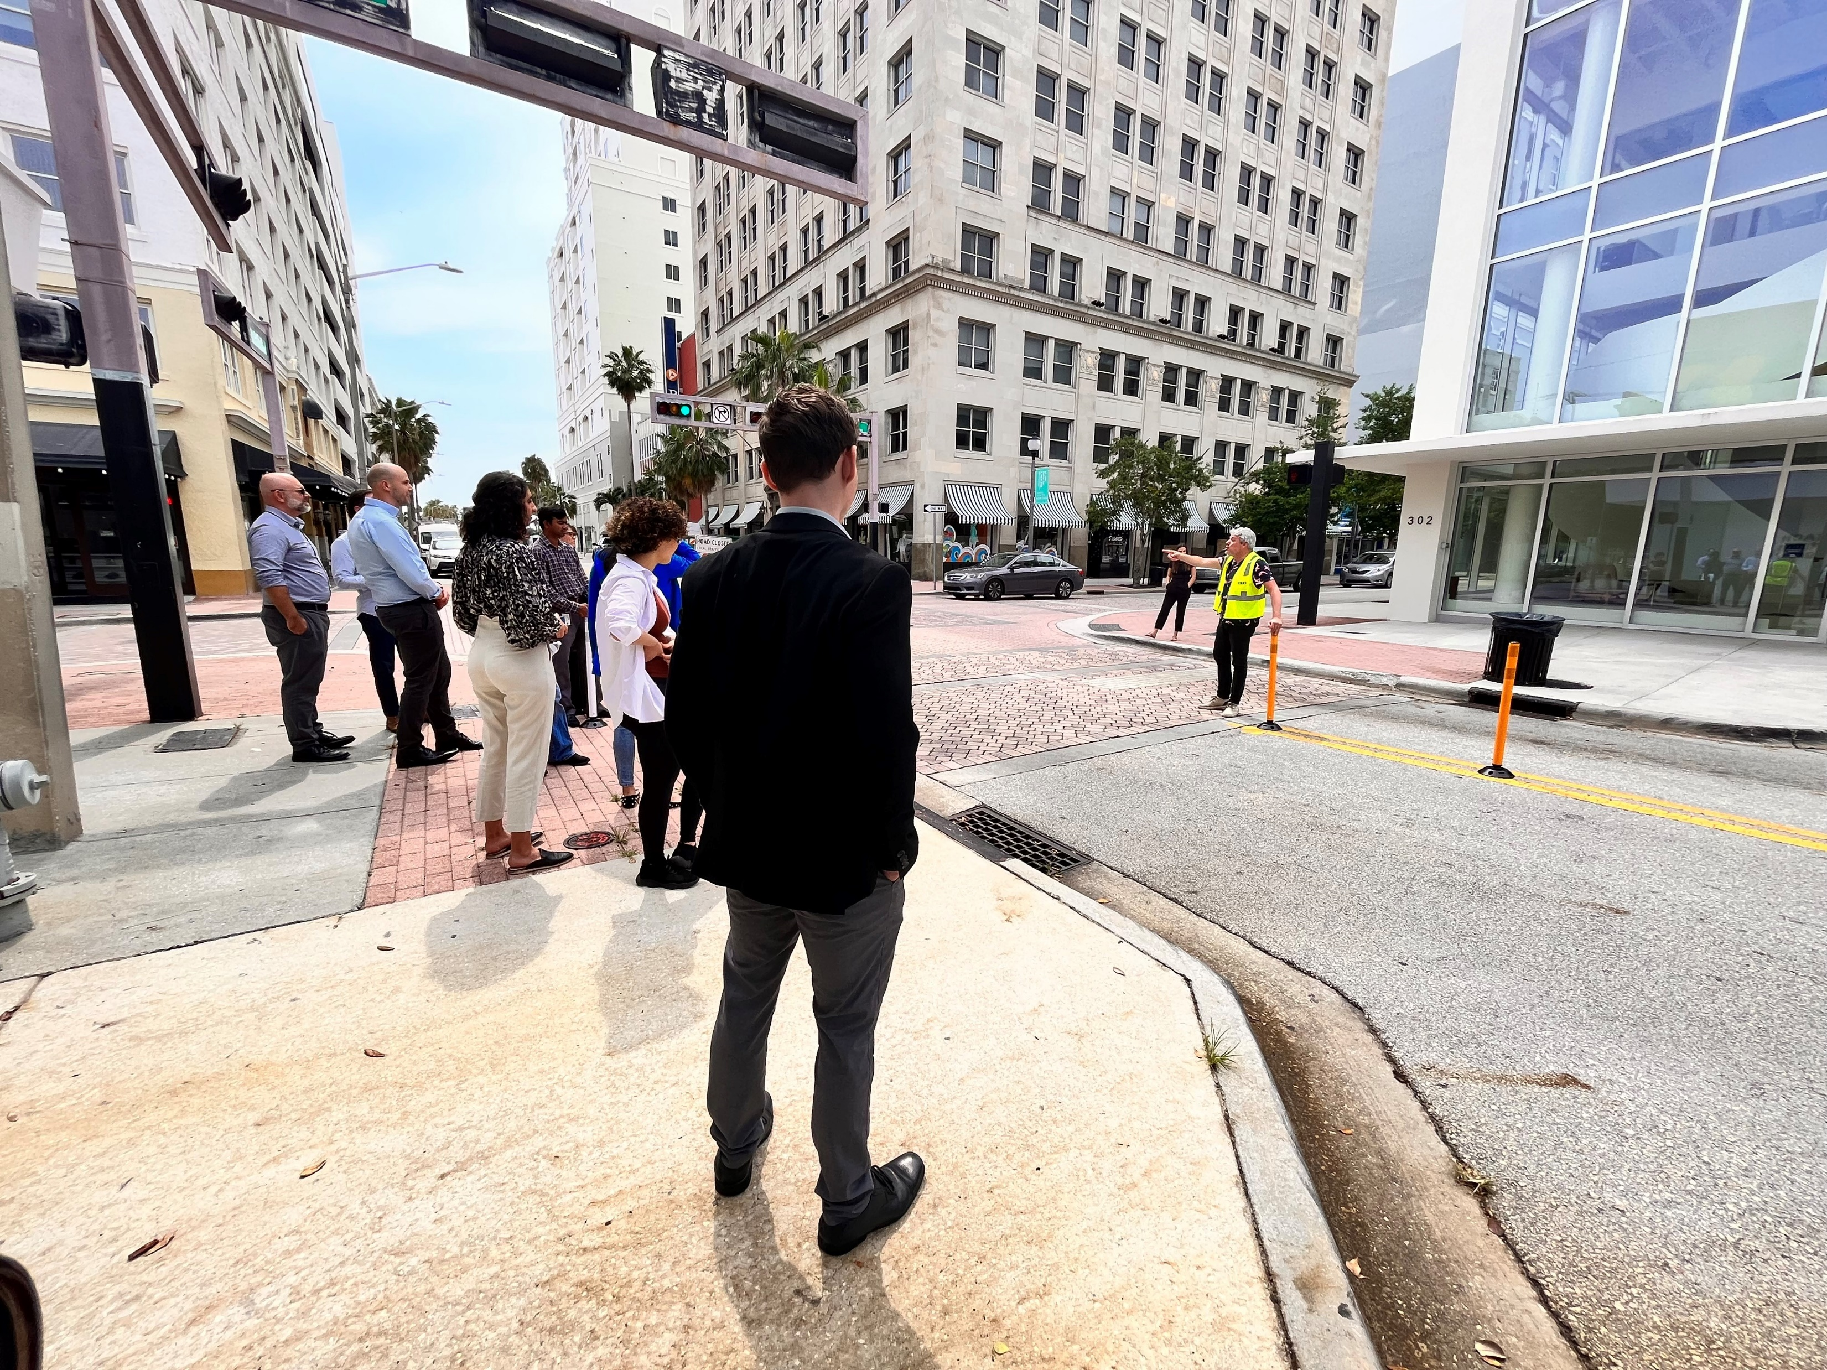
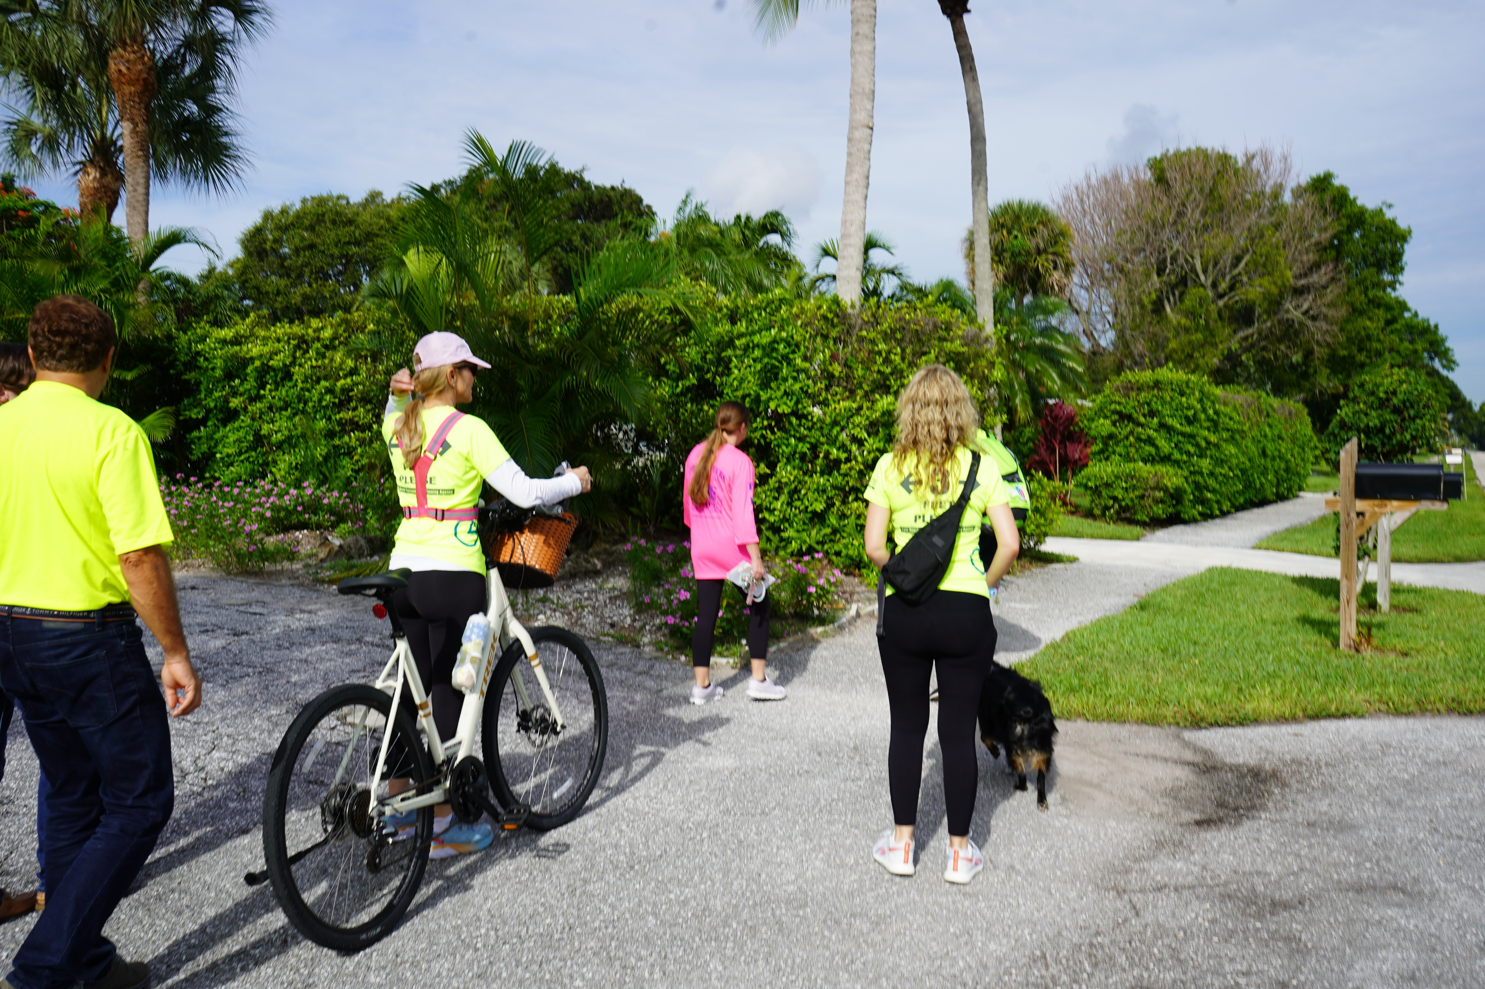
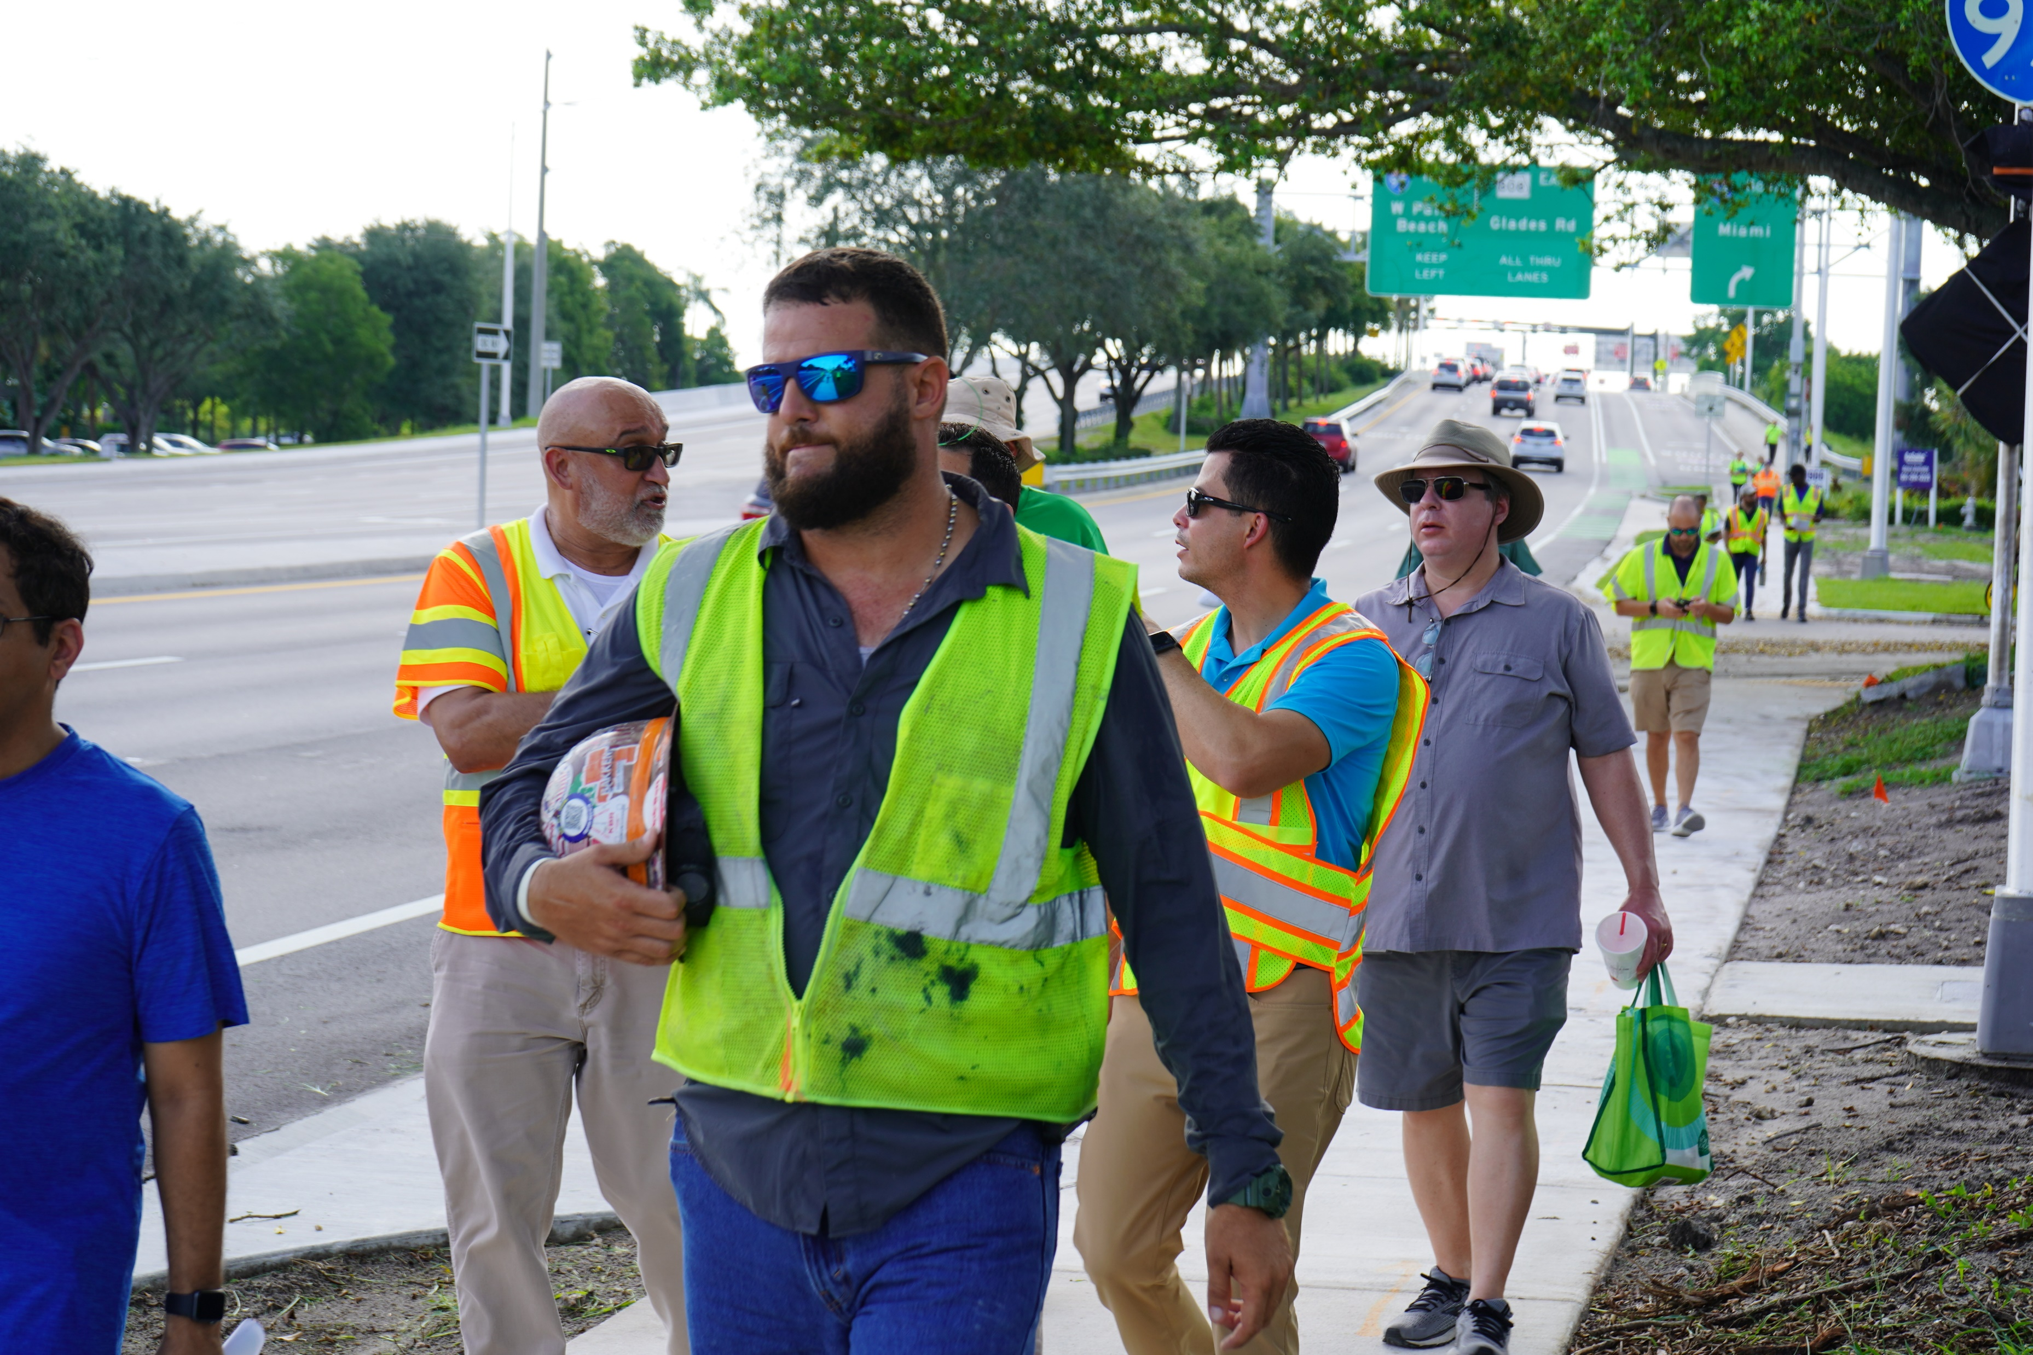
TPA Q2 2023 Reporting
Walk Bike Safety Audits
Vision Zero Workshop
Notes:
To track the progress made since updating the TPA’s 2021 Vision Zero Action Plan, the following actions/activities were applied during the second quarter to help reach our Vision Zero goal:
Walk Bike Safety Audits at:
Whispering Pines Elementary School
Palm Springs Middle School
Dwight D. Einsenhower Elementary School
Glades Rd DDI

Slide 6
Questions?
Notes:
Notes:
Signal Four Analytics is an interactive web-based platform from the FDOT, which is maintained by the University of Florida GeoPlan Center in partnership with the Traffic Records Coordinating Committee (TRCC). The TRCC manages federal funds and aims to improve traffic information systems in the state. Access to the Signal Four Dashboard is open to the public, and its downloading capabilities to government agencies.
FDOT has a program to review all fatalities that occur on the State Highway System anywhere in the 5-county District, called the Highway Safety Improvement Program (HSIP).

