Slide 1
Draft Goals & Objectives
June Committees 2023

Slide 2
Vision 2050 Timeline
WE ARE HERE
Goals & Objectives | Needs Assessment & Project Evaluation | Modeling & Scenario Planning | Plan Review & Adoption
Spring 2023 | Winter 2023 | Spring 2024 | Dec. 2024

Slide 3
Why Goals & Objectives
Performance-Based Planning is Required by Federal Transportation Legislation
Demonstrate Consistency with Federal Planning Factors and Florida Transportation Plan (FTP)

Slide 4
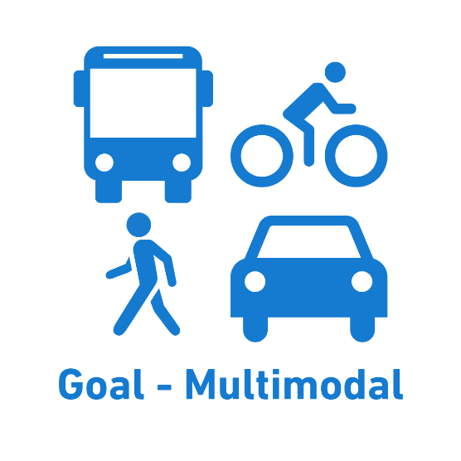
TPA’s Vision Driven Goals
To Collaboratively Plan, Prioritize, and Fund the Transportation System for Palm Beach County
A Safe, Efficient, and Connected Multimodal Transportation System

Slide 5
Goals & Objectives Hierarchy
Goal
Desired outcome
Objective
What are we doing?
Strategy
How are we doing it?
Measures
How will we evaluate progress?

Slide 6
An Example: Multimodal
Objective (M.1)
Develop a transportation system that improves regional accessibility and mobility for all users, including the movement of goods
Strategies
Address the unique needs of the elder population, people with disabilities, and those unable to drive.
Identify and prioritize projects that increase commuter mode split for walking, bicycling, and transit
Bolster provision of mobility service options in dense activity centers and active corridors
Enhance connectivity between activity centers with transit

Slide 7
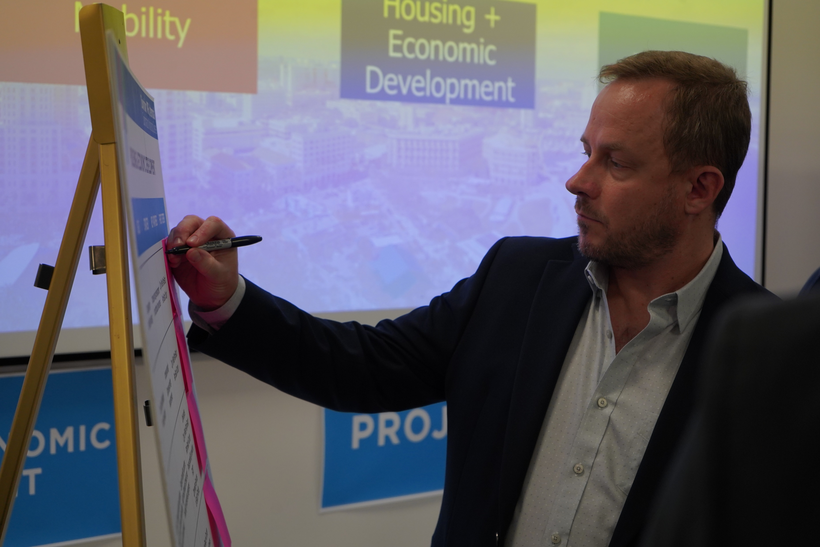
Seeking Your Feedback
A draft Goals & Objectives memo is included in the agenda backup for your review and feedback.

Slide 8
Seeking Your Feedback
Nathan George
LRTP Coordinator
(561) 725-0810
ngeorge@palmbeachtpa.org
Save the Date:
Performance Measures & Targets Workshop
August 17th, 9 AM – 11 AM

