Slide 1
2022-2023 Vision Zero Status Report Card
June 2023

Slide 2
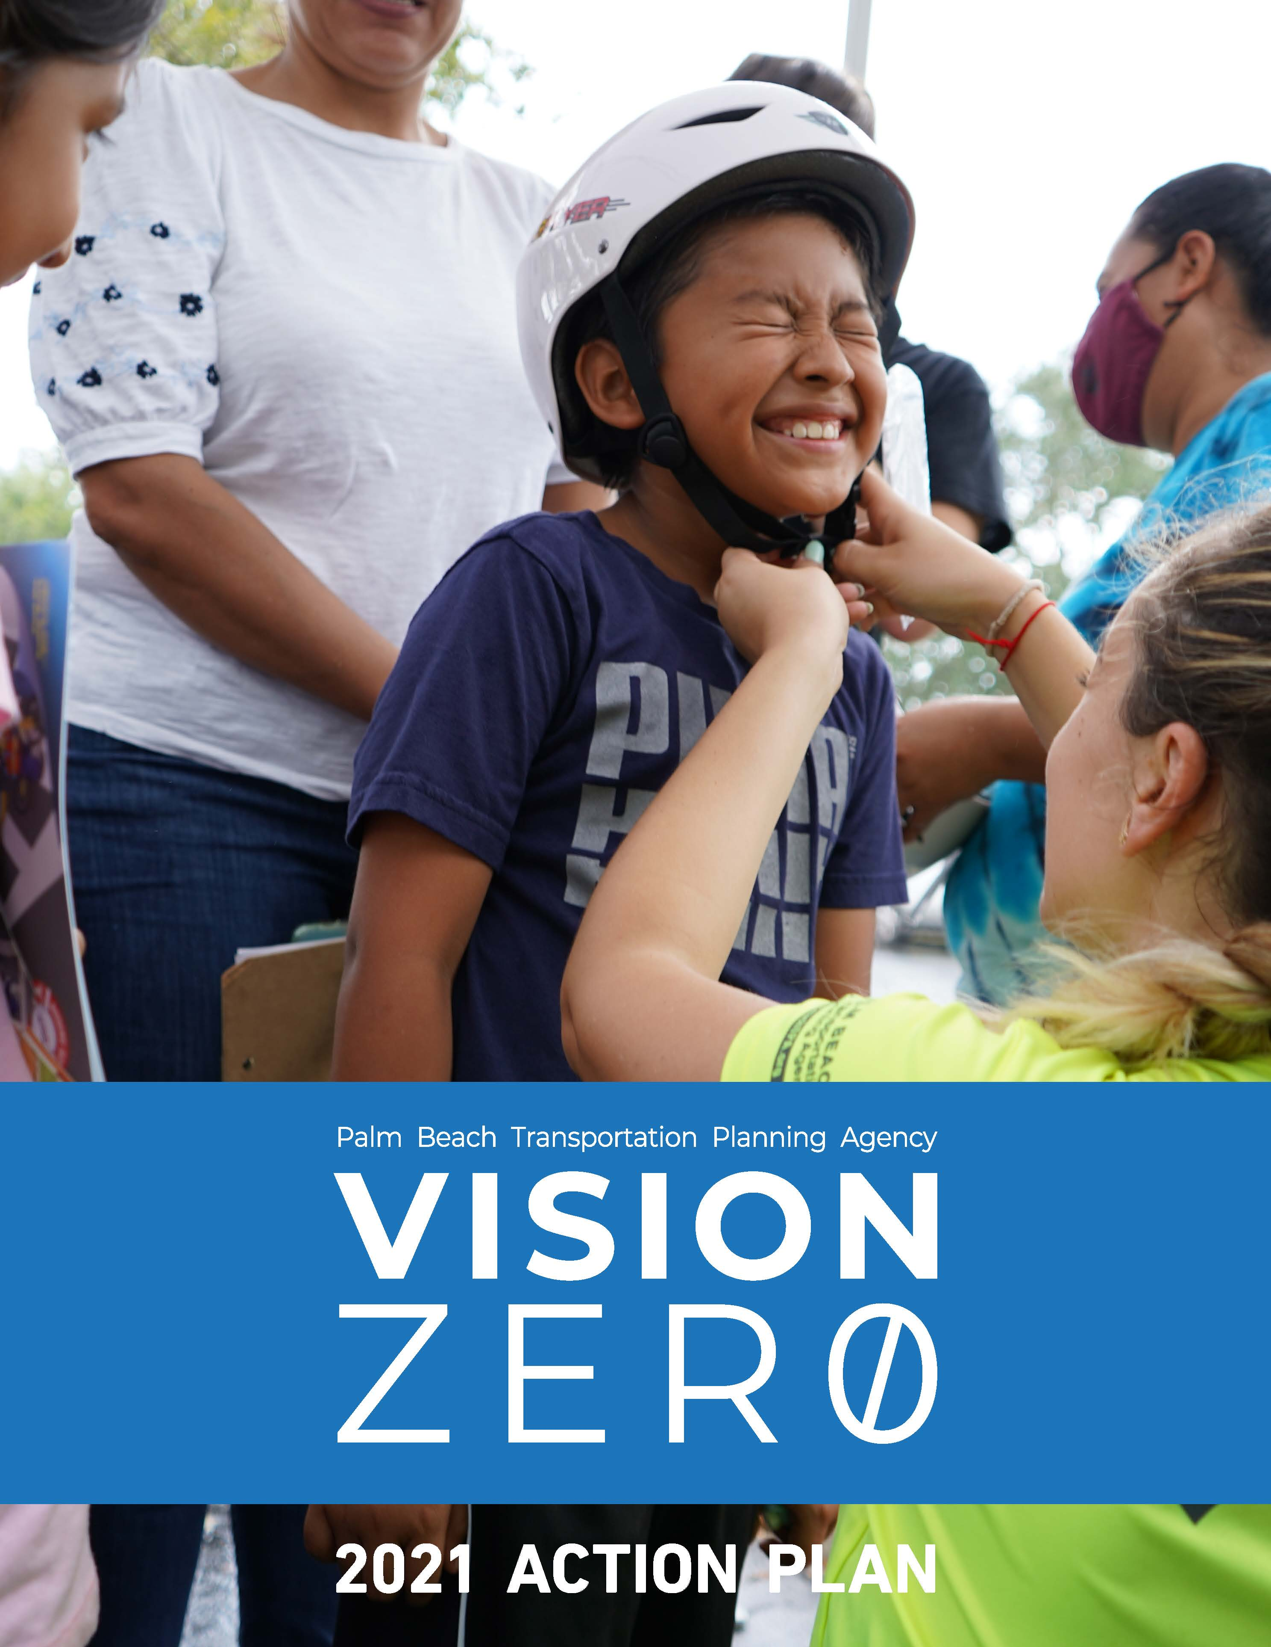
Vision Zero Action Plan Overview
Adopted April 18, 2019
Updated October 16, 2021
Eliminate fatal and serious injuries
3 strategies to implement

Slide 3

Policy Related Actions
Produce a Vision Zero Report
Safety changes in TPA legislation and policy positions
Target speed for high crash corridors
Display safety analysis for TIP projects
Met
Work with school district to update transportation curriculum
In Process
Notes:
The TPA actively participates in the creation of the policy positions of the Florida Metropolitan Planning Organizations Advisory Council (MPOAC).
The majority of these actions are in process and scope of work will continue into FY 24.

Slide 4

Funding Related Actions
Work with signal maintaining agencies for safety improvements
Evaluate TPA-funded projects
Met
In Process
Notes:
PBC applied for LI grants to fund signal upgrades as well as the City of Boca Raton applied for a TA grant to fund pedestrian and bicycle signal improvements at the NW 6th Way and Spanish River Blvd intersection.
Staff is working on an interactive dashboard to display the status of TPA priority projects.

Slide 5
Cultural Related Actions
Provide reviews of fatal pedestrian and bicycle crash reports
Include typical section attributes in federal-aid eligible roads
Implement Vision Zero media and public education campaign
Host annual Vision Zero workshop
Met
Host and/or participate in Vision Zero safety events
In Process

Slide 6
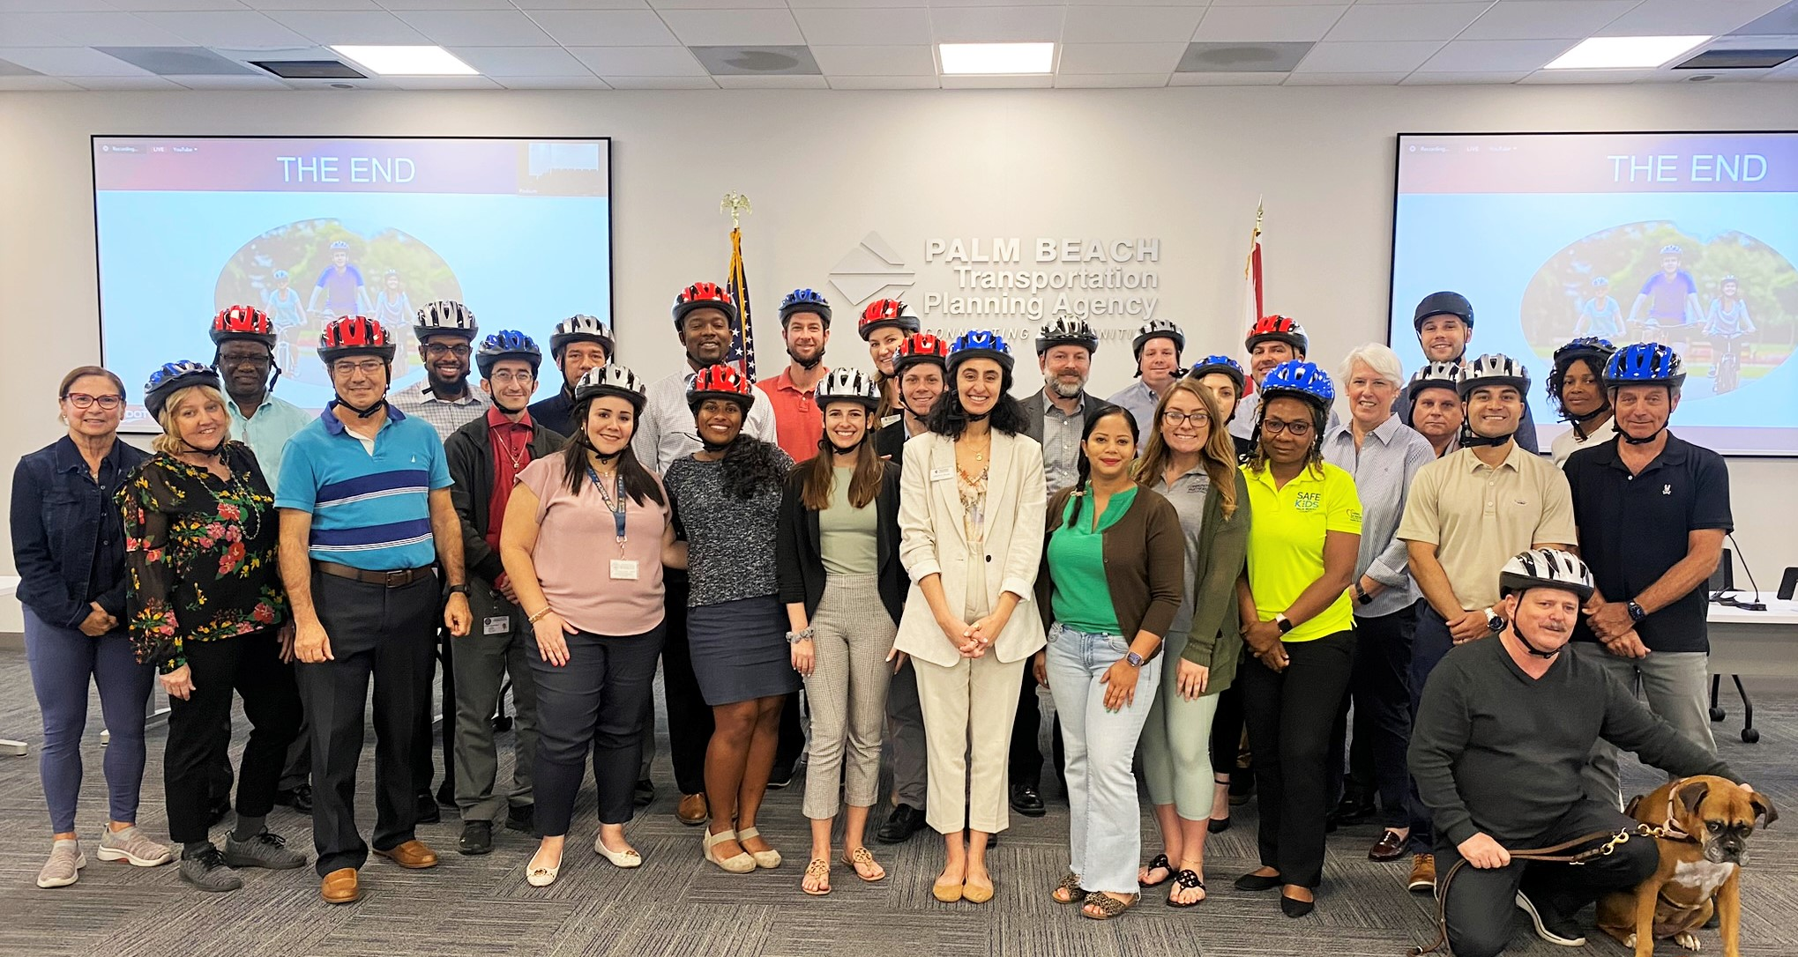
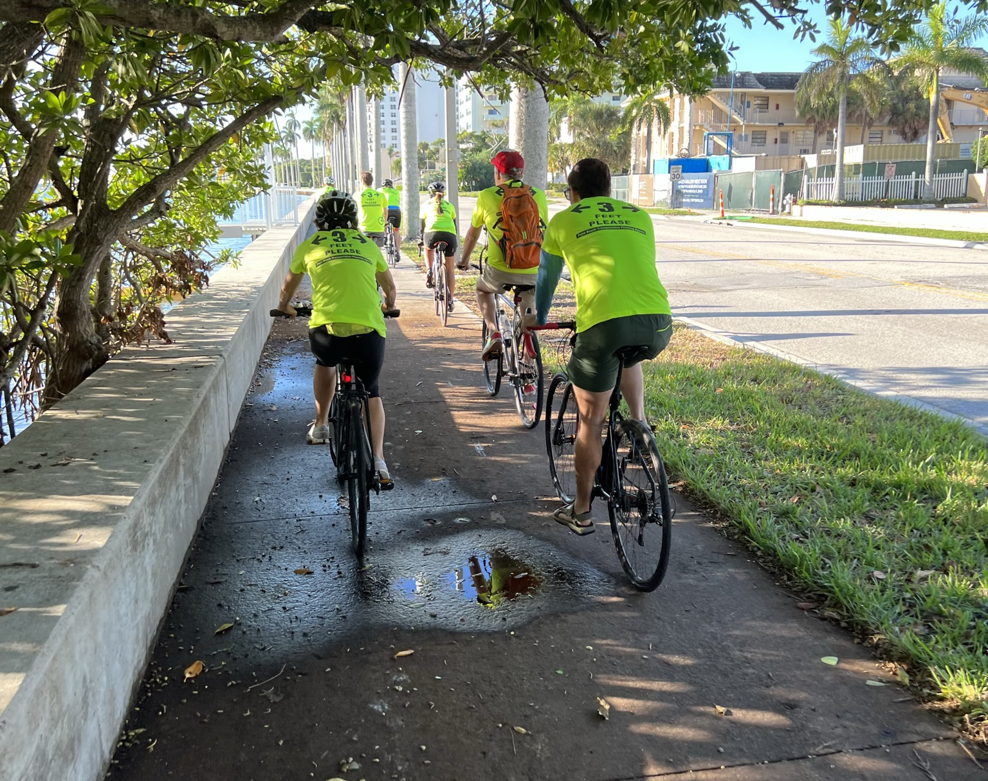
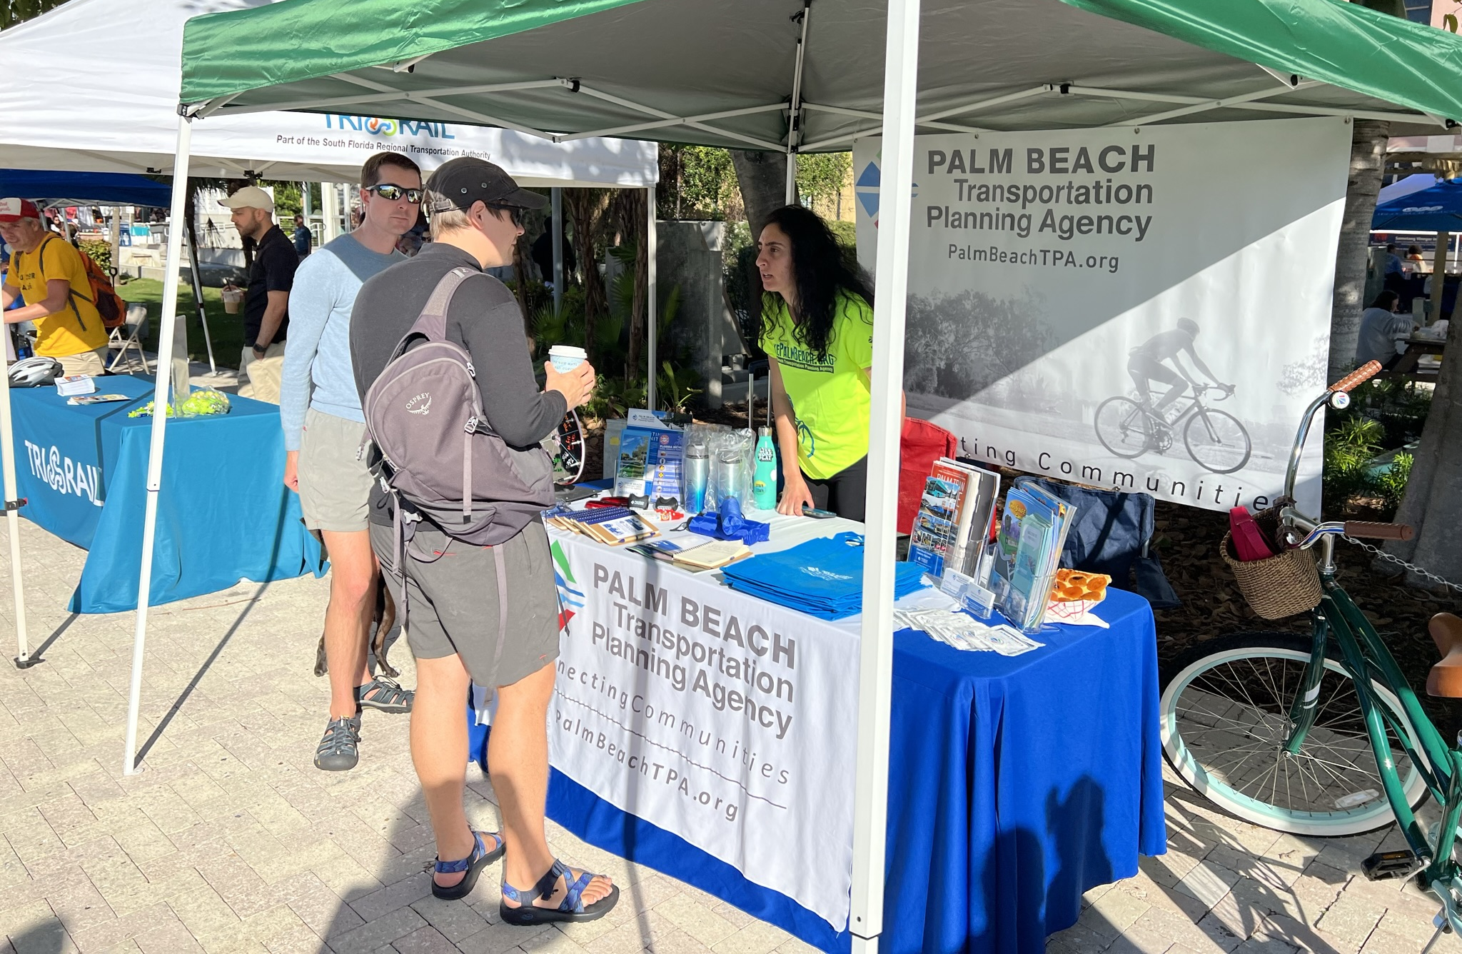
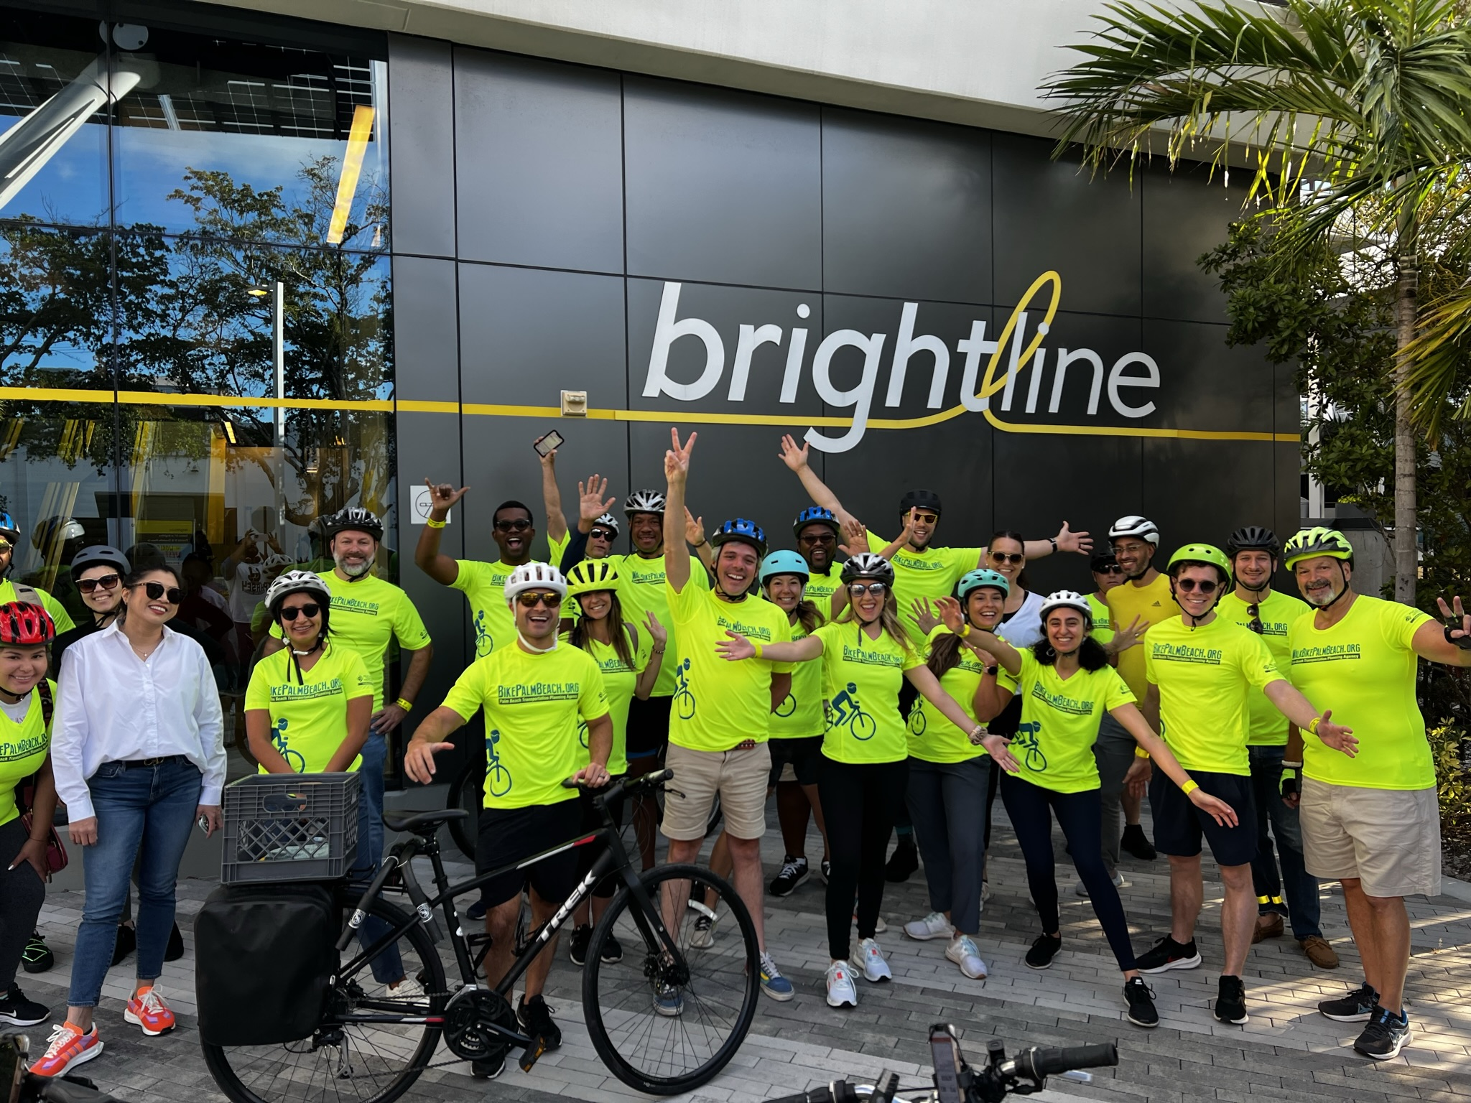
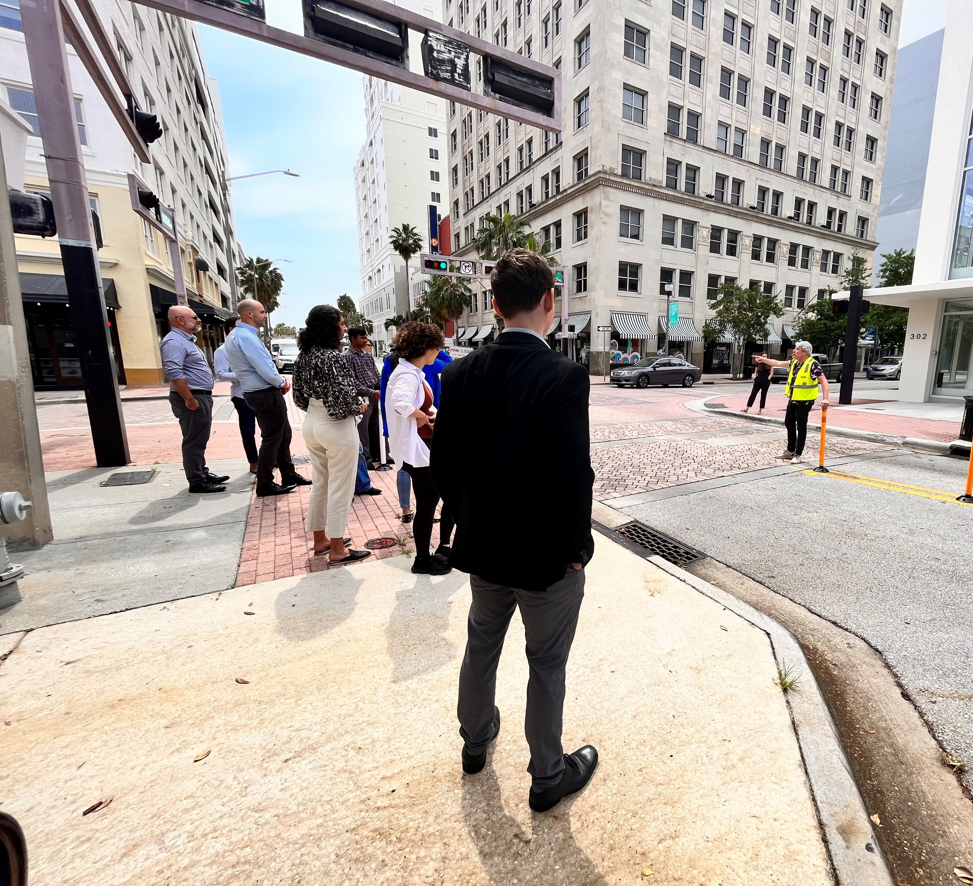
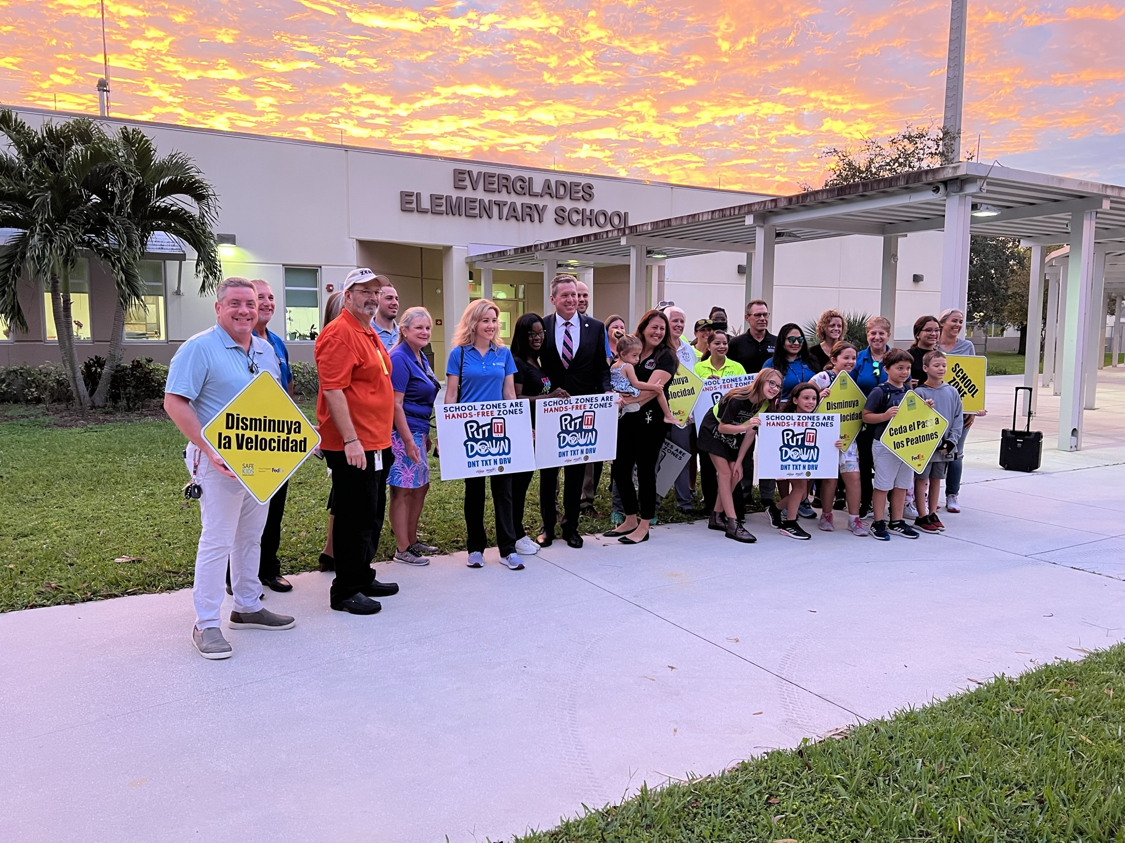
2022-2023

Slide 7
Thank you!
Valentina Facuse, TPA Ped-Bike Coordinator
Vfacuse@PalmBeachTPA.org
561-725-0806

