Slide 1
Transportation Improvement Program
Fiscal Year (FY) 2024-2028
Final Draft for July Adoption
TPA Committees

Slide 2
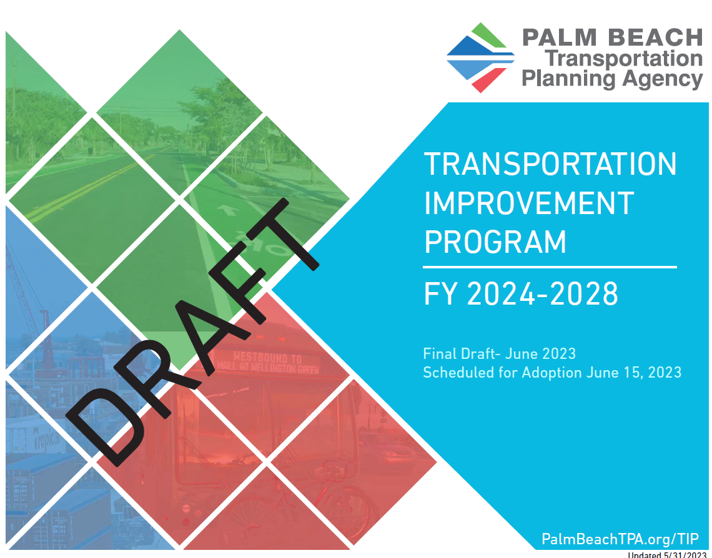
What is the Transportation Improvement Program?
List of projects by phase and funding for the next 5 years
24
25
26
27
28
Notes:
Spending authority in the first year

Slide 3
TIP Development Process
Project
Development
List of
Priority Projects
(LOPP)
Draft Tentative
Work Program
(DTWP)
Transportation Improvement Program (TIP)
TPA Call for Project Applications:
Project Applications
Feasibility Review
New Project Rankings
Winter - Spring 2022
TPA Adopts: List of Priority Projects for New Outer Year & Provides to FDOT
State Road Modifications
Local Initiatives
Transportation Alternatives
July 2022
FDOT presents draft work program per 339.135, F.S.
December 2022
TPA builds New 5 Year TIP
Presents Draft TIP for FY 24-28 in March 2023
TPA Adopts: Final TIP for FY 24-28 in June 2023
TPA Endorses: requests changes, additions, or deletions
June 2023

Slide 4
Funding Summary
$3.1 Billion Federal/State funding
in Palm Beach County

Slide 5
LRTP Priorities Summary
Project Category | LRTP 2045 Cost Feasible Plan | Fiscal Year 24-28 TIP |  |  | TPA Priorities Not Committed yet in TIP
 |  | Underway/ Complete | In TIP with CST Phase | In TIP w/o CST Phase
Strategic Intermodal System (SIS) (project line items in LRTP) | 45 | 11 | 14 | 7 | 13
TPA Major Priority Projects (project line items in LRTP with CST) | 17 | 4 | 7 | 4 | 3
State Road Modifications (annual submittals) | 15 prioritized | 1 | 3 | 10 | 1
Local Initiatives (annual submittals | 19 prioritized | 0 | 13 | 0 | 6
Transportation Alternatives (annual submittals) | 15 prioritized | 4 | 11 | 0 | 0

Slide 6
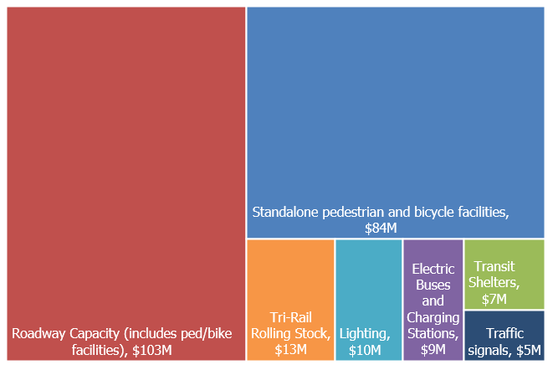
Summary of TPA Priorities
$235 M
Programmed in TIP

Slide 7
State Road Modifications (SRM)
Highlights
Yr/Rank | Project
04-1 | SR 7: 60th St to Northlake Blvd – Delayed to >FY 28
04-2 | SR-7: Okeechobee Blvd to 60th St – Delayed to FY 28
14-3 | Atlantic Ave: SR-7 to Lyons Rd – on schedule for FY 24
16-1 | Atlantic Ave: Lyons Rd to Turnpike – on schedule for FY 27 Atlantic Ave: Turnpike to Jog Rd – construction still outside work program
18-1c | Okeechobee Blvd: SR-7 to US-1 – FDOT feasibility study in FY 25
18-3 | US-27 Connector: US-27 to SR-715 – preliminary Project Development study in FY 27

Slide 8
Local Initiatives (LI)
Upcoming Projects in FY 2024
Prioritized, not programmed yet
Yr/Rank | Project/Applicant
17-1/5 | 36th St and bridge – West Palm Beach
18-6 | Germantown Rd – Delray Beach
19-1 | Electric Buses and Chargers – Palm Tran
Yr/Rank | Project/Applicant
22-1 | SW 18th Street Shared Use Path – Boca Raton
22-3 | Gardens Parkway bike lane and sidewalk – Palm Beach Gardens
22-4 | 4 Electric Buses – Palm Tran
22-5 | Barwick Rd Shared Use Path – Delray Beach
22-6 | Bus Stop Improvements – Palm Tran
22-7 | Speed Tables - ITID

Slide 9
Transportation Alternatives (TA)
Upcoming Projects in FY 2024
New projects funded for CST FY 26:
Yr/Rank | Project/Applicant
16-2 | North Shore Pedestrian Bridge– West Palm Beach
19-2 | SE 1st shared use path – Boynton Beach
20-3 | Cherry Rd path and lighting – Palm Beach County
20-4 | Bus Stops ADA connections and enhancements – Palm Tran
Yr/Rank | Project/Applicant
22-1 | Various Locations – Indian Trail Improvement District (ITID)
22-2 | Fairchild Ave – Palm Beach Gardens
22-3 | 49th St – West Palm Beach
22-4 | Various Locations – Royal Palm Beach

Slide 10
Programming and Production
23
24
25
26
27
28
>28
Current Fiscal Year
“New 5th Year”
Draft Transportation
Improvement Program (TIP)

Slide 11


Programming and Production
Example of Major Projects Production
Right-of-Way, Utilities
Environmental
Study
Design
Construction
23
24
25
26
27
28
>28
Current Fiscal Year
“New 5th Year”
Draft Transportation
Improvement Program (TIP)

Slide 12
Programming and Production
Transportation Alternatives
Resurfacing, Restoration, Rehabilitation
Design
Construction
23
24
25
26
27
28
>28
Current Fiscal Year
“New 5th Year”
Draft Transportation
Improvement Program (TIP)

Slide 13
TIP Project Sections
Approved
TPA Priority List
TPA PRIORITY PROJECTS
FDOT PRIORITIES AND OTHER PROJECTS
OPERATIONS AND MAINTENANCE
  Major Projects/
  State Road Modifications
  Local Initiatives Program
  Transportation Alternatives Program
  Strategic Intermodal System (SIS) Capacity
  Other FDOT & Local Projects
  Airports, Railroads and Seaport
  Major Maintenance
  O&M Roadways
  O&M Transit

Slide 14
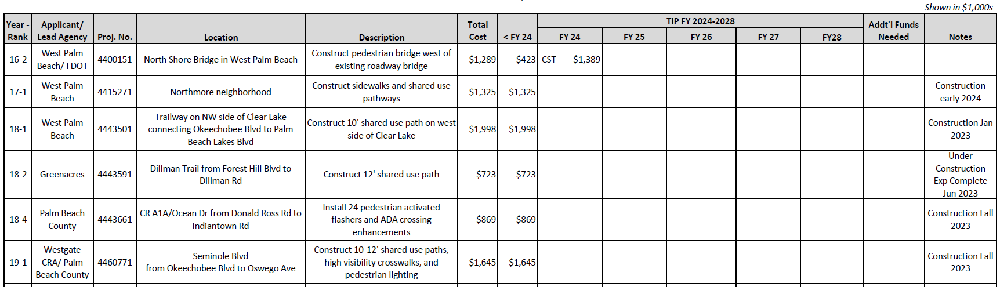
Guide to Summary Tables
Funding still
needed
New 5th Year
added to TIP
Year &
Priority
Common years
in adopted TIP

Slide 15
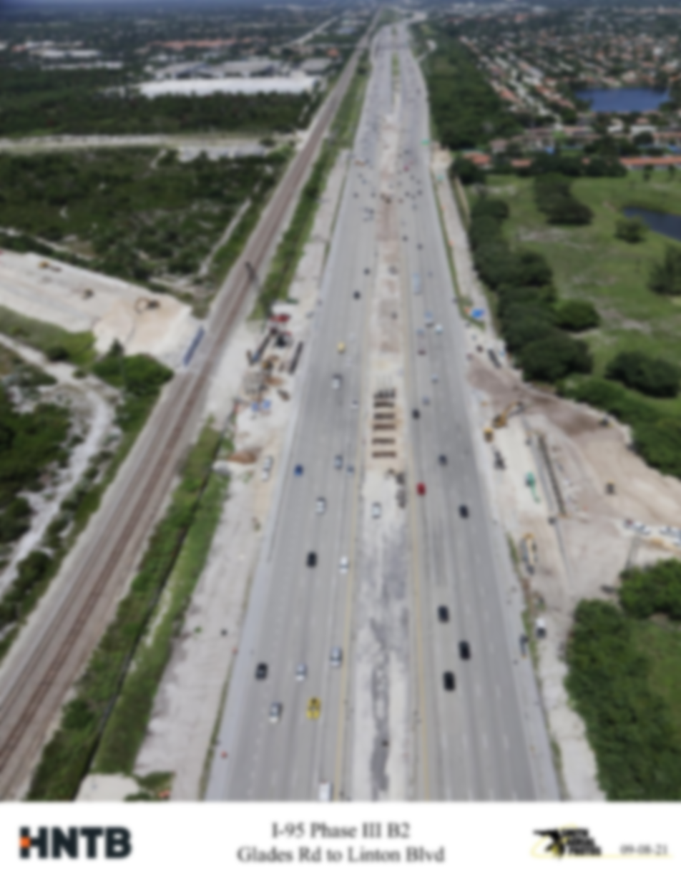
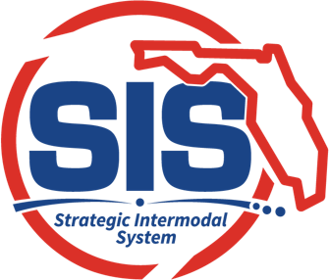
Strategic Intermodal System (SIS)
SIS Summary of Projects
Programmed: $1,488,020,385
Cost | Projects
$1,234M | Turnpike Widening Projects + 3 Interchanges
$439M | 15 I-95 Interchanges (New or Modified)

Slide 16
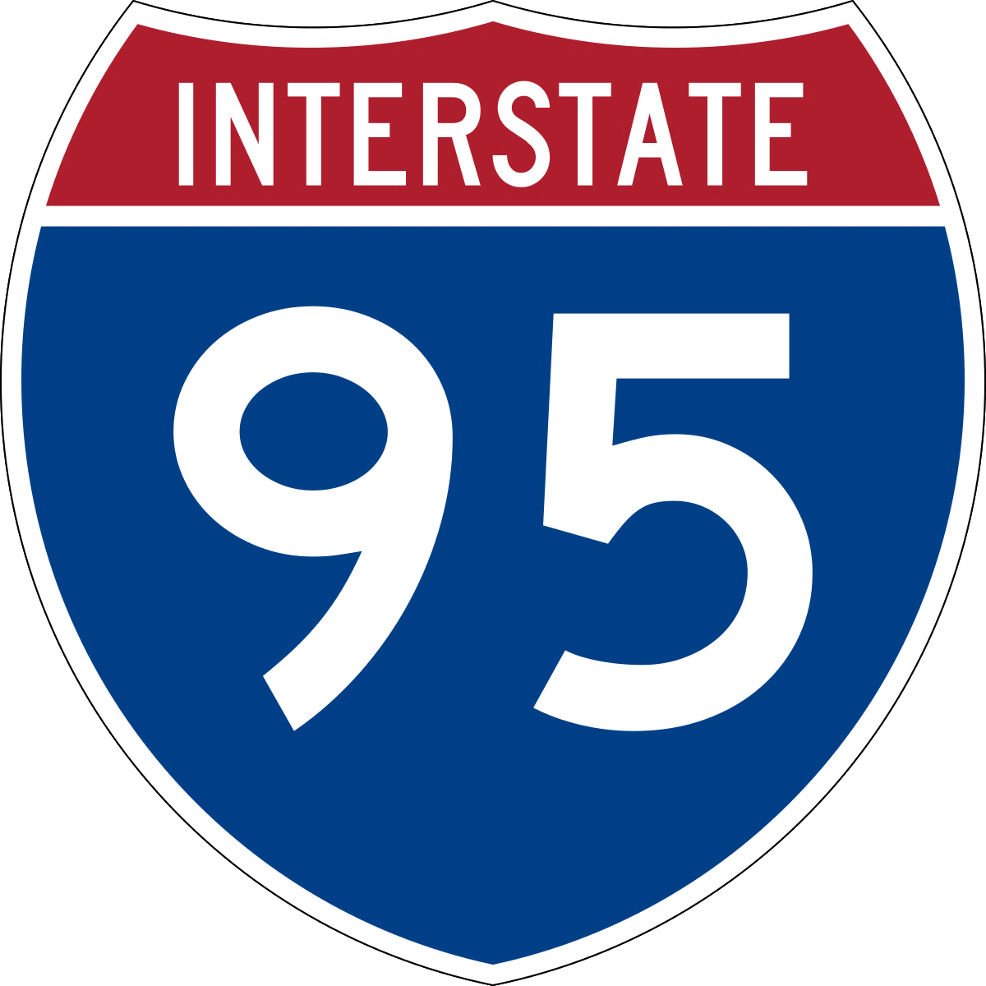
I-95 Projects
 |  |  | <24 | 24 | 25 | 26 | 27 | 28 | >28
 | Indiantown Rd to Martin County | Widen to 8L |  | Study
 | Indiantown Rd |  | CST
 | Central Blvd | New TDI | PE |  |  |  |  |  | CST
 | Northlake Blvd |  | PE |  |  | CST
 | 45th St | DDI | PE |  |  | CST
 | Palm Beach Lakes Blvd |  | PE |  |  | CST
 | Southern Blvd |  |  |  | PE |  |  |  | CST
 | Forest Hill Blvd |  | PE |  |  | CST
 | 10th Ave N | DDI | PE |  |  |  |  |  | CST
 | 6th Ave S |  | PE |  | CST
 | Lantana Rd | DDI | PE |  |  |  |  |  | CST
 | Hypoluxo Rd | DDI | PE |  |  |  | CST
 | Gateway Blvd |  | PE |  |  |  | CST
 | Boynton Beach Blvd |  | PE |  | CST
 | Woolbright Rd |  | PE |  |  |  | CST
 | Linton Blvd |  | PE |  |  |  |  | CST
North
DDI
Diverging Diamond Interchange
TDI
Tight Diamond Interchange
PE
Preliminary Engineering
CST
Construction
South

Slide 17

Turnpike Projects
North
 |  |  | <24 | 24 | 25 | 26 | 27 | 28 | >28
 | Indiantown Rd to Martin County | Widen to 8L |  |  | PE |  |  |  | CST
 | PGA Blvd to Indiantown Rd | Widen to 8L |  |  |  |  | PE |  | CST
 | Beeline Hwy to PGA Blvd | Widen to 8L |  | PE |  |  |  | CST
 | Okeechobee Blvd to Beeline Hwy | Widen to 8L |  | PE |  | CST
 | Southern Blvd to Okeechobee Blvd | Widen to 8L |  |  | CST
 | WPB Service Plaza to Southern Blvd | Widen to 8L |  | PE |  | CST
 | Boynton Beach Blvd | Ramps & Aux lanes | PE | CST
 | Hypoluxo Rd | New interchange |  |  |  | Study
 | Glades Rd | Improvements |  |  |  |  | PE |  | CST
 | N of Atlantic Ave to Boynton Beach Blvd | Ramps & Aux lanes |  |  |  |  |  | PE | CST
 | N of Glades Rd to S of Atlantic Ave | Widen to 10L |  | PE |  |  | CST
 | Broward County to N of Glades Rd | Widen to 8L | PE |  | CST
new
new
new
new
PE
Preliminary Engineering
South
CST
Construction

Slide 18
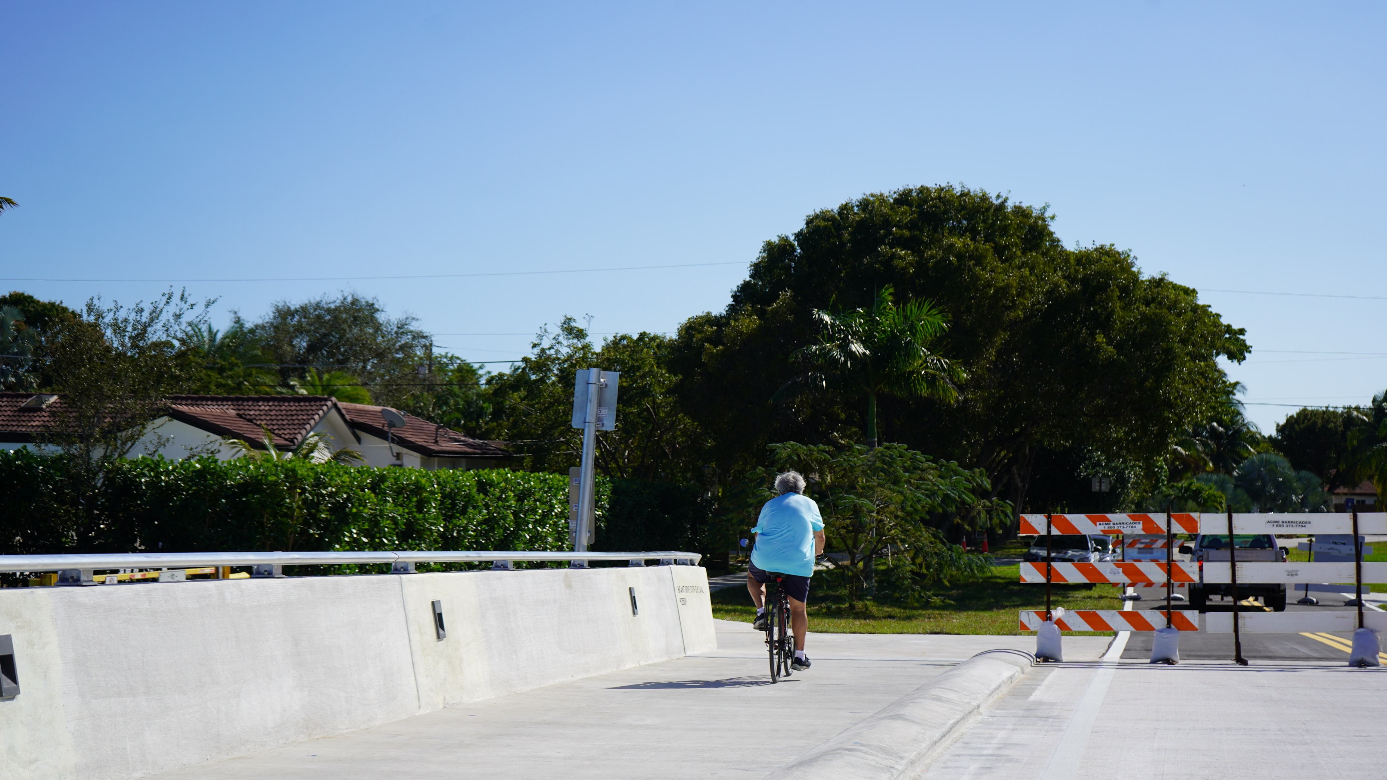
Delray Beach/Boca Raton Brant Drive Bridge 2023

Slide 19
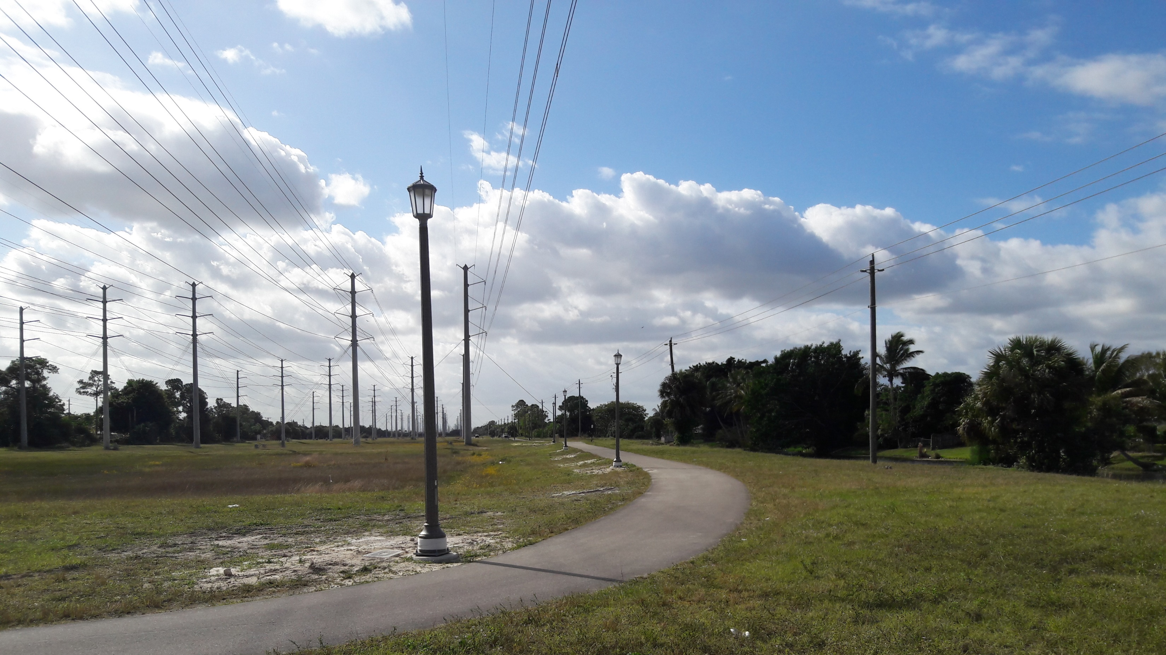
Royal Palm Beach – FPL pathway lighting 2021

Slide 20
Other New Projects
Resurfacing (FY 27)
Roadway Extension (FY 28)
  US-27 from MP 12.7 to MP 16
  Federal Hwy/SR-5 from US-1 to 10th Ave S
  SR-7 from S of SR-804/Boynton Beach Blvd to Lake Worth Rd
  Royal Palm Way from 4 Arts Plaza to S County Rd
  SR-717/E Canal St from SR-80 to SE Ave E
  Lake Worth Rd from Everett Ct to A St
  Forest Hill Blvd from east of Lake Clarke Drive to US-1
Flavor Pict Rd from Lyons Rd to Hagen Ranch
Bridge Rehab (FY 28)
  SR-706/Indiantown Rd Bridges (#930453 & 930454)
  SR-A1A/Ocean Blvd Bridge over Boca Inlet (#930060)
Resurfacing (FY 28)
  Beeline Hwy/SR-710 from west of Park Commerce Blvd to east of Aviation Blvd

Slide 21
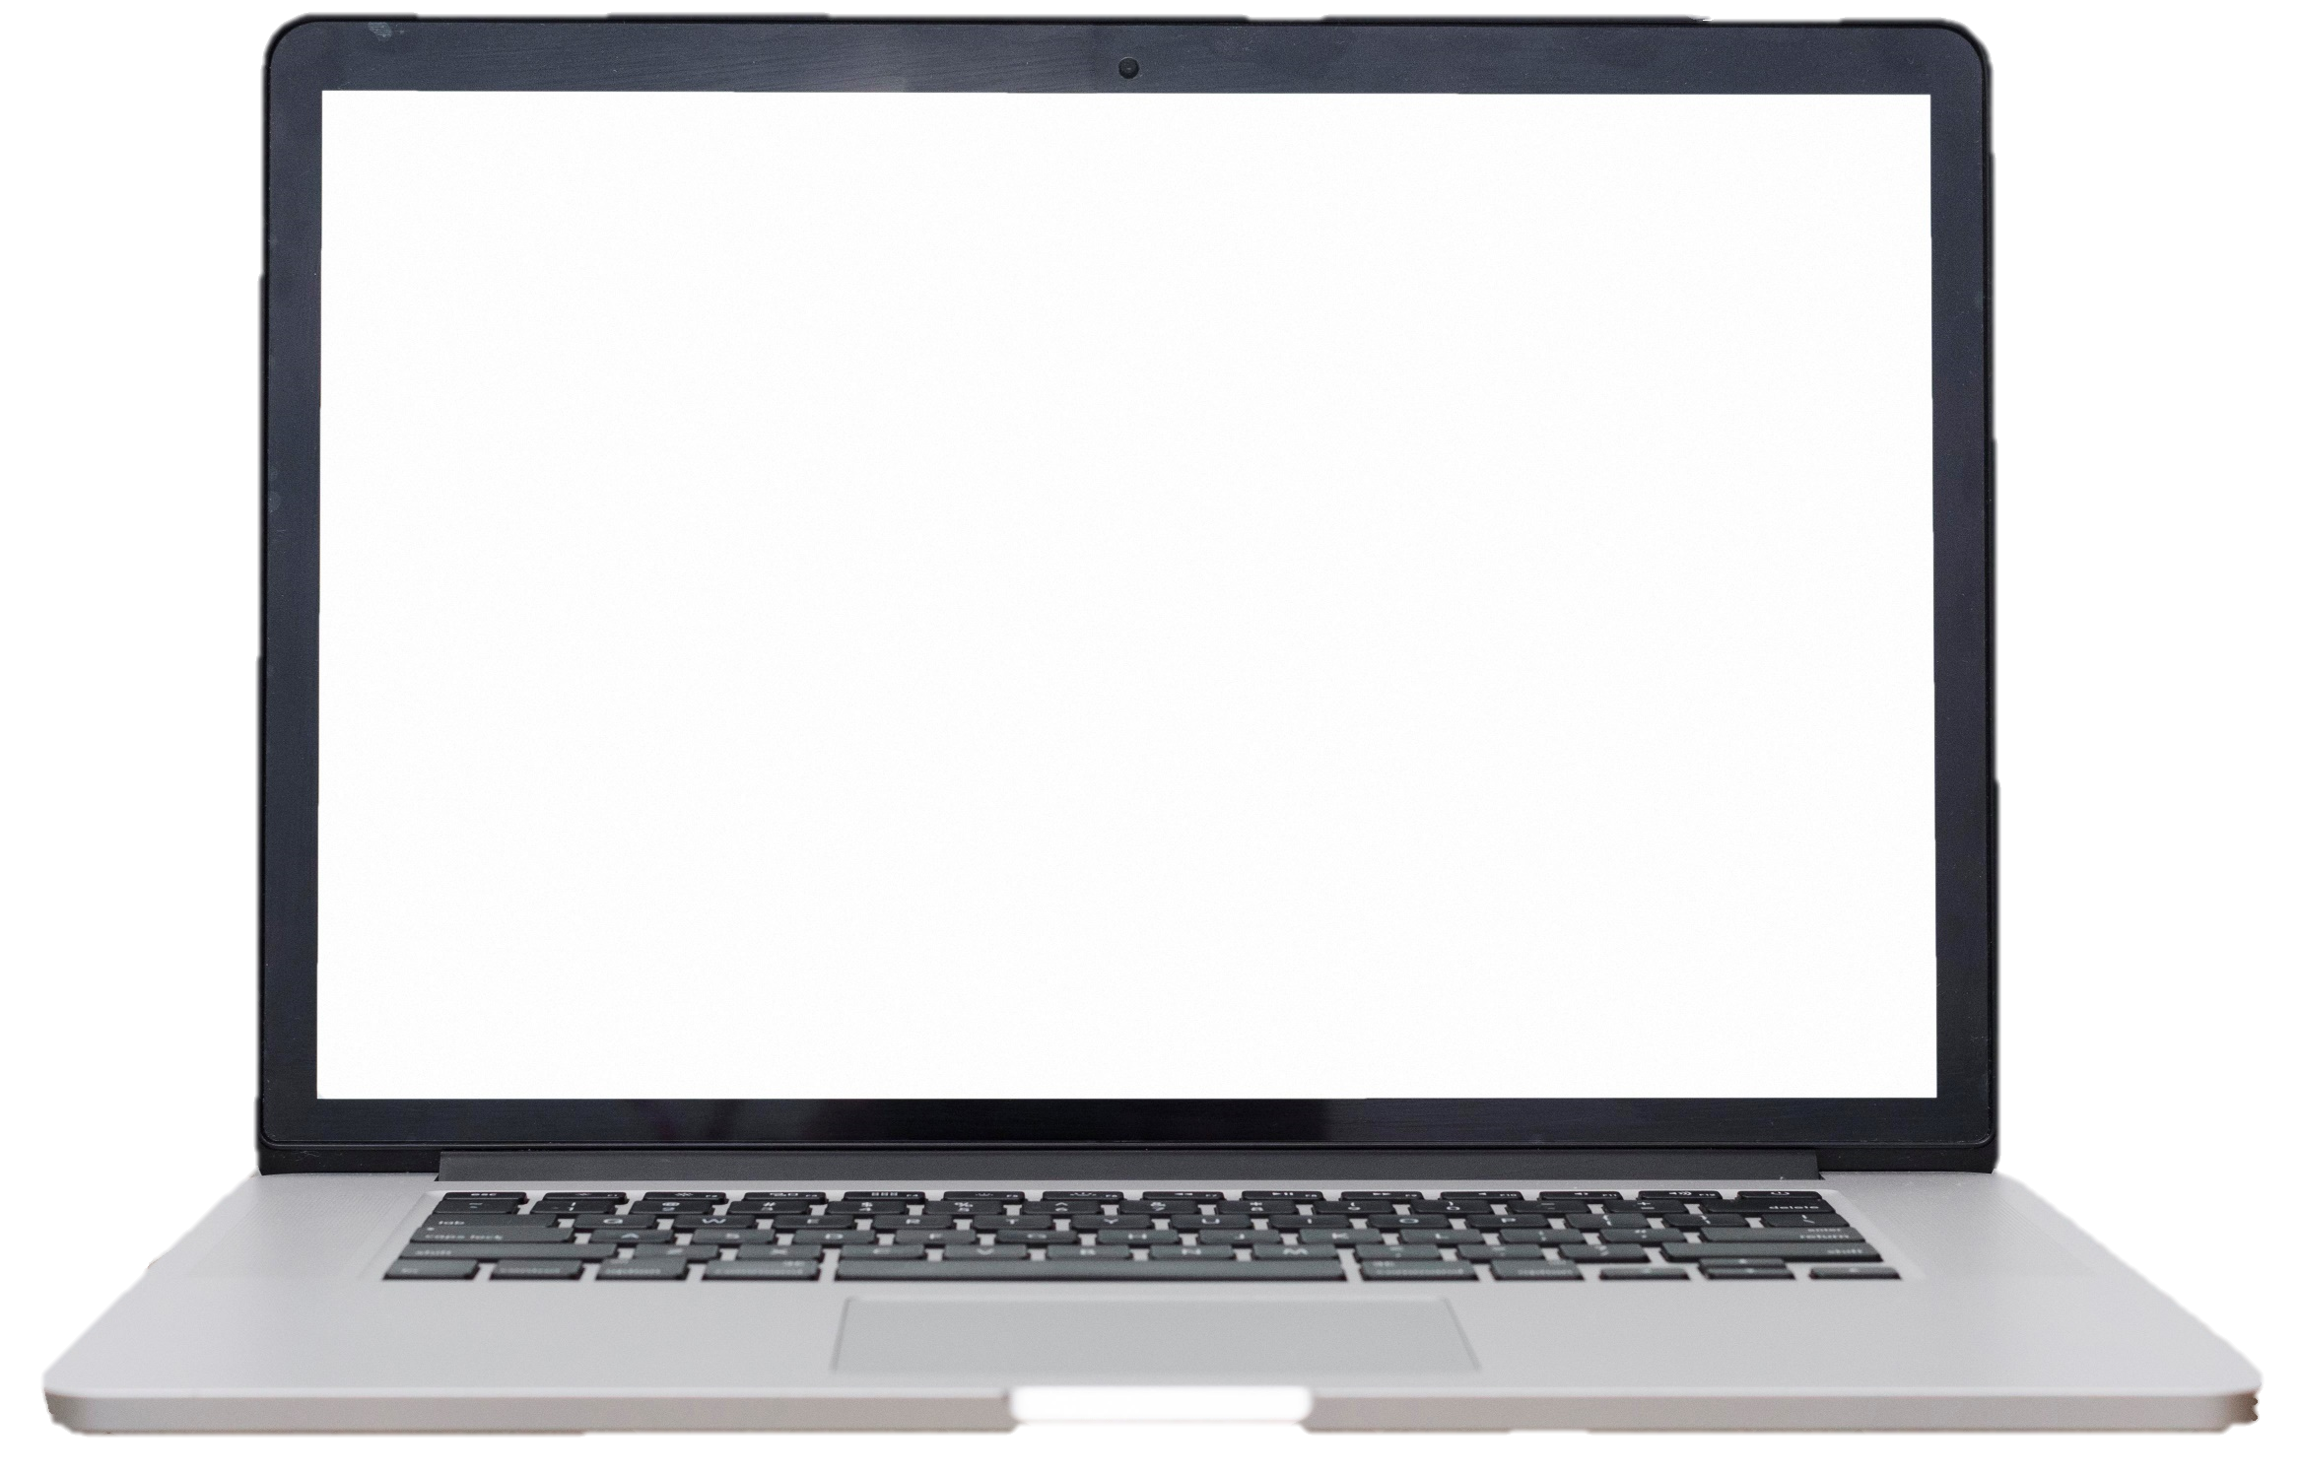
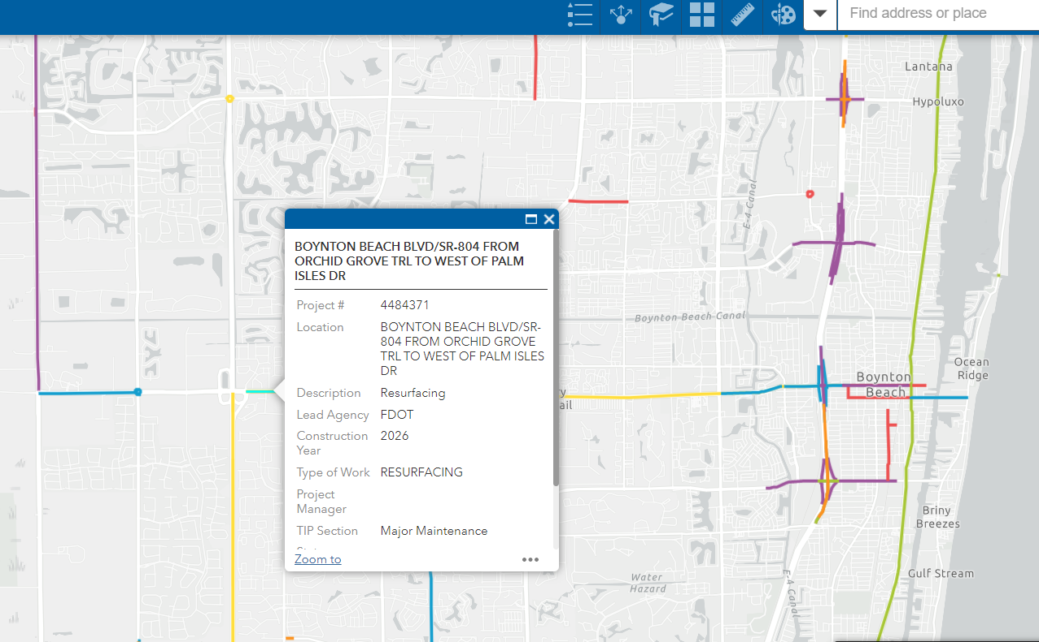
View Draft TIP
PalmBeachTPA.org/TIP
Executive Summary
Full Document
Link to Map
Appendices
  Glossary
  Public Participation
  Performance Measures
  Fiscal Analysis

Slide 22

Provide Feedback
Improve clarity
Corrections
Submit local projects for reference
Final adoption in June

Slide 23
Motion to Recommend Adoption
FY 24-28 TIP

