Slide 1
2045 LRTP - Amendment #2
Final Review
October 2023 - Committees & Board

Slide 2
2045 LRTP Amendment #2
Last updated by Administrative Modification on January 7, 2022.
Amendment #2 is required for consistency:
  New Revenues (CARU, Discretionary Grants)
  2024 – 2028 Transportation Improvement Program (TIP)
  FDOT Strategic Intermodal System (SIS) Cost Feasible Plan

Slide 3
Plan Update Thresholds
Amendment:
  Significant scope changes
  Project schedule advancements
  Cost increase greater than 50% and $50 million
Administrative Modification:
  Design scope is generally consistent
  Schedule not accelerated
  Cost changes do not trigger amendment thresholds.

Slide 4
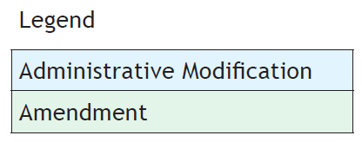
Consistent Cost Feasible Plan

Slide 5
Financially Constrained
LRTP Plan Amendments require a confirmation that Revenues equal Expenditures

Slide 6
2045 LRTP Amendment #2
September 1:
Public Notice was posted on the LRTP webpage for review and comment.
September Committees & Board:
First Review of Amendment #2
October Committees:
Final Review and Recommend Approval
October Board:
Final Review and Adopt Amendment #2

Slide 7
Motion to Recommend Adoption of Amendment #2 to the 2045 LRTP

